Slide 1
Biomedical Informatics:
Introduction and Definitions
Summer Institute / HIT Series
Hadi Kharrazi MHI MD PhD
kharrazi@jhu.edu
Johns Hopkins University
⬥ School of Public Health
⬥ School of Medicine
2 hrs / ~80 slides

Slide 2
Introduction
Hadi Kharrazi, MHI, MD, PhD
  Current affiliation: JHSPH-HPM (Aug 2012)
  Associate Director CPHIT
  Director: Dr. J. Weiner
  Previous affiliation: Indiana University
  Dalhousie University
  Research interests: Population Health IT
  • CDSS/QM in HIE environments
  • Personal Health Records (PHR)

Slide 3
Overview
US Healthcare
  General, Cost, Triple Aims
Biomedical / Health Informatics
  Concept & Definition
  History
  Subdomains
  Data Sources
  Systems
  Methods
Use Cases (population health examples)
  Clinical
  Consumer
  Community / Population / Public
Drivers
  Incentives
  Mandates
  Facilitators
Common Issues
  Terminologies
  Standards of Information Exchange
  Usability Issues / Human Factors
  Value-Added
Resources
  Books
  Web

Slide 4
US Healthcare

Slide 5
US Healthcare – General
At least 15.3% of the population is completely uninsured
More money per person is spent on health care in the United States than in any other nation in the world
Despite the fact that not all citizens are covered, the United States has the third highest public healthcare expenditure per capita
Active debate about health care reform in the United States concerns questions of a right to health care, access, fairness, efficiency, cost, and quality
The US pays twice as much yet lags behind other wealthy nations in such measures as infant mortality and life expectancy
The US life expectancy lags 42nd in the world, after most rich nations, lagging last of the G5 (Japan, France, Germany, UK, USA) and just after Chile and Cuba.
The World Health Organization (WHO), in 2000, ranked the US health care system as the highest in cost, first in responsiveness, 37th in overall performance, and 72nd by overall level of health (among 191 member nations included in the study)
On March 23, 2010, the Patient Protection and Affordable Care Act became law, providing for major changes in health-insurance procedures

Slide 6
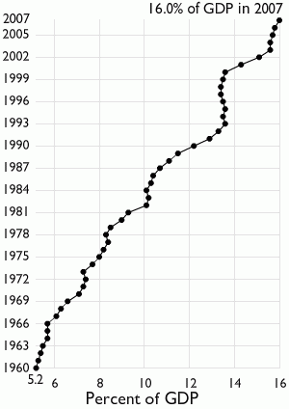
US Healthcare – Cost → Historical
Current estimates put U.S. health care spending at approximately 16% of GDP. DHHS expects that the health share of GDP will reach 19.5% of GDP by 2017.
Of each dollar spent on health care in the United States 31% goes to hospital care, 21% goes to physician services, 10% to pharmaceuticals, 8% to nursing homes, 7% to administrative costs, and 23% to all other categories.
In 2007, the U.S. spent $2.26 trillion on health care or $7,439 per person.
Medical causes were cited by about half of bankruptcy filers in the US in 2001.
Historical U.S. Healthcare
Spending as % of GDP

Slide 7
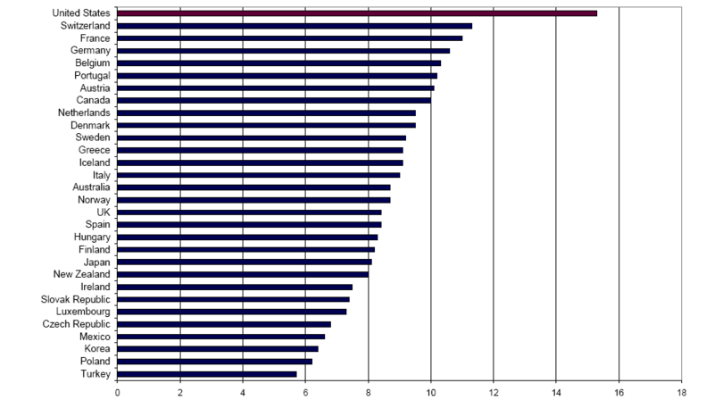
US Healthcare – Cost → Compare
Healthcare Spending as % of GDP

Slide 8
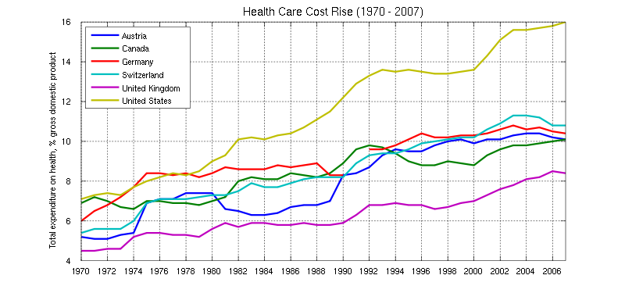
US Healthcare – Cost → Rise
Historical Healthcare Spending Rise

Slide 9
US Healthcare – Cost → Breakdown
US Healthcare Spending Breakdown

Slide 10
US Healthcare – Cost → Waste
Healthcare Dollars Waste (in billions)
Total $765 billion (around 25% of healthcare cost)

Slide 11
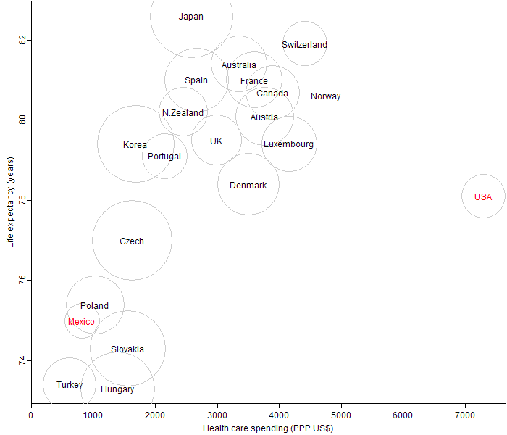
US Healthcare – Cost → vs Outcome (Life Expectancy)
Life expectancy versus healthcare spending

Slide 12
US Healthcare – Triple Aims
Better Health for the Population
Lower Cost Through Improvements
Better Care for the Individuals
Triple Aims developed by the Institute for Healthcare Improvement (IHI)

Slide 13
Health Informatics Principles

Slide 14

Biomedical / Health Informatics – Concept & Definition
The science of information (Information = data with meaning / Humans will benefit from information)
Data → Information (who, when, where, what) → Knowledge (how) → Wisdom (why)
AMIA’s definition of HI → “Biomedical informatics (BMI) is the interdisciplinary field that studies and pursues the effective uses of biomedical data, information, and knowledge for scientific inquiry, problem solving, and decision making, motivated by efforts to improve human health.”
WHO’s definition of eHealth → “Use of information and communication technologies for health for different purposes”
HIMSS definition of eHealth → “Application of the Internet/other technologies to health care for various goals and objectives”
Academic definition of HI → “A rapidly developing scientific field that deals with resources, devices, and formalized methods for optimizing the storage, retrieval, and management of biomedical information for problem solving and decision making.”

Slide 15
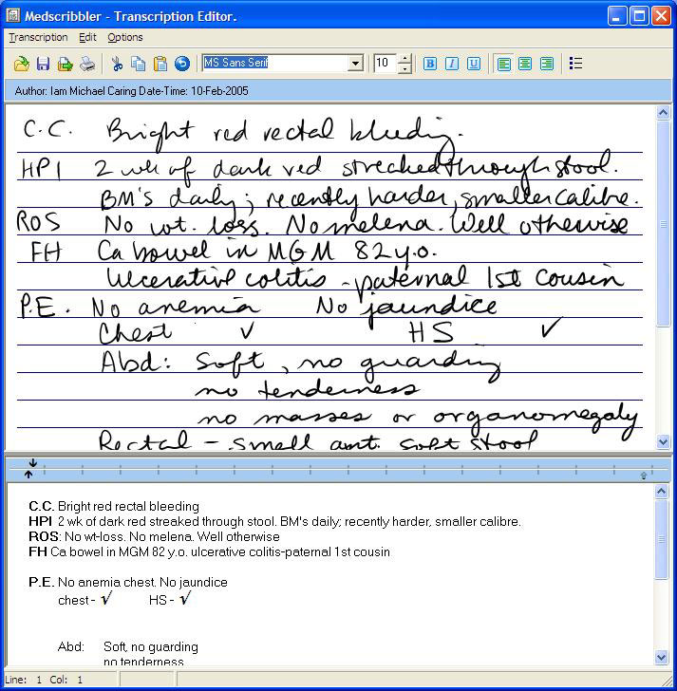
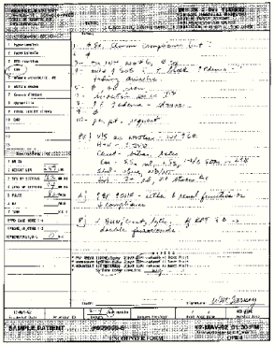
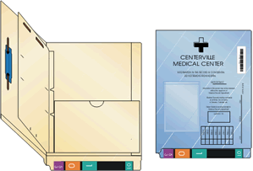
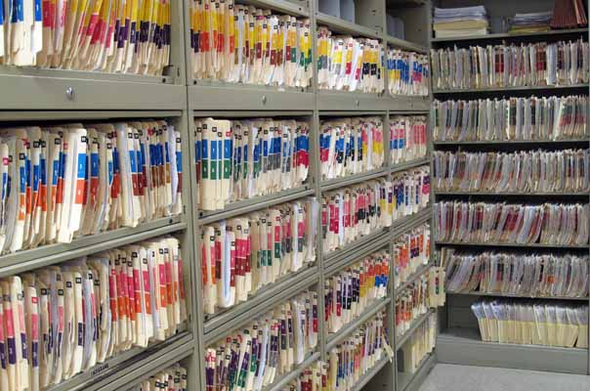

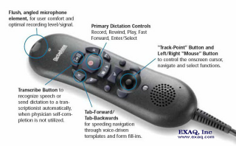
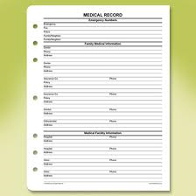
Health Informatics – History

Slide 16
Health Informatics – Subdomains
Biomedical informatics methods, techniques, and theories
Basic Research
Population
HIT
Bioinformatics
Public Health
Informatics
Applied Research
Imaging
Informatics
Clinical
Informatics
Consumer Health
Informatics
Molecular Research
Health Research
Population Health Informatics as an emerging domain

Slide 17
Health Informatics – Subdomains → Overlaps
Some consider “population health informatics” a bridge to fill the gap between traditional clinical informatics and public health informatics.
Consumer Health Informatics
Bioinformatics
Biosurveillance
Informatics
Clinical
Informatics
Public Health
Informatics
Population Health Informatics
Imaging Informatics
Epidemiology
Informatics
Pathology
Informatics
Dental Informatics
Nursing Informatics
Notes:
Big Data Stats
Big Data Stat – Healthcare
Big Data by Field – correlate with HI fields
Big Data – Size? Method? Question?
What is HIE…
IHIE and CRISP Big Data
Method? Question? → hard time to explore the data → visualization (CRISP GIS), … apply CPG
Apply QM, CPG across data – fingerprints
JHMI case – all systems but going Epic (Clarity, Cogito)
CPHIT

Slide 18
Health Informatics – Data Sources
Public Health Systems
IDS / ACO / Virtual Net
Community / Population
Web Portals
National Datasets
Social Network
Practice Team
Family and
Care givers
HIE
Social
HR data
GIS
Physician
Patient
Biomet.Tele-H.
mHealth
apps
Claims
MIS
HIS
EHR
CPOE
CDSS
PHR
email and others
Weiner, 2012 http://www.ijhpr.org/content/1/1/33
Notes:
kilobyte (kB)
megabyte (MB)
gigabyte (GB)
terabyte (TB)
petabyte (PB)
exabyte (EB)
zettabyte (ZB)
yottabyte (YB)

Slide 19
Health Informatics Systems

Slide 20
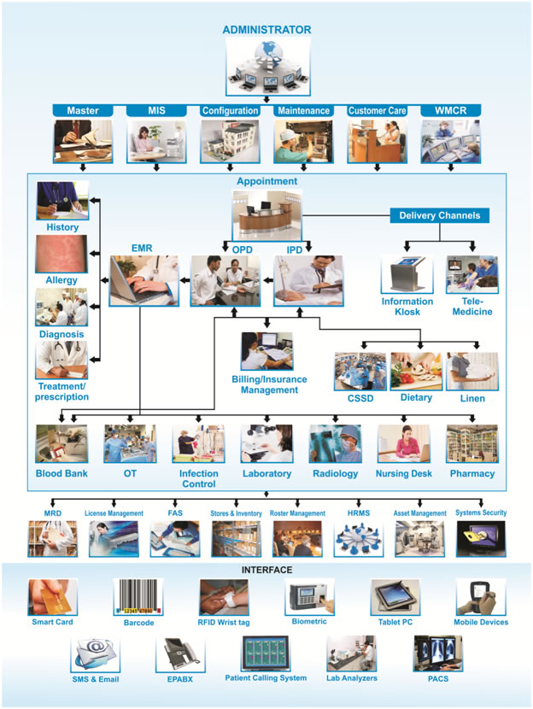
Health Informatics – Systems
Bioinformatics
Provider/Clinical Informatics Systems
  Common: EHR(EMR), CPOE
  Specialty: LIS, RIS(PACS), e-Prescribing
  Add-ons: CDSS
Patient/Consumer Health Informatics
  PHR
  mHealth / Telehealth
Payers/Insurer Informatics Systems
  Claims, PBMs
  Predictive Models
Government Informatics Systems
  National and State-level Databases
  Public Health Systems (Surveillance)
  Health Information Exchanges
Notes:
kilobyte (kB)
megabyte (MB)
gigabyte (GB)
terabyte (TB)
petabyte (PB)
exabyte (EB)
zettabyte (ZB)
yottabyte (YB)

Slide 21
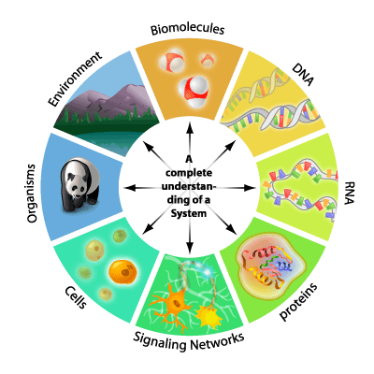
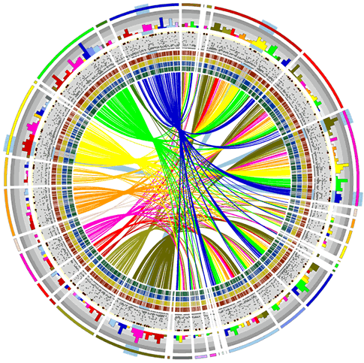
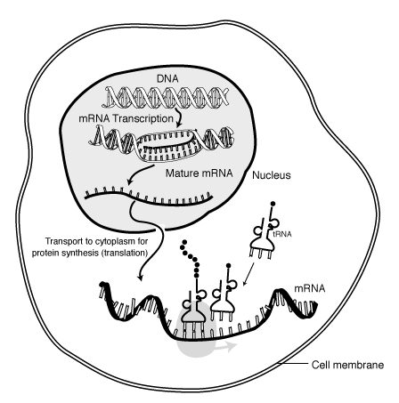

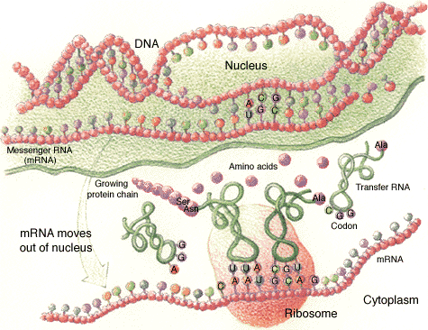
Health Informatics – Systems → Researchers → Bioinformatics
Genomics
Proteomics
Transcriptomics
Glycomics
Metabolomics
Pharmacogenomics
Bioinformatics focus on biomolecules, DNA, RNA, proteins, networks and cells
Notes:
kilobyte (kB)
megabyte (MB)
gigabyte (GB)
terabyte (TB)
petabyte (PB)
exabyte (EB)
zettabyte (ZB)
yottabyte (YB)

Slide 22
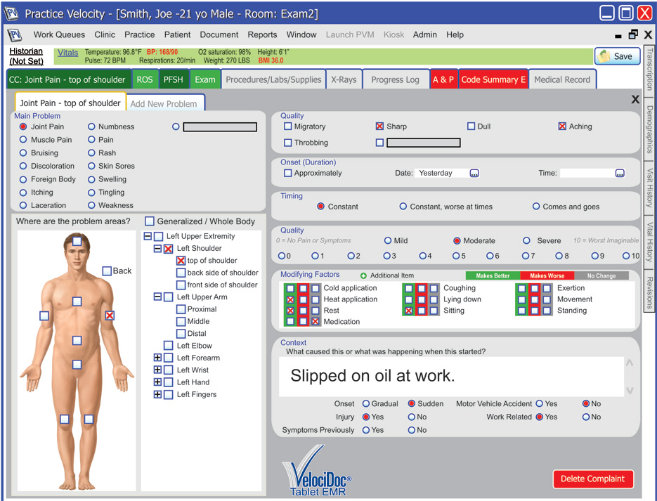
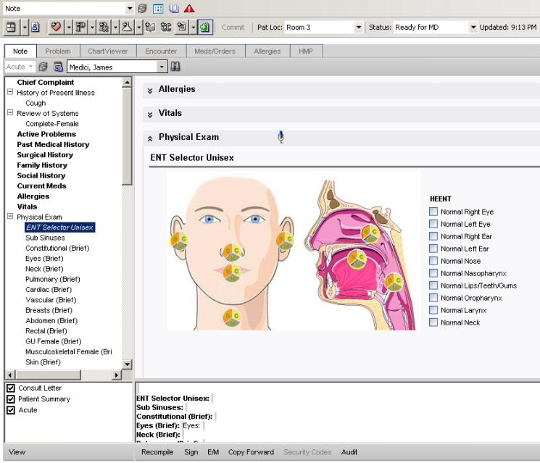
Health Informatics – Systems → Provider → EHRs / CPOE
Electronic Health/Medical Record Systems (EHR) & Computerized Physician Order Entry Systems (CPOE)
Notes:
kilobyte (kB)
megabyte (MB)
gigabyte (GB)
terabyte (TB)
petabyte (PB)
exabyte (EB)
zettabyte (ZB)
yottabyte (YB)

Slide 23
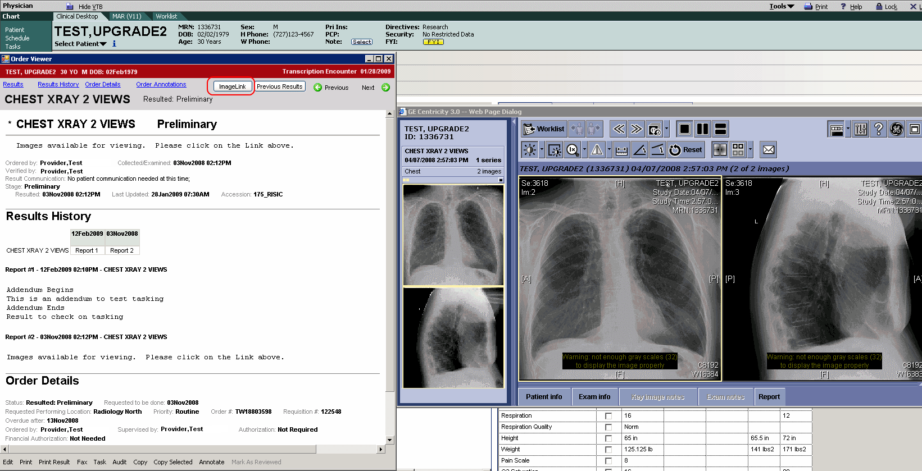

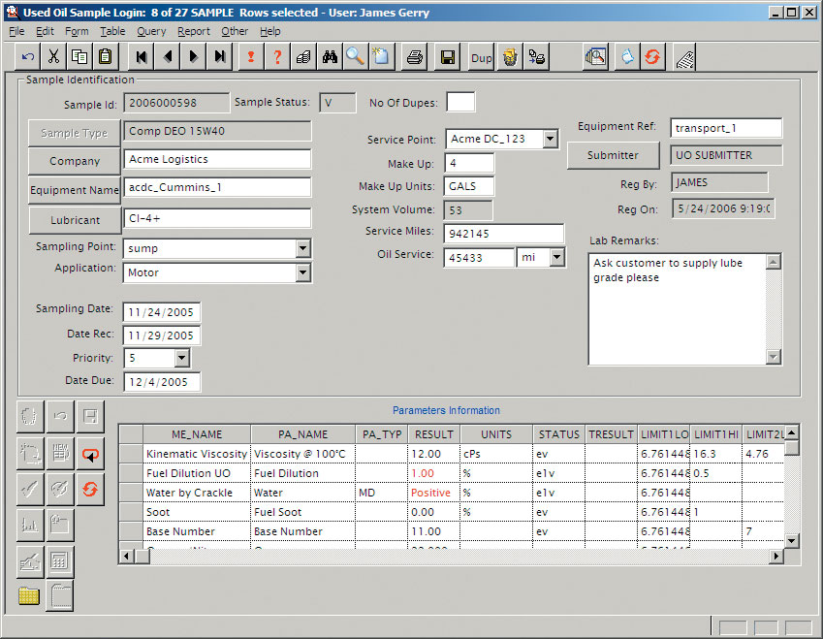
Health Informatics – Systems → Provider → LIS / RIS (PACS)
Laboratory Information Systems (LIS) & Radiology Information Systems (RIS)
Notes:
kilobyte (kB)
megabyte (MB)
gigabyte (GB)
terabyte (TB)
petabyte (PB)
exabyte (EB)
zettabyte (ZB)
yottabyte (YB)

Slide 24
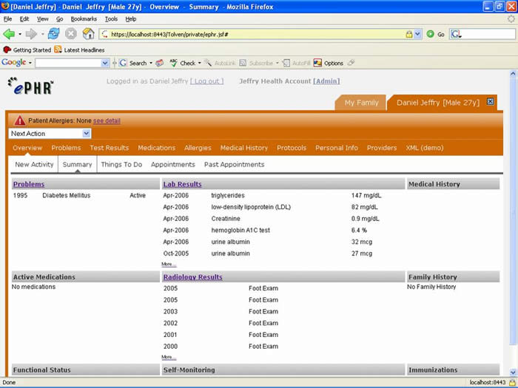

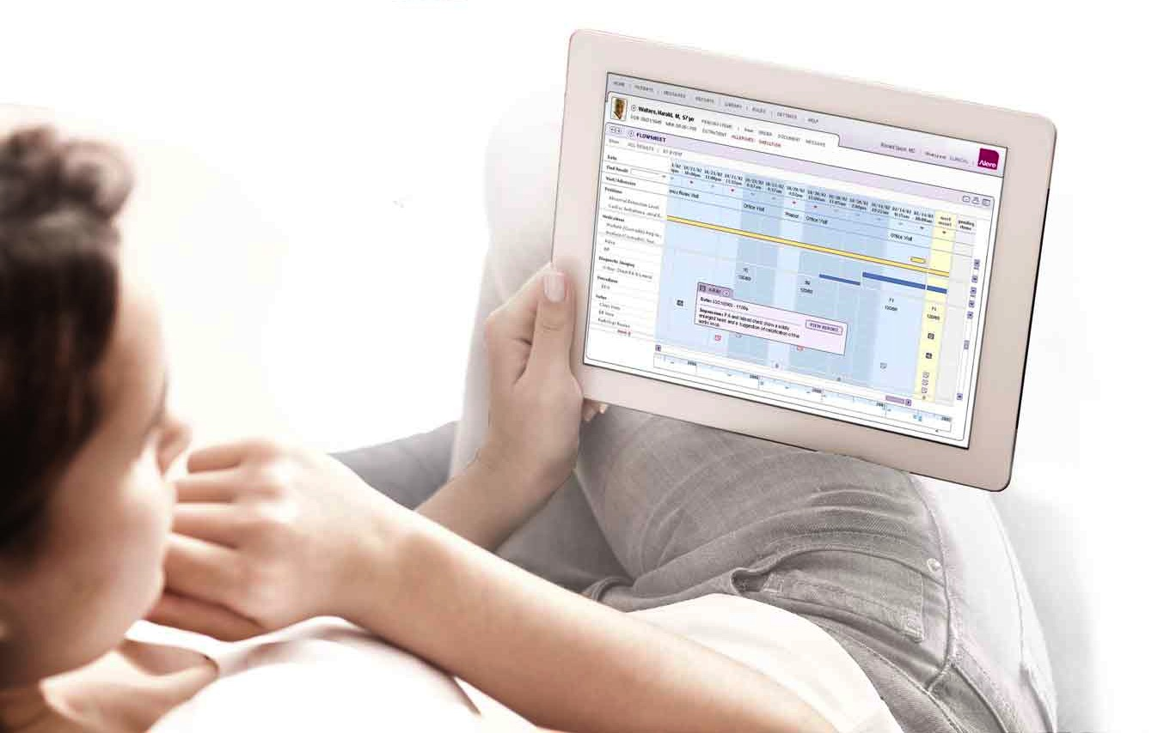
Health Informatics – Systems → Patient/Consumer → PHR
Personal Health Records (PHRs)
Notes:
kilobyte (kB)
megabyte (MB)
gigabyte (GB)
terabyte (TB)
petabyte (PB)
exabyte (EB)
zettabyte (ZB)
yottabyte (YB)

Slide 25
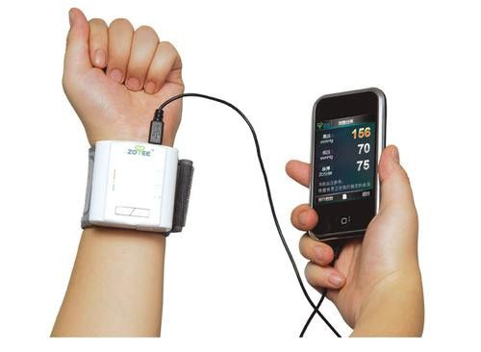
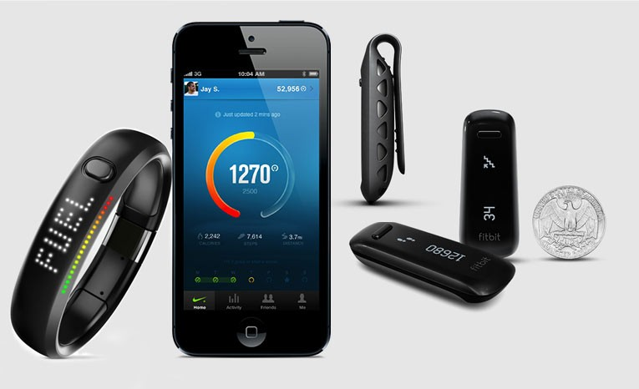

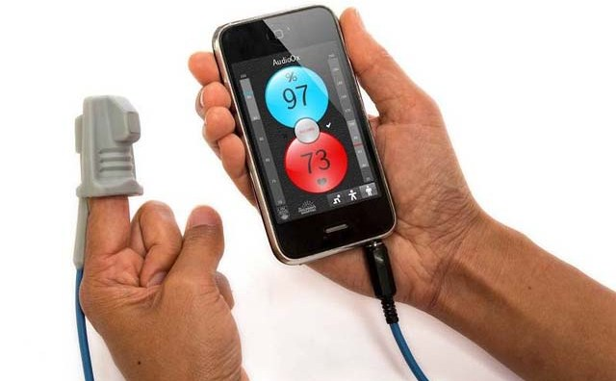
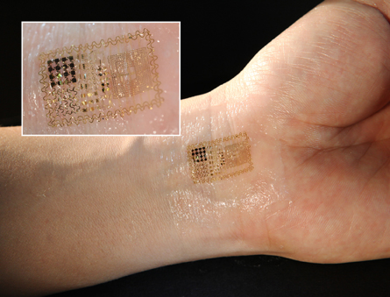
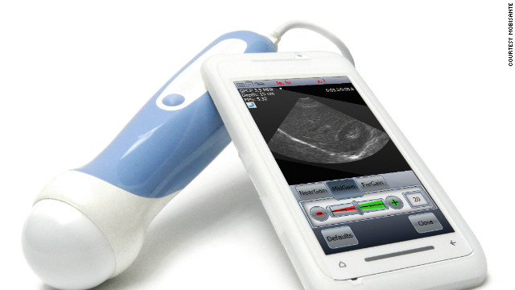
Health Informatics – Systems → Patient/Consumer → mHealth
mHealth (mobile health)
Notes:
kilobyte (kB)
megabyte (MB)
gigabyte (GB)
terabyte (TB)
petabyte (PB)
exabyte (EB)
zettabyte (ZB)
yottabyte (YB)

Slide 26
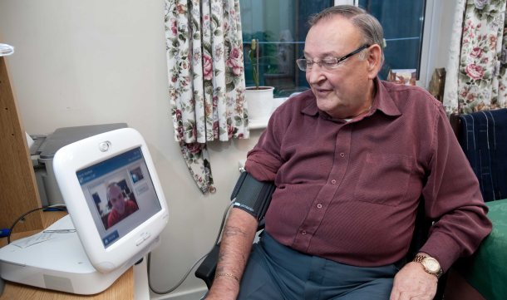
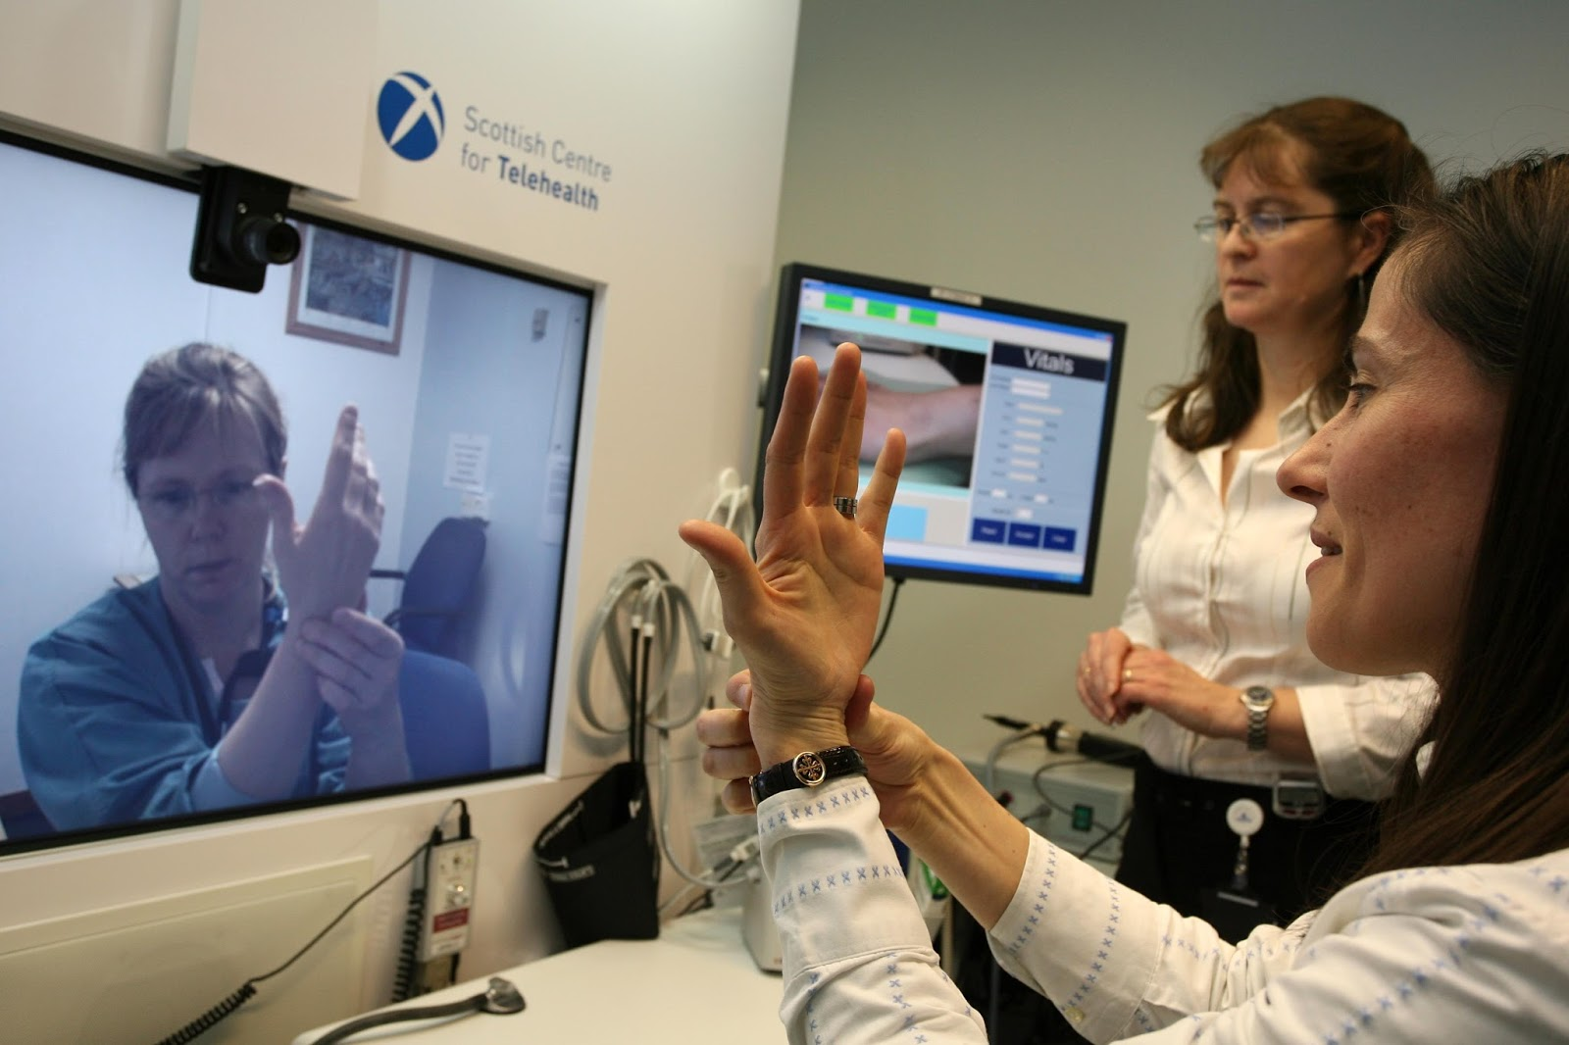
Health Informatics – Systems → Patient/Consumer → Telehealth
Tele-Health / Tele-medicine
Notes:
kilobyte (kB)
megabyte (MB)
gigabyte (GB)
terabyte (TB)
petabyte (PB)
exabyte (EB)
zettabyte (ZB)
yottabyte (YB)

Slide 27
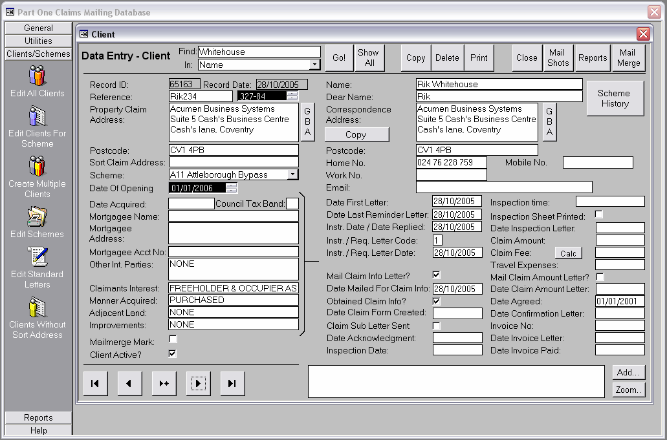

Health Informatics – Systems → Payers → Claims / Predictive Modeling
Insurance Claims
Notes:
kilobyte (kB)
megabyte (MB)
gigabyte (GB)
terabyte (TB)
petabyte (PB)
exabyte (EB)
zettabyte (ZB)
yottabyte (YB)

Slide 28
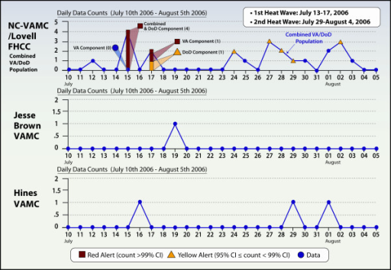
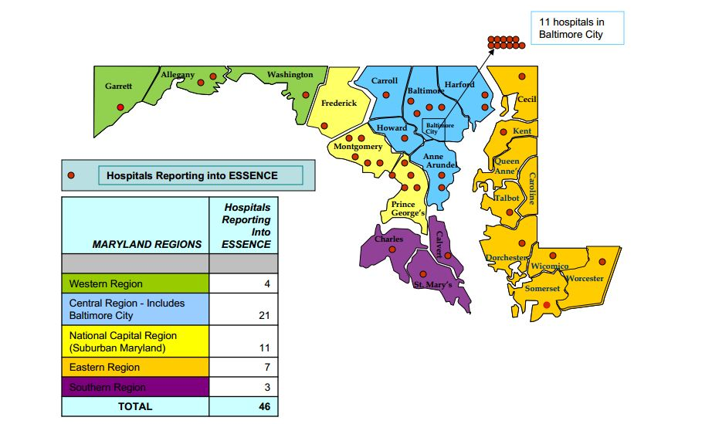
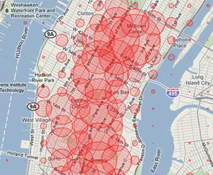
Health Informatics – Systems → Public/Government → Biosurveillance
Biosurveillance Tools (e.g., ESSENCE)
Notes:
kilobyte (kB)
megabyte (MB)
gigabyte (GB)
terabyte (TB)
petabyte (PB)
exabyte (EB)
zettabyte (ZB)
yottabyte (YB)

Slide 29
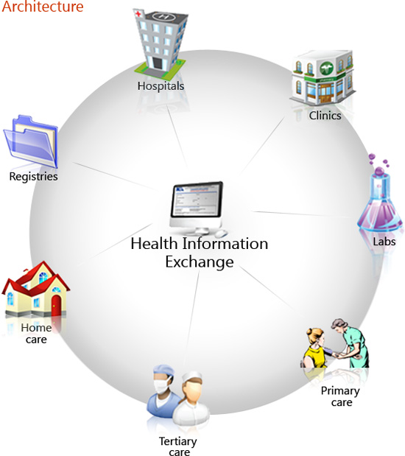
Health Informatics – Systems → Public/Government → HIEs
Concept of an Health Information Exchange
Notes:
kilobyte (kB)
megabyte (MB)
gigabyte (GB)
terabyte (TB)
petabyte (PB)
exabyte (EB)
zettabyte (ZB)
yottabyte (YB)

Slide 30
Health Informatics – Systems → Public/Government → HIEs
EHRs
PHRs
MPI
Claims
Registries
PACS
LABs
Federated Consistent HIE
(Health Information Exchange)
Copyright Regenstrief Institute

Slide 31
Health Informatics Methods

Slide 32
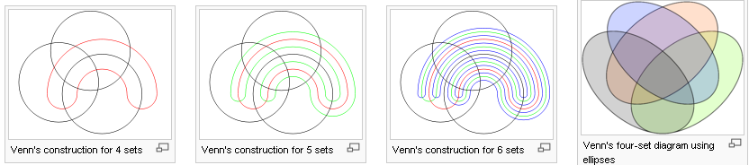
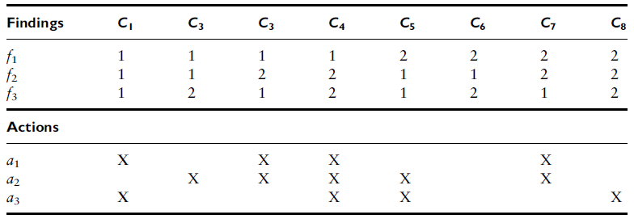
Health Informatics – Methods → Logic
A
B
Set Theory: x = {a, b, c, d, e, f} & y = {c, e} → y ⊆ x
Boolean Logic: AND, OR, XOR, NAND → If/Then
Venn Diagram
Informal Logic: certainty factors (e.g., MYCIN decision support)
Decision Tables: representation of logic
C
(A AND B) OR C
2

Slide 33
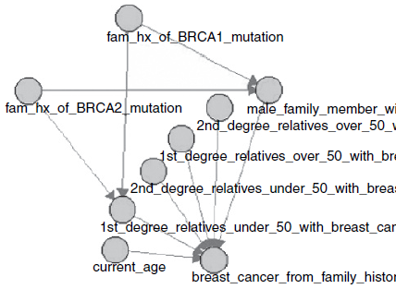
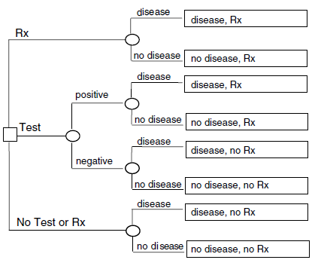
Health Informatics – Methods → Probability
Statistics: Inference, Prediction…
Bay’s Rule: Pr(A | B) = Pr(A)*Pr(B | A) / Pr(B)
Bayesian Belief Networks: depicts the various dependencies in the form of an acyclic directed graph
Decision Analysis: branching sequences of decision nodes and chance nodes

Slide 34

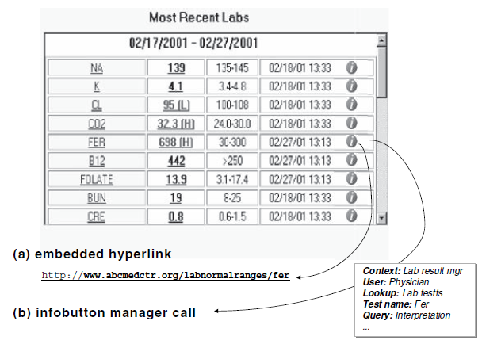
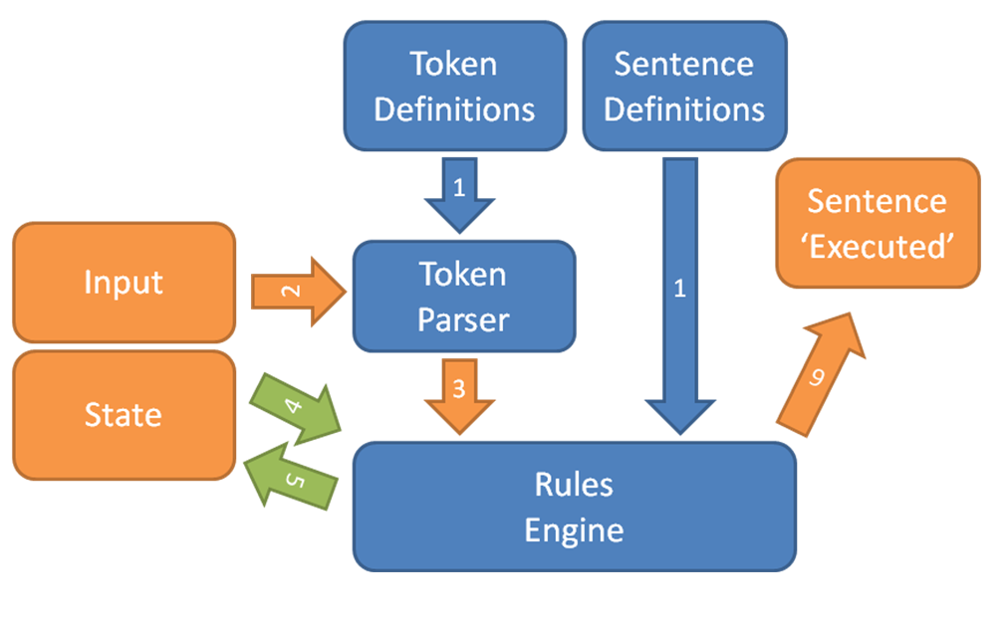
Health Informatics – Methods → IR/NLP
User-Initiated:
(1) Taxonomy-based (2) Free text
Semi-automated or Automated:
(1) Patient-specific (2) Context-specific
(natural language processing)

Slide 35
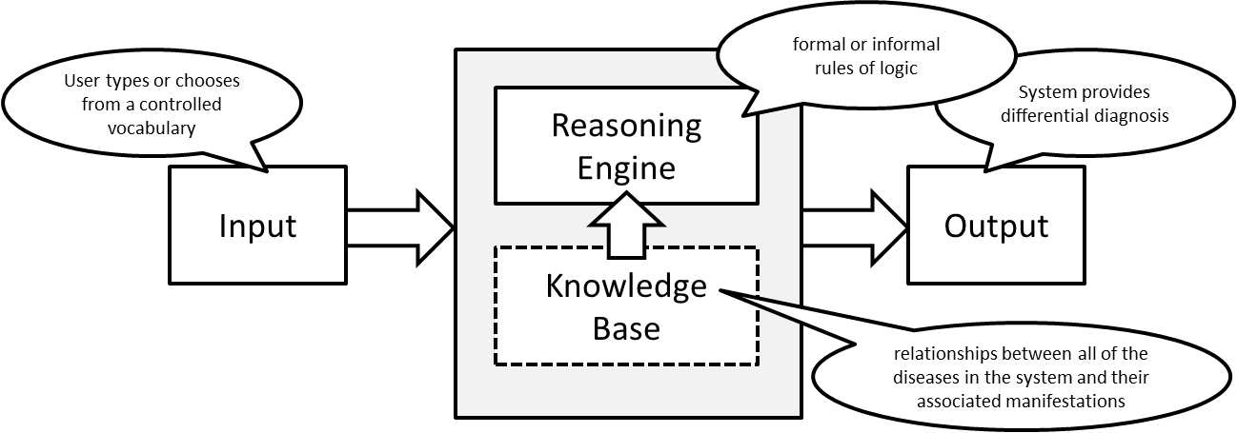
Health Informatics – Methods → Expert Systems
Clinical Decision Support Systems:
(1) input
(2) inference engine
(3) knowledge base
(4) output
A general model of a clinical diagnostic decision support system

Slide 36
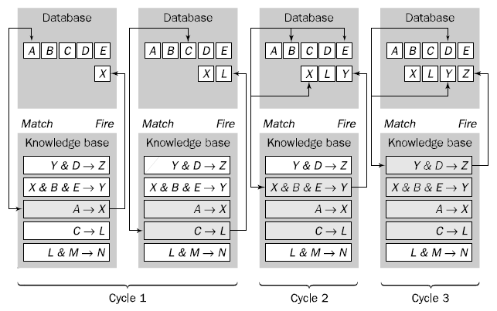
Health Informatics – Methods → Expert Systems (cont.)
Rule-based system:
(1) backward chaining (2) forward chaining
Forward Chaining Rule-bases CDSS

Slide 37
Health Informatics – Methods → Expert Systems (cont.)
Frame Based Systems:
(1) Order sets
(2) Treatment plans and others…
Patient #1
Name | Robin Fox
Sex | Male
DoB | 1989/06/15
Diagnoses | Asthma
Signs | Tachypnea
Symptoms | Dispnea
Treatments | Azmacort
Patient #2
Name | Anna Green
Sex | Female
DoB | 1976/11/18
Diagnoses | Diabetes
Signs
Symptoms | Thurst
Treatments | Sitagliptin
Patient #3
Name | Adam Plat
Sex | Male
DoB | 1992/01/09
Diagnoses
Signs
Symptoms | Headache
Treatments
Sample Patient Frames

Slide 38
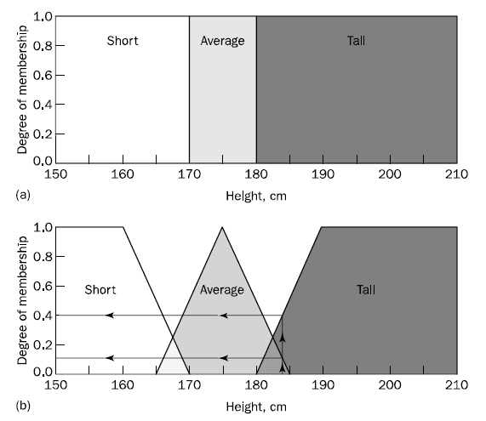
Health Informatics – Methods → Expert Systems (cont.)
Fuzzy Systems
Crisp vs Fuzzy systems

Slide 39
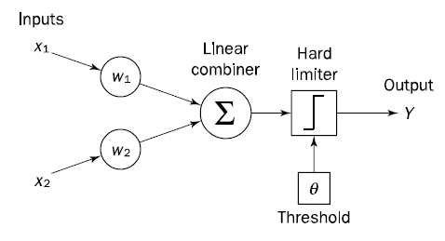
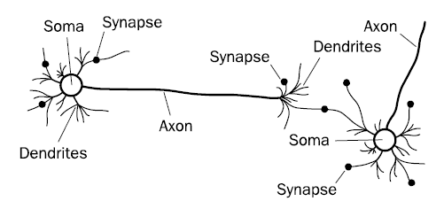
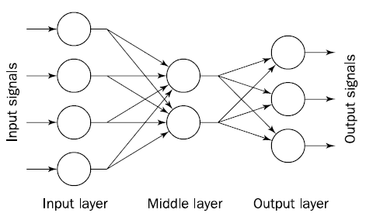
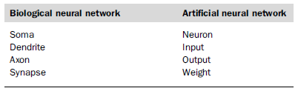
Health Informatics – Methods → Neural Networks
Artificial neural networks (ANN) are constructed in a fashion similar to biological neural networks: (1) Single Layer ANN; (2) Multi-Layer ANN
Architecture of a single neuron
Biological neural network
Analogy between biological and artificial NN
Architecture of a typical artificial neural network

Slide 40
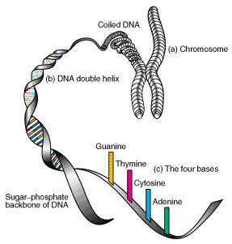
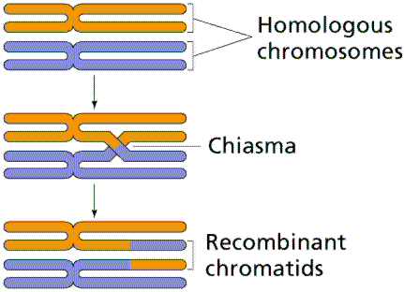

Health Informatics – Methods → Genetic Algorithms / Evolutionary Computation
By iteratively extracting the best solutions, an optimal solution can be reached → challenge is creating the criteria which fitness is defined
Crossing-over between homologous chromosomes produces chromosomes with new associations of genes and alleles
A 16-bit binary string of an artificial chromosome

Slide 41
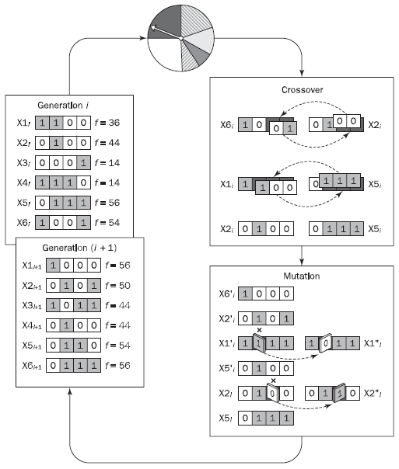
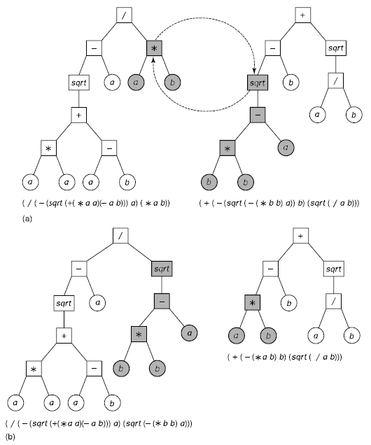
Health Informatics – Methods → Genetic Programming (cont.)
Genetic algorithm cycle
Crossover in genetic programming

Slide 42

Health Informatics – Methods → Data Mining
Data mining is the process of extracting patterns from data. Data mining is becoming an increasingly important tool to transform these data into information.
Data mining can be used to uncover patterns in data but is often carried out only on samples of data. The mining process will be ineffective if the samples are not a good representation of the larger body of data → pattern validation is necessary.
Typical problems addressed by intelligent systems

Slide 43
Health Informatics – Methods → Big Data
Big Data Specs – data driven 4Vs:
  Volume → quantity (size)
  Variety → type (structure, standardized, ontology)
  Veracity → quality (meaning, completeness, accuracy)
  Velocity → time (real-time, timeliness)

Slide 44
Health Informatics Use Cases

Slide 45

Use Cases – Clinical / Public Health → Use of EHR data for Surveillance
Data sources for the electronic surveillance system for early notification of community-based epidemics (ESSENCE)
Copyright APL

Slide 46

Use Cases – Clinical / Public Health → Use of EHR data for Surveillance (cont.)
Processing for the electronic surveillance system for early notification of community-based epidemics (ESSENCE)
Copyright APL

Slide 47


Use Cases – Consumer
Track your asthma attacks
And then shared it with your community
Copyright propellerhealth.com

Slide 48

Use Cases – Community → Use of HIEs for Population Health
Calculating and Predicting Readmission to Hospitals
Copyright CRISP

Slide 49

Use Cases – Community → Use of HIEs for Population Health (cont.)
Notice: Risk of readmission for patient is high.
83%
var1
55%
var2
85%
var3
20%
var4
5%
var5
100%
Simulate outcome
Simulate a different outcome…
var1
55%
83%
var2
85%
var3
20%
var4
5%
var5
100%
Drag sliders to see the estimated effect on readmission risk score
Advance Predicting Modeling Integrated in Encounter Notification Systems

Slide 50

Use Cases – Community → Use of HIEs for Population Health (cont.)
Inpatient Utilization By Census Tract – Neighborhood View (Capitol Heights Area)
Copyright CRISP

Slide 51
Drivers

Slide 52
Drivers
Incentives:
ARRA / HITECH → (1) EHR adoption [Meaningful Use (MU) measures]; (2) state-wide HIEs; (3) Beacon Communities
Mandates:
ACA → Payment Reforms → PCMH and ACO initiatives → Value-based → Capitated models → Population health
Facilitation:
ONC → Data Standards, integration, and sharing → Distributed models

Slide 53

Drivers – Incentive → EHR adoption [Meaningful Use]
HIT-Enabled Health Reform
Stage 3
Stage 1
Stage 2
2009 HITECH Policies
2011 Criteria
(Capture & Share)
2013 Criteria
(Advanced Care)
2015 Criteria
(Improved Outcome)
Drivers → ARRA → HITECH / MU of EHRs + HIEs

Slide 54

Drivers – Incentive → EHR adoption [Meaningful Use] (cont.)
Percentage of EHR systems among office-based physicians
Notes:
kilobyte (kB)
megabyte (MB)
gigabyte (GB)
terabyte (TB)
petabyte (PB)
exabyte (EB)
zettabyte (ZB)
yottabyte (YB)

Slide 55
Drivers – Mandate → Accountable Care Organizations (ACO)
ACO are networks of providers with unifies governance that assume risk for the quality and total cost of the care they deliver.
An ACO:
  Authorization: ACA (2010)
  Aims: Triple Aims (improve health, improve care, and lower cost)
  Plans: 400+ / Memberships: 4m
  Leadership: Physician-led organizations
  Focus: Population health management & PCP
  Population: Considerable population (>5000) → big data / provider variability
  Contract: 3 years
  Measures: Provide quality benchmarking, reporting, and tracking
  Membership: No patient lock-in (in contrast with HMOs)
  Financial: Shared saving (upward risk) and penalties (downward risk)
  Future: Moving to the global capitation model / P4P
  HIT Drivers: Meaningful Use (MU → EHR adoption → CDRs) and Health Information Exchanges (HIEs)

Slide 56
Drivers – Mandate → Policy Mandates and IT Systems
ACO
Analytics
ACO Management
Provider
Hospitals
Inpatient
IP EHR
HIE
Provider
Ambulatory
Outpatient
Enterprise EHR / CDW
PCMH
OP EHR
Para
Pharm
Lab
Imaging
Custom.
LIS/RIS
PBM
Another ACO
Provider
Patient
Population
Community
Public Health
PHR
mHealth
Telehealth
Payer
Private
Public
Claims
Ins.Ex.
Pub. Health
Datasets

Slide 57


Drivers – Facilitate → ONC-HIT
ONC
HIT
HHS Organizational Chart

Slide 58





Drivers – Facilitate → Data Standards

Slide 59
Common Challenges

Slide 60


Common Issues → Terminologies / Coding Systems → ICD
One of the best known terminologies is the International Classification of Diseases (ICD). First published in 1893, it has been revised at roughly 10-year intervals, first by the Statistical International Institute and later by the World Health Organization.
Examples of codes in ICD-9 and ICD-9-CM (*)
Examples of codes in ICD-10 and ICD-10-CM (*)

Slide 61

Common Issues → Terminologies / Coding Systems → DRG
The coding system is an abstraction of an abstraction; it is applied to lists of ICD-9-CM codes that are themselves derived from medical records. The principal bases for the groupings are factors that affect cost and length of stay.
Diagnosis-related group codes assigned to cases of bacterial pneumonia

Slide 62

Common Issues → Terminologies / Coding Systems → CPT
The American Medical Association developed the Current Procedural Terminology (CPT) in 1966 to provide a precoordinated coding scheme for diagnostic and therapeutic procedures that has since been adopted in the United States for billing and reimbursement.
Sample CPT codes used for physician procedure reporting

Slide 63


Common Issues → Terminologies / Coding Systems → SNOMED
The College of American Pathologists developed Systematized Nomenclature of Medicine (SNOMED) as a multiaxial system for describing pathologic findings through postcoordination of topographic (anatomic), morphologic, etiologic, and functional terms.
Description-logic representation of the SNOMED-CT term “Bacterial pneumonia.”

Slide 64

Common Issues → Terminologies / Coding Systems → LOINC
Originally called Laboratory Observations, Identifiers, Names and Codes (LOINC), the system has been extended to include non-laboratory observations (vital signs, electrocardiograms), so Logical has replaced Laboratory to reflect the change.
LOINC Code examples

Slide 65

Common Issues → Terminologies / Coding Systems → RxNorm / NDC
The WHO Drug Dictionary is an international classification of drugs that provides proprietary drug names used in different countries.
Drugs are classified according to the Anatomical-Therapeutic-Chemical (ATC) classification, with cross-references to manufacturers and reference sources.
The National Drug Codes (NDC), produced by the FDA, is applied to all drug packages.
RxNorm is the results of a collaboration between the FDA, the NLM, the VA, and the pharmacy knowledge base vendors.

Slide 66

Common Issues → Terminologies / Coding Systems → UMLS
In 1986, the NLM, began consulting contractors to identify ways to construct a resource that would bring together and disseminate controlled medical terminologies. The Unified Medical Language System has been updated annually since then.
Its principal component is the Metathesaurus, which contains over one million terms collected from over 100 different sources (including many of those that we have discussed), and attempts to relate synonymous and similar terms from across the different sources.
Some of the bacterial pneumonia concepts in the UMLS Metathesaurus

Slide 67

Common Issues → Terminologies / Coding Systems → UMLS (cont.)
Some of the information available in the UMLS about selected pneumonia concepts.

Slide 68
Common Issues → Standards of Info Exchange → HL7
The purpose of a data-interchange standard is to permit one system, the sender, to transmit to another system, the receiver, all the data required to accomplish a specific communication, or transaction set, in a precise, unambiguous fashion.
Open Systems Interconnection (OSI) reference model: describes seven levels of requirements or specifications for a communications exchange: physical, data link, network, transport, session, presentation, and application.
Level 7, the application level, deals primarily with the semantics or data-content specification of the transaction set or message → reflected in HL7 name.
HL7 is the most widely implemented health care data-messaging standard and is in use at over 1,500 health care facilities.
Version 1.0: served mainly to define the scope and format of standards.
Version 2.0: was the basis for several data-interchange demonstrations involving more than 10 vendors.
Version 2.2: it was approved by ANSI as the first health care data-interchange American National Standard.
Version 3.0: is object oriented and based on a Reference Information Model (RIM).

Slide 69

Common Issues → Standards of Info Exchange → HL7 (cont.)
An example of an HL7 v2.3 ADT transaction message. This message includes the Message Heading segment, the EVN trigger definition segment, the PID patient-identification segment, the PV1 patient-visit segment, the OBR general-order segment, and several OBX results segments.

Slide 70

Common Issues → Standards of Info Exchange → HL7 (cont.)
An example of an HL7 v3 CCDA (Consolidated Clinical Doc Architecture) formatted discharge summary.

Slide 71
Common Issues → Standards of Info Exchange → Others
Digital Imaging and Communications in Medicine (DICOM): The purposes of the ACR/NEMA standard were to promote a generic digital-image communication format, to facilitate the development and expansion of picture-archiving and communication systems.
ASTM E1238: Standard Specification for Transferring Clinical Observations Between Independent Systems used in commercial and reference clinical laboratories.
IEEE 1073: Standard for Medical Device Communications, has produced a family of documents that defines the entire seven-layer communications requirements for the Medical Information Bus (MIB)/
ASC X12, an independent organization accredited by ANSI, has developed message standards for purchase-order data, invoice data, and other commonly used business documents.
UCC is an ANSI-approved organization that defines the universal product code. Standards include specifications for the printing of machine-readable representations (bar codes).
The National Council for Prescription Drug Programs (NCPDP): have created a set of standards to communicate medication orders and other Rx related issues.

Slide 72
Common Issues → Usability Issues / Human Factors
Usability is defined as:
  Learnability: system should be relatively easy to learn
  Efficiency: an experienced user can attain a high level of productivity
  Memorability: system features should be easy to retain once learned
  Errors: system should be designed to minimize errors and support error detection
  Satisfaction: the user experience should be subjectively satisfying
Heuristic evaluation is a usability inspection method, in which the system is evaluated on the basis of a small set of well-tested design principles. This methodology embodies a particular philosophy, which emphasizes simplicity and functionality over intricacy of design and presentation.
Human Computer Interaction (HCI) is a multifaceted discipline devoted to the study and practice of usability. HCI has emerged as a central area of both computer science research and development and applied behavioral and social science.
Cognitive walkthrough (CW) is a cognitive task-analytic method that has been applied to the study of usability and learnability of several distinct medical information technologies. The method involves identifying sequences of actions and goals needed to accomplish a given task.

Slide 73

Common Issues → Usability Issues / Human Factors (cont.)
Norman’s seven-stage model of action.

Slide 74

Common Issues → Usability Issues / Human Factors (cont.)
EHR navigation with no feedback on completed steps
Copyright upassoc.org

Slide 75






Common Issues → Value-Added
Academic and other publications on HIT value-added (mainly cost) are available but
impact on other triple aims (clinical outcomes) are still missing rigor scientific evidence…

Slide 76
Additional Resources

Slide 77

Resources – Books
Title | Guide to Health Informatics
Authors | Coiera, E
Year | 2003
Hardcover | 472 pages
Publisher | Hodder Arnold Publication
Language | English
ISBN | 0340764252

Slide 78

Resources – Books (cont.)
Title | Biomedical Informatics: Computer Applications in HealthCare and Biomedicine
Authors | Shortliffe, E.H. and Cimino, J.J (eds)
Year | 2014
Hardcover | 1024 pages
Publisher | Springer; 4th edition (2014)
Language | English
ISBN | 978-1-4471-4474-8
Link | http://www.springer.com/us/book/9781447144731

Slide 79
Resources – Web
Associations:
  AMIA (American Medical Information Association): www.amia.org
  IMIA (International Medical Information Association): www.imia-medinfo.org
  HIMSS (Healthcare Information and Management Systems Society): www.himss.org
  Academy Health (HIT Interest Group): www.academyhealth.org
Government and Non-for-profit:
  ONC: www.healthit.gov
  CMS MU: www.cms.gov/Regulations-and-Guidance/Legislation/EHRIncentivePrograms
  HL7: hl7.org
  NLM: https://www.nlm.nih.gov
Journals:
  JAMIA (Journal of AMIA): jamia.bmj.com
  JMIR (Journal of Medical Internet Research): www.jmir.org
  IJMI (International Journal of Medical Informatics): www.ijmijournal.com
  HIJ (Health Informatics Journal): jhi.sagepub.com
  ACI (Applied Clinical Informatics): aci.schattauer.de

Slide 80

Resources – Web (cont.)
  AMIA (American Medical Information Association): www.amia.org

Slide 81
Summary
US Healthcare
  General, Cost, Triple Aims
Biomedical / Health Informatics
  Concept & Definition
  History
  Subdomains
  Data Sources (EHR, claims…)
  Systems (provider, payers, patients, public/government)
  Methods (logic, probability, expert system, NN, GA, DM, IR/NLP, BD)
Use Cases (population health examples)
  Clinical
  Consumer
  Community / Population / Public
Drivers
  Incentives (MU, HIE, Beacon)
  Mandates (ACA-P4P: PCMH, ACO)
  Facilitators (ONC, S&I)
Common Issues
  Terminologies (ICD, SNOMED, RxNorm, LOINC, …)
  Standards of Information Exchange (HL7, DICOM)
  Usability Issues / Human Factors
  Value-Added
Resources
  Books
  Web (Associations, Government, Non-profit)

