Slide 1
Computer Systems and the Web/Databases
Summer Institute / HIT Series
Hadi Kharrazi MHI MD PhD
kharrazi@jhu.edu
Johns Hopkins University
⬥ School of Public Health
⬥ School of Medicine
1.5 hrs / ~75 slides

Slide 2
Overview
Networking Overview
  Network Topology
  IP Address
  Domain Name
  Network Devices
Web Server Technology Overview
  Static Languages (e.g., HTML)
  Server Side Languages (e.g., PHP)
  Databases (e.g., MySQL)
  Server Side Integration (HTML/PHP/MySQL)
Database Overview
  Relational Databases
  MySQL GUI
  SQL Language
Resources
  Books
  Web

Slide 3
Networking Overview

Slide 4
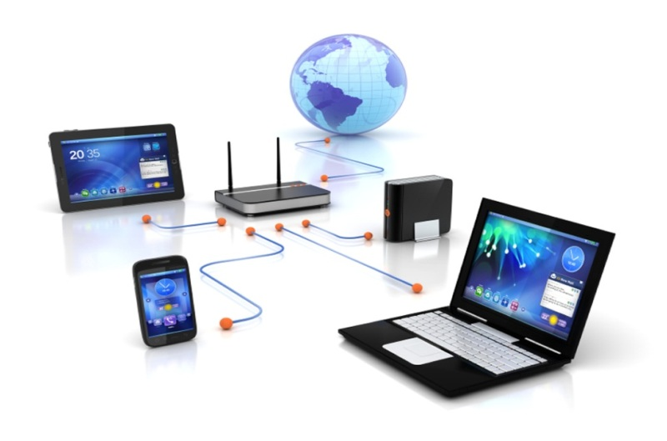
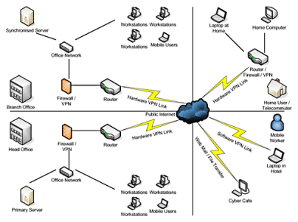
Networking Overview
Networking is the construction, design, and use of network, including the physical (cabling, hub, switch, router, bridge, gateway, backbone and etc.), the selection and use of telecommunication protocol and computer software for using and managing the network, and the establishment of operation policies and procedures related to the network.
OSI (open systems interconnected) has 7 layers… physical to application layer!
Common Terms: Client, Server, Network (LAN, MAN, WAN), Hub, Switch, Router, Gateway, Backbone, Bridge

Slide 5









Networking Overview
Local
Wireless
Network
Backbone ISP
Local
Wired
Network
Regional ISP
Exchange
Point
Firewall
Hub or
Switch
Client or
Server
Router
IP: 167.18.162.162
Access
Point
Server
Farm
Main
Router
NAP
(Network
Access
Point)
Main
Router
Client
Router
Gateway
Firewall
Client
POP
(Point of
Presence)
IP: 129.173.66.101
Hub or
Switch
Client
Internet
TCP/IP
Protocol
Port80: HTTP
Port21: FTP
Port22: SSH
Local
Wired
Network
Client
Client
LAN
MAN
WAN

Slide 6
Networking Topology
Network Topology
Bus/Star/Ring…
Network Topology
Bus/Star/Ring…
Network Topology
Bus/Star/Ring…

Slide 7
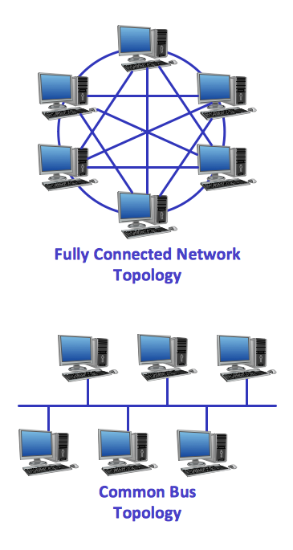
Networking Overview → Topology (cont.)
A network is a series of points or nodes interconnected by communication paths.
General configurations of networks is called Topology of network.
The most common topologies:
  Bus
  Star
  Ring

Slide 8
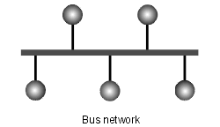
Networking Overview → Topology (cont.)
Bus topology
  All devices are attached to a line directly
  All signals pass through each of the devices
  Each device has a unique identity and can recognize those signals intended for it

Slide 9
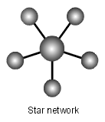
Networking Overview → Topology (cont.)
Star topology
  There is a central computer or server to which all the workstations are directly connected
  Every workstation is indirectly connected to every other through the central computer

Slide 10
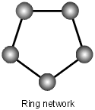
Networking Overview → Topology (cont.)
Ring topology
  The workstations are connected in a closed loop configuration
  Adjacent pairs of workstations are directly connected
  Other pairs of workstations are indirectly connected, the data passing through one or more intermediate nodes

Slide 11
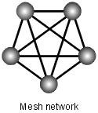
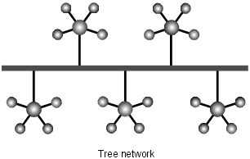
Networking Overview → Topology (cont.)
Hybrid topologies
  Mesh network: each workstation is connected directly to each of the others
  Tree network: uses two or more star networks connected together. A tree network is a bus network of star networks

Slide 12
IP Address
IP Address
167.18.162.162
IP Address
129.173.66.101

Slide 13
Networking Overview → IP Address (cont.)
IP Address
  Every machine on the Internet has a unique identifying number, called an IP Address.
  A typical IP address looks like this: 216.27.61.137
  To make it easier for humans to remember, IP addresses are normally expressed in decimal format as a "dotted decimal number" like the one above.
  Computers communicate in binary form:
  216.27.61.137
  The same IP address in binary:
  11011000.00011011.00111101.10001001

Slide 14
Networking Overview → IP Address (cont.)
IP Address
  The four numbers in an IP address are called octets, because they each have eight positions when viewed in binary form.
  If you add all the positions together, you get 32, which is why IP addresses are considered 32-bit numbers.
  Since each of the eight positions can have two different states (1 or 0) the total number of possible combinations per octet is 2^8 or 256. So each octet can contain any value between 0 and 255.
  Combine the four octets and you get 2^32 or a possible 4,294,967,296 unique values!

Slide 15
Networking Overview → IP Address (cont.)
IP Address
  32-bit addresses won’t be enough for very much longer
  IPv6, which uses 128-bit addresses, allowing a startlingly vast range of addresses: approximately 3.402824 x 10³⁸
  more than enough to allow every atom in the universe a unique IP address.
  a routing table will keep track of: network numbers, the next router to use to get to that network and the interface this next router is reachable through.

Slide 16
Domain Name
IP Address
167.18.162.162
Domain Name
google.com
IP Address
129.173.66.101
Domain Name
hkharrazi.com

Slide 17
Networking Overview → Domain Name (cont.)
Domain Names
  Domain name servers, or DNS, are an incredibly important but completely hidden part of the Internet.
  The DNS system is a database, and no other database on the planet gets this many requests
  When you use the Web or send an e-mail message, you use a domain name to do it.
  the URL "http://www.jhu.edu" and e-mail address student@jhu.edu contain the domain name jhu.edu
  Every time you use a domain name, you use the Internet's domain name servers (DNS) to translate the human-readable domain name into the machine-readable IP address. Sounds simple!
  During a day of browsing and e-mailing, you might access the domain name servers hundreds of times!

Slide 18
Networking Overview → Domain Name (cont.)
Domain Names
  The COM, EDU and UK portions of these domain names are called the top-level domain (TLD) or first-level domain.
  There are several hundred top-level domain names, including COM, EDU, GOV, MIL, NET, and ORG , as well as unique two-letter combinations for every country.
  Within every top-level domain there is a huge list of second-level domains. For example, in the COM first-level domain, you've got: Yahoo, Msn, Microsoft plus millions of others...
  Every name in the first top-level domain must be unique.

Slide 19
Network Devices
Gateway
Server
Router
Hub
Client

Slide 20
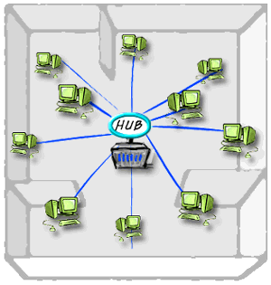
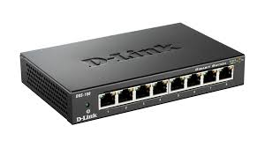
Networking Overview → Network Devices
Hub/Switch
  In data communications, a hub is a place of convergence where data arrives from one or more directions and is forwarded out in one or more other directions.
  It is “dumb” system that broadcasts the packet to all directions.
  A hub usually includes a switch of some kind.
  The distinction seems to be that the hub is the place where data comes together and the switch is what determines how and where data is forwarded from the place where data comes together.

Slide 21
Networking Overview → Network Devices (cont.)
Router
  On the Internet, a router is a device or, in some cases, software in a computer, that determines the next network point to which a packet should be forwarded toward its destination.
  The router is connected to at least two networks and decides which way to send each information packet.
  A router is located at any gateway (where one network meets another), including each Internet point-of-Presence (POP).
  A router maintains a table of the available routes along with distance/cost algorithms to determine the best route for a given packet
  Typically, a packet may travel through a number of network points with routers before arriving at its destination.
  Routing is a function of the Network layer in the TCP/IP protocol

Slide 22
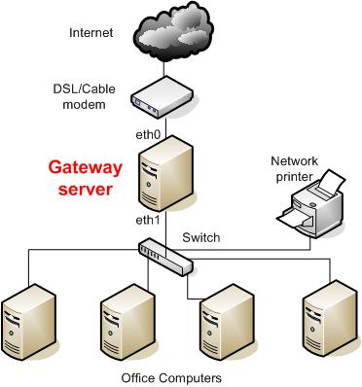
Networking Overview → Network Devices
Gateway
  A network point that acts as an entrance to another network. On the Internet, a node or stopping point can be either a gateway node or a host (end-point) node.
  Both the computers of Internet users and the computers that serve pages to users are host nodes.
  The computers that control traffic within company's network or at local Internet Service Provider (ISP) are gateway nodes.

Slide 23
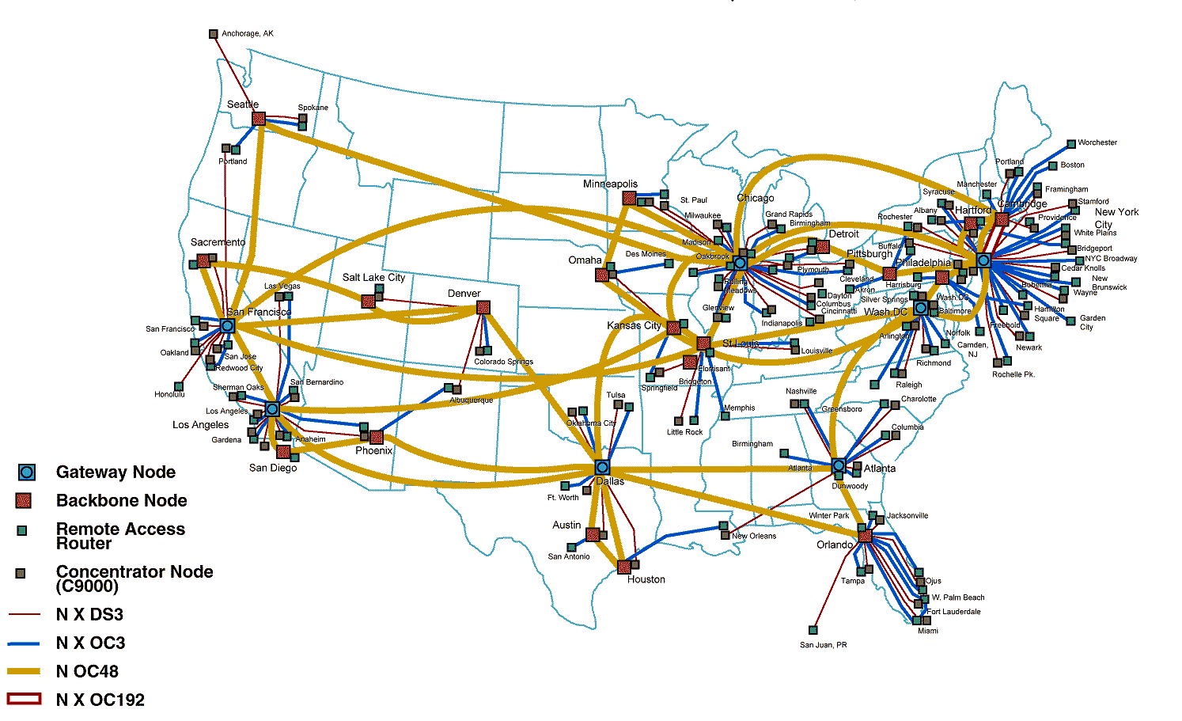
Networking Overview → Network Devices
Backbone
  A backbone is a larger transmission line that carries data gathered from smaller lines that interconnect with it.
  On the Internet or other wide area networks, a backbone is a set of paths that local or regional networks connect to for long-distance interconnection.

Slide 24
Web Server Technology Overview

Slide 25
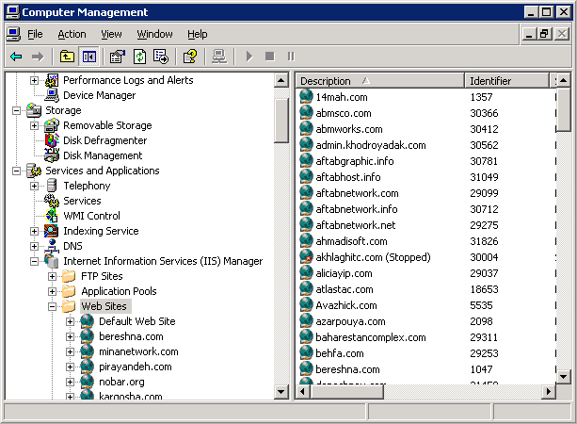
Web Server
Windows Server (IIS)
Apache Server
etc.

Slide 26
Web Server Overview
The term web server can mean one of two things:
  A computer responsible for serving web pages, mostly HTML documents, via the HTTP protocol to clients, mostly web browsers. Servers can have different Operating Systems such as Microsoft Windows, Mac OS, Linux, UNIX and FreeBSD.
  A software program that is working as a daemon serving web documents such as Apache Server (Open Source) or Internet Information Server - IIS (Microsoft/Commercial).

Slide 27
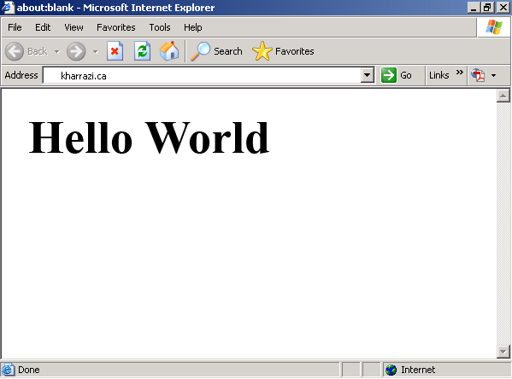
Client Side Language
Windows Server (IIS)
C:\InetPub
kharrazi.ca
images
adobe.com
httpdocs
about.html
contact.html
Internet Browser
(Firefox, IE)
index.html
yahoo.com
products.html

Slide 28


Web Server Overview → Client Side Language (e.g., HTML)
HTML (Hypertext Markup Language) is the document format language used on the World Wide Web. Web browsers (e.g., Firefox, Chrome, IE, Safari, Opera) read HTML and display the page.
Sample code (tags):
Server
Client
<html>
<head>
</head>
<body>
Hello World!
</body>
</html>
Internet
Explorer
Server sends the raw HTML file
through internet (TCP/IP) and
client (web surfer) receives it
The client’s browser
interprets the HTML
page and shows it

Slide 29
Server Side Language
HTML content
(client-side language)
Windows Server (IIS)
C:\InetPub
PHP Engine
kharrazi.ca
images
adobe.com
httpdocs
about.html
contact.html
Internet Browser
(Firefox, IE)
index.php
yahoo.com
products.html

Slide 30
Web Server Overview → Server Side Language (e.g., PHP)
PHP (Hypertext Preprocessor) is a server-side, cross-platform, HTML embedded scripting language that lets you create dynamic web pages. PHP-enabled web pages are treated just like regular HTML pages and you can create and edit them the same way you normally create regular HTML pages.
Client
Server
<html>
<body>
Hello World!
</body>
</html>
<?php
echo “Hello World!”;
?>
Internet
Explorer
The PHP engine (php.exe) parses
the PHP code on the server and
generates an HTML code
Server sends the raw HTML file
through internet (TCP/IP) and
client (web surfer) receives it
The client’s browser
interprets the HTML
page and shows it

Slide 31
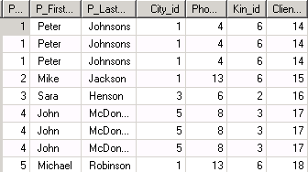
Databases Servers
Raw content
(data content)
Database
Management
Systems
Data Processed
by PHP and
sent as HTML
C:\InetPub
MySQL
Database
Server
MySQL Workbench
kharrazi.ca
adobe.com
MySQL/data
kharrazi.MYI
+ DATA
kharrazi.frm
yahoo.com
ibdata1
Internet Browser
(Firefox, IE)

Slide 32
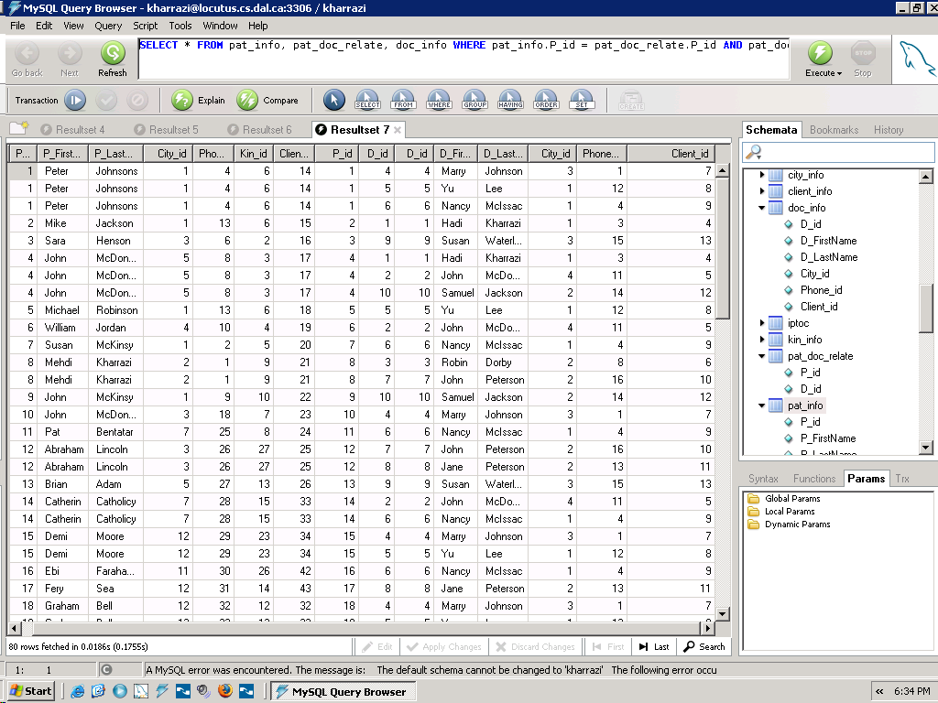

Web Server Overview → Data Base Management System (e.g., MySQL)
MySQL is an open source relational database management system (RDBMS) that uses Structured Query Language (SQL), the most popular language for adding, accessing, and processing data in a database.
Server
Client
C:\mysql\Data\kharrazi.frm
(MySQL Data Structure)
Fast, Compressed and
Reliable Storage on HDD
C:\ProgramFiles\..\MySQLQueryBrowser.exe
(MySQL Client Browser GUI)
C:\mysql\bin\mysqld.exe
(MySQL Server)
Port 3306 (MySQL Default)
Hard Disk Drive
SQL Language to communicate
With MySQL server:
SELECT * FROM pat_info

Slide 33
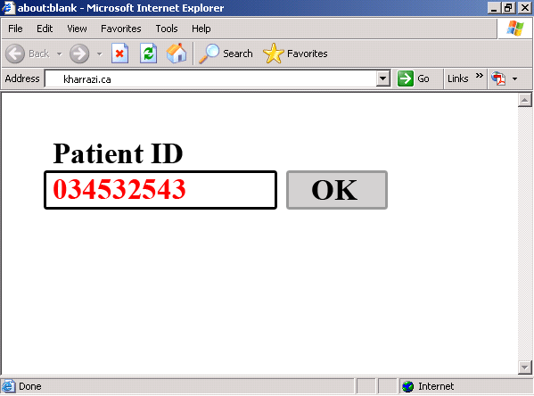
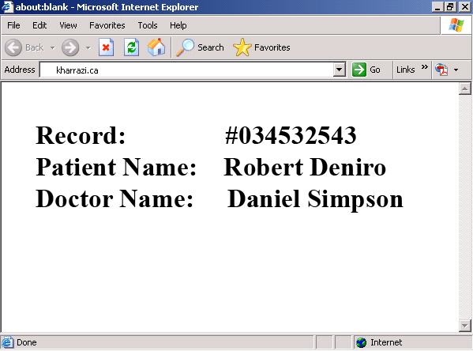
Web Server Overview → HTML/PHP/MySQL Integration
MySQL and PHP are integrated very well and therefore it is currently the most popular combination of a server side language and a database engine to work on web.
Server
Client
2
PHP Script (result.php)
(receiving data and querying MySQL)
PID = 034532543
1
HTML Form (index.html)
(sending data to result.php)
PHP Engine
MySQL Connector
SQL Syntax
3
MySQL Server
(mysqld.exe)
PHP Engine
Database = Patients
User/Pass = …
PID = 034532543
Sending back
the results
4
PHP Script (result.php)
(creating the response in HTML)

Slide 34
Web Server Overview → Applications
Windows Remote Desktop
  Manage Windows-based Servers
  Setting (hostname, user/pass, default port 3389)
PuTTY
  Manage Linux-based Servers
  Settings (hostname, user/pass, SSH 22, Tunneling 3306)
FileZilla
  Upload files directly to a remote server
  FTP (plain FTP) or SFTP (Secure FTP under SSH)
  Setting (hostname, user/pass, default port 21/22)
NotePad++
  Edit plain text files / code a program / highlight the code…
MySQL GUI Tools
  Connect to MySQL database engine

Slide 35
Web Server Overview → Applications (cont.) – NotePad++
An IDE (integrated development environment) is an application or set of tools that allows a programmer to write, compile, edit, and in some cases test and debug within an integrated, interactive environment.
NotePad++ is NOT a full feature IDE, but it is a simple and useful code editor which will help us writing codes in many languages such as HTML, PHP and etc. Some of the features for NotePad++ is:
  Syntax Highlighting (Colored Coding)
  Tabbed Navigation
  Code Completion
  Code Folding
  Free (Open Source)

Slide 36
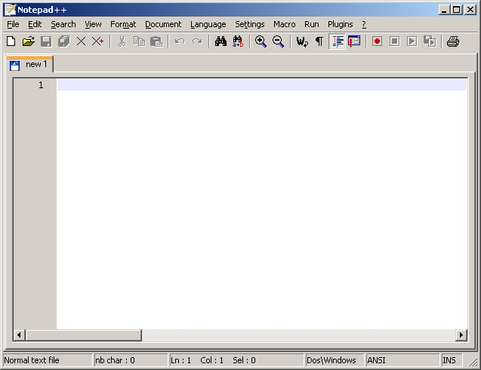
Web Server Overview → Applications (cont.) – NotePad++
Page (File)
Line Numbers
Code

Slide 37
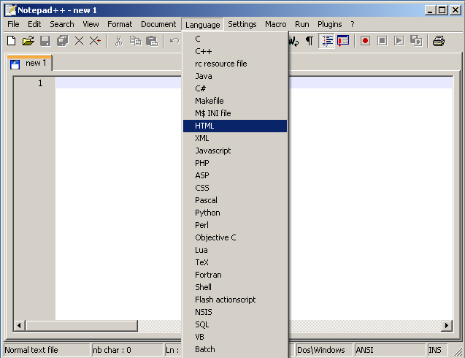
Web Server Overview → Applications (cont.) – NotePad++
Coding Language
(colored coding,
syntax highlighting)
HTML Coding

Slide 38
Web Server Overview → Applications (cont.) – NotePad++
Sample HTML Code:
<html>
<body>
Hello World!
</body>
</html>

Slide 39
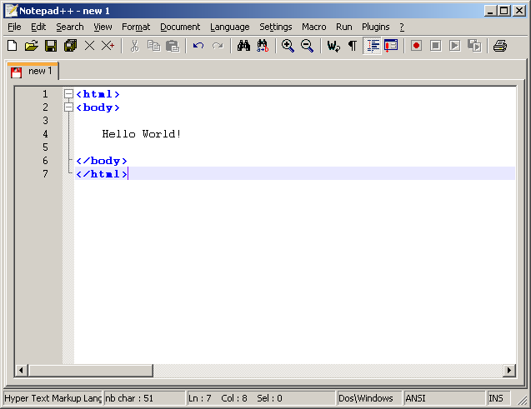
Web Server Overview → Applications (cont.) – NotePad++
Saving
Tabbed Browsing
(Red =Not Saved)
Sample HTML Code
Folded Code

Slide 40
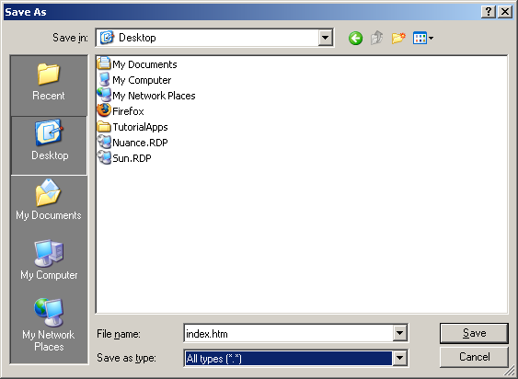
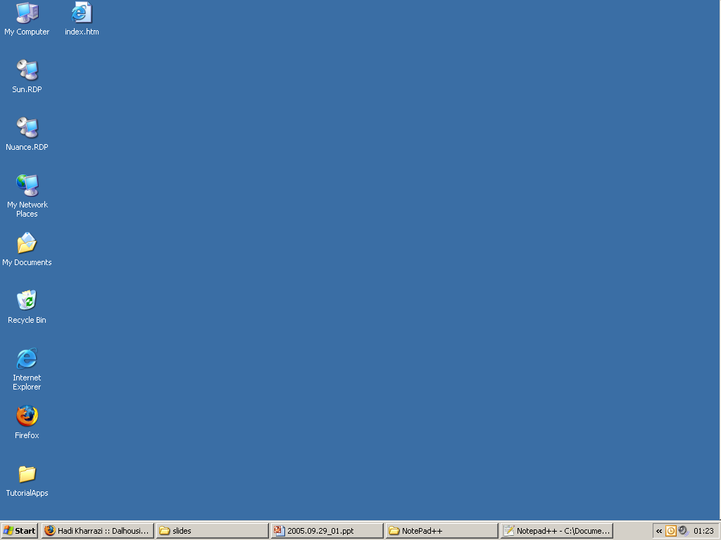
Web Server Overview → Applications (cont.) – NotePad++
Save it as:
index.htm
Double Click on:
index.htm

Slide 41
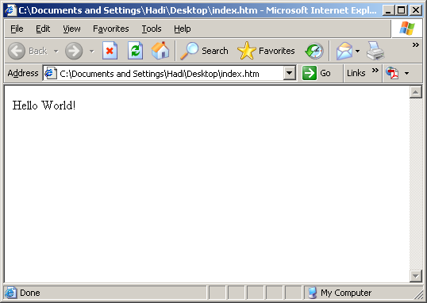
Web Server Overview → Applications (cont.) – NotePad++
Internet Explorer
or Mozila FireFox can translate (decode) your html file

Slide 42
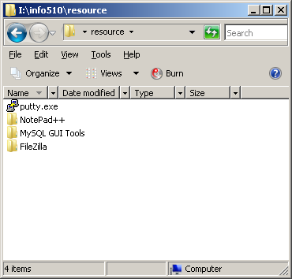
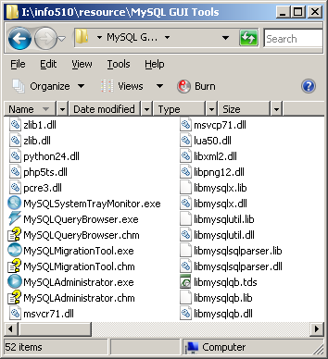
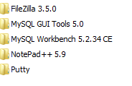
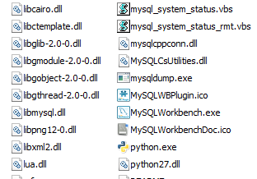
Web Server Overview → Applications (cont.) – MySQL Workbench

Slide 43
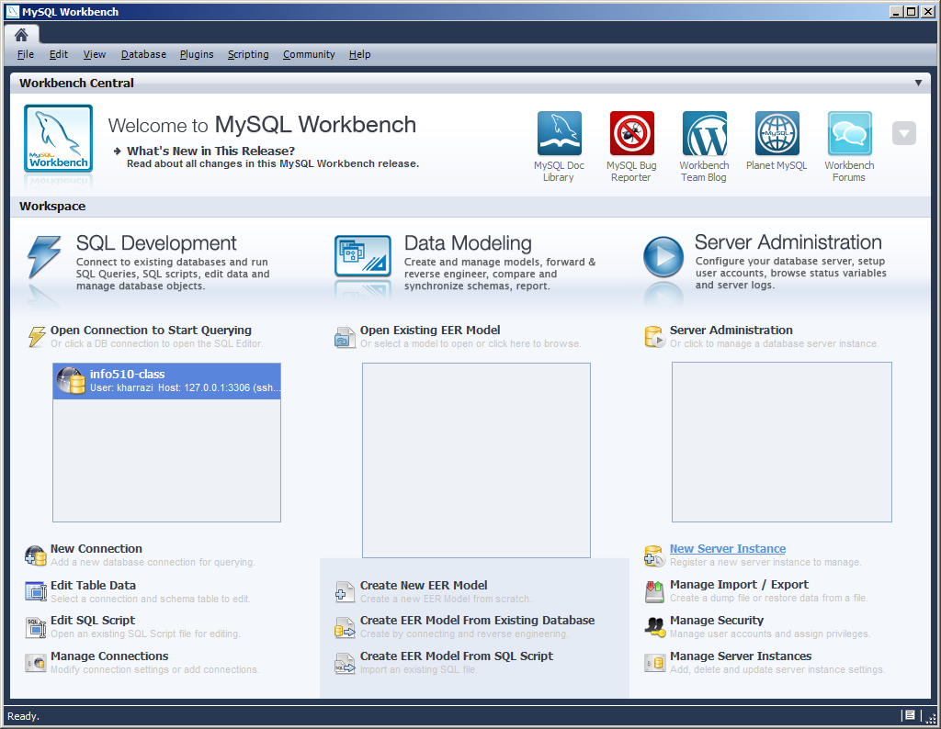
Web Server Overview → Applications (cont.) – MySQL Workbench

Slide 44
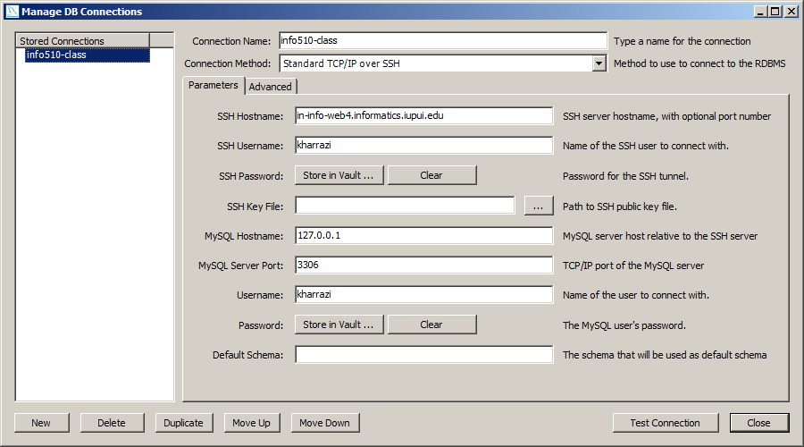
Web Server Overview → MySQL Workbench
2
Name your connection
3
Set to TCP/IP over SSH
4
Server
5
Your username
6
Your password
7
Your username
8
Your password
1
Create a new connection (e.g., info510-class)
9
Test the connection

Slide 45
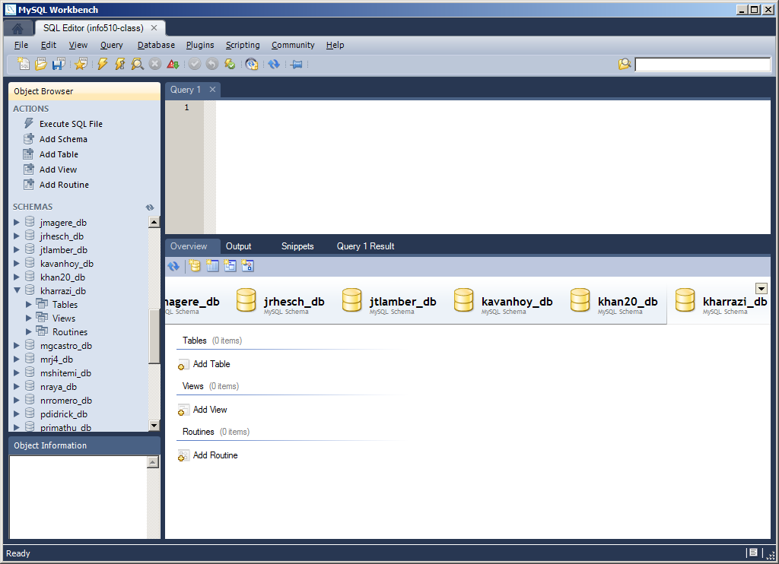
Web Server Overview → Applications (cont.) – MySQL Workbench

Slide 46
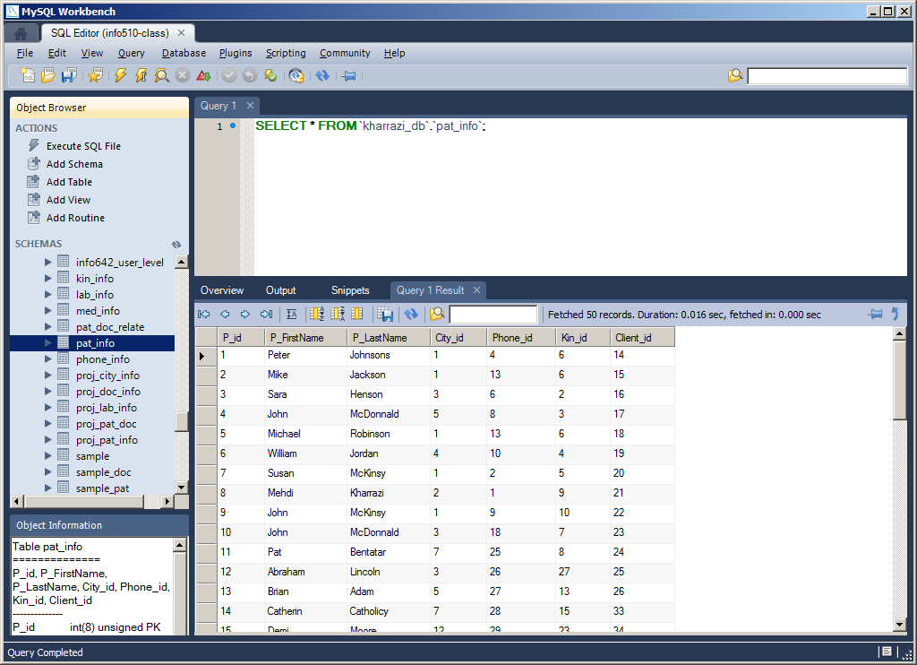
Web Server Overview → Applications (cont.) – MySQL Workbench

Slide 47
Database Overview

Slide 48
Database Overview
Different types of Database structures (Hierarchical, Relational, Temporal) are based on the way they store the data on Hard Disk Drive and how they read from the stored data.
Famous Relational Databases: Oracle, MS SQL (Microsoft), DB2 (IBM), MySQL, mSQL, Postgre SQL and etc.
MySQL is an open source relational database management system (RDBMS) that uses Structured Query Language (SQL), the most popular language for adding, accessing, and processing data in a database.

Slide 49
Database Overview → Relational Databases
RDBMS (Relational Database Management System)
RDBMSs can provide faster access to data than flat files.
RDBMSs can be easily queried (SQL Language) to extract sets of data that fit certain criteria.
RDBMSs have built-in mechanisms for dealing with concurrent access so that you as a programmer don't have to worry about it.
RDBMSs have built-in privilege systems.

Slide 50
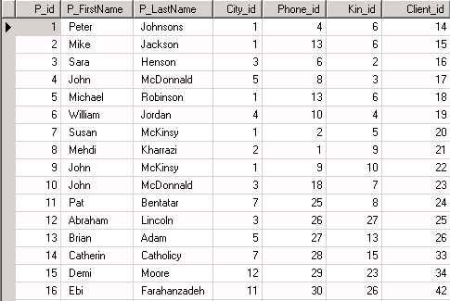
Database Overview → Relational Databases (cont.)
Relational databases are made up of relations, more commonly called tables.
A table is exactly what it sounds like a table of data. If you've used an electronic spreadsheet (Excel), you've already used a relational table.
A database usually
consists of several
tables.
MySQL can handle
thousands of
databases.
Table
Database

Slide 51
Database Overview → Relational Databases (cont.)
Elements of the relational database table:
Key (auto-increase)
Attribute
Column
Table
Row
(Topple)
Foreign Key
(referring to
another table)
Cell

Slide 52
Database Overview → Relational Databases (cont.)
Keys
Keys are special fields
Keys are defined on table creation
Keys tie tables together
Keys are unique: no two records have same value of the key
Primary key: Unique and links two tables → e.g. SSN number
Only one primary key per table
Key (auto-increase)

Slide 53
Database Overview → Relational Databases (cont.)
Indexes
Similar to the index of a book
MySQL automatically creates an index for each primary key
Indexes make it a lot faster to retrieve results
User can define additional indexes
Primary Key – Index 1
Index 2

Slide 54
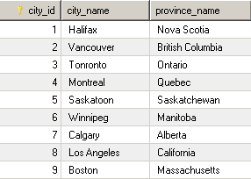
Database Overview → Relational Databases (cont.)
Internal Key (1 to 1 relationship):
Table: City_information (ONE-ONE)

Slide 55
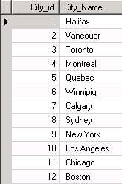
Database Overview → Relational Databases (cont.)
Foreign Key (1 to Many relationship):
Foreign Key
(referring to
another table)
Table: Patient_information (MANY)
Table: City_information (ONE)

Slide 56
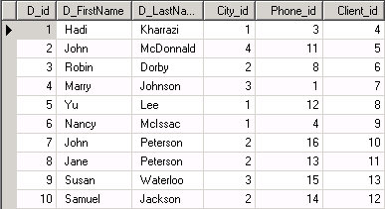
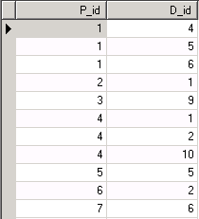
Database Overview → Relational Databases (cont.)
Foreign Key (Many to Many relationship):
Patient #1 has doctor #4, #5 and #6.
Dr. #1 has patient #2 and #4.
Table: Doctor_information (MANY)
Table: Patient_information (MANY)
Table: Patient_Doctor_realationship

Slide 57
Database Overview → Relational Databases (cont.)
Database Normalization
In the field of relational database design, normalization is a systematic way of ensuring that a database structure is suitable for general-purpose querying and free of certain undesirable characteristics — insertion, update, and deletion anomalies — that could lead to a loss of data integrity
Atomic data → smallest piece of data that can't or shouldn't be divided. The decision to consider a piece of information as atomic or not depends on the context and decision of the database designer:
  Pizza delivery: order_id, address (includes house_number and street_name)
  Real estate agent: mls_id, house_number, street_name
  (Real estate agent may want to know the houses on sale on one street)g

Slide 58
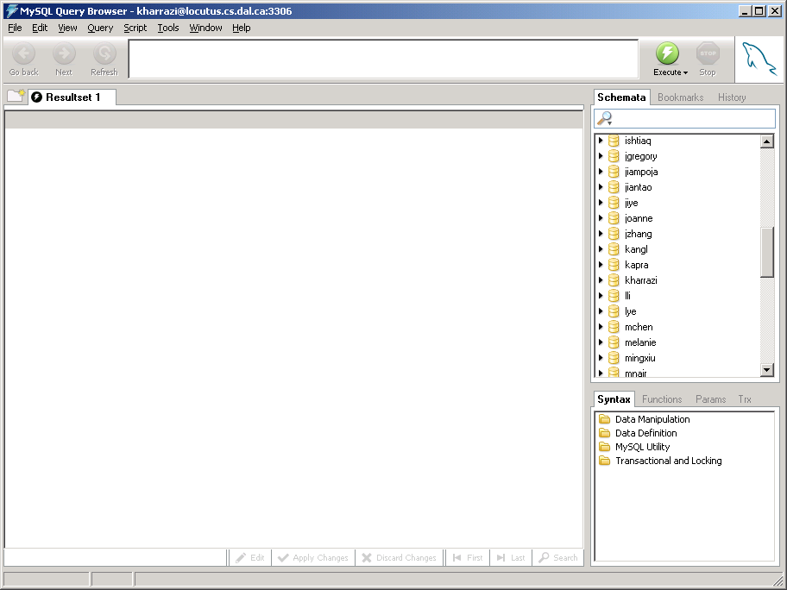
Database Overview → MySQL GUI (cont.)
(Browsing)
Query
Window
List of Databases
Results

Slide 59
Database Overview → MySQL GUI (cont.)
(Fetching Database)
Click on your DB

Slide 60
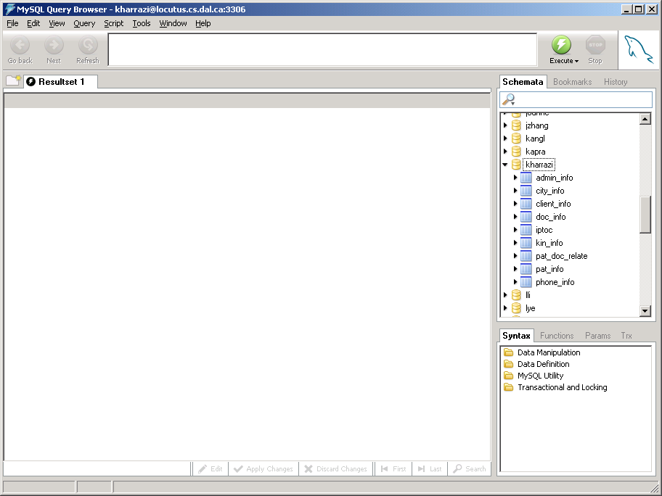
Database Overview → MySQL GUI (cont.)
(Fetching Database)
If you had tables
you would see
them here

Slide 61
Database Overview → MySQL GUI (cont.)
(Querying a Table)
Drag one of your
table and drop it
in the SQL area

Slide 62
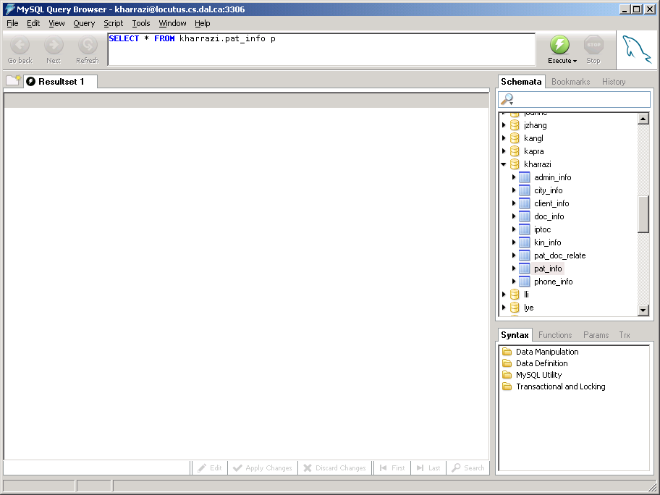
Database Overview → MySQL GUI (cont.)
(Querying a Table)
SQL command will be
generated automatically
Notice: In case you can’t see the SQL command please change the default font in: ‘tools -> options -> general options -> application fonts’ to a font which your PC has.

Slide 63
Database Overview → MySQL GUI (cont.)
(Querying a Table)
Click on Execute

Slide 64
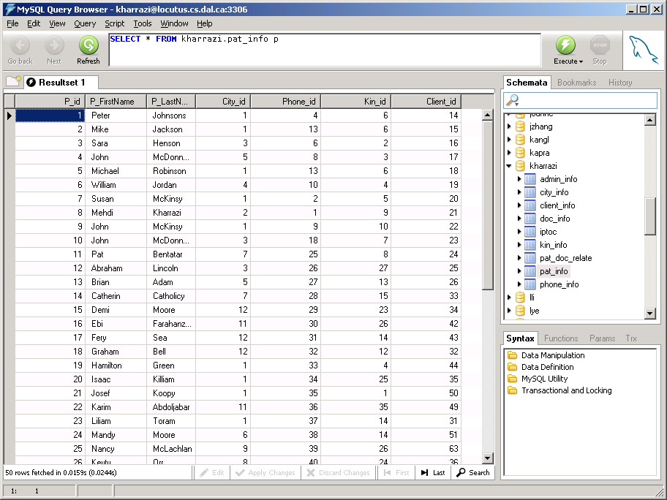
Database Overview → MySQL GUI (cont.)
(Querying a Table)
Results

Slide 65
Database Overview → MySQL GUI (cont.)
(Querying a Table)
SQL command line

Slide 66
Database Overview → SQL Language
SQL is a standard computer language for accessing and manipulating databases.
What is SQL?
  SQL stands for Structured Query Language
  SQL allows you to access a database
  SQL is an ANSI standard computer language
  SQL can execute queries against a database
  SQL can retrieve data from a database
  SQL can insert new records in a database
  SQL can delete records from a database
  SQL can update records in a database
  SQL is easy to learn

Slide 67
Database Overview → SQL Language (cont.)
SQL is an ANSI (American National Standards Institute) standard computer language for accessing and manipulating database systems.
SQL statements are used to retrieve and update data in a database. SQL works with database programs like MS Access, DB2, Informix, MS SQL Server, Oracle, Sybase, etc.
Unfortunately, there are many different versions of the SQL language, but to be in compliance with the ANSI standard, they must support the same major keywords in a similar manner (such as SELECT, UPDATE, DELETE, INSERT, WHERE, and others).

Slide 68
Database Overview → SQL Language (cont.)
SQL Data Manipulation Language (DML):
  SELECT - extracts data from a database table
  UPDATE - updates data in a database table
  DELETE - deletes data from a database table
  INSERT INTO - inserts new data into a database table
SQL Data Definition Language (DDL):
  CREATE TABLE - creates a new database table
  ALTER TABLE - alters (changes) a database table
  DROP TABLE - deletes a database table
  CREATE INDEX - creates an index (search key)
  DROP INDEX - deletes an index

Slide 69
Database Overview → SQL Language (cont.)
SQL in a Nutshell
SQL Introduction
SQL: SELECT Statement
SQL: WHERE (BETWEEN/LIKE/LIMIT) Clause
SQL: AND & OR
SQL: IN
SQL: ORDER BY Clause
SQL: INSERT INTO Statement
SQL: UPDATE/SET Statement
SQL: DELETE Statement
SQL: Joining and Keys (Inner Join)
SQL: LEFT JOIN/ON (Outer Join)
SQL: GROUP BY & HAVING
SQL: FUNCTIONS
SQL: CREATE Database, Table, and Index
SQL: DROP Index, Table and Database
SQL: ALTER Table

Slide 70
Database Overview → SQL Language (cont.) → SELECT Statement
The SELECT statement is used to select data from a table. The tabular result is stored in a result table.
Syntax:
Examples:
SELECT * FROM pat_info
SELECT P_FirstName FROM pat_info
SELECT P_FirstName, P_LastName FROM pat_info
SELECT DISTINCT city_id FROM pat_info
SELECT column_name(s) FROM table_name

Slide 71
Database Overview → SQL Language → WHERE Statement
To conditionally select data from a table, a WHERE clause can be added to the SELECT statement.
Syntax:
Examples:
SELECT * FROM pat_info WHERE P_FirstName='Mike'
SELECT * FROM pat_info WHERE P_id<6
SELECT * FROM pat_info WHERE P_id<6 LIMIT 2
SELECT * FROM pat_info WHERE P_id BETWEEN 6 AND 9
SELECT * FROM pat_info WHERE P_FirstName LIKE 'h%'
SELECT column FROM table
WHERE column operator value

Slide 72
Database Overview → SQL Language → AND/OR/IN Clause
AND & OR join two or more conditions in a WHERE clause. The AND operator displays a row if ALL conditions listed are true. The OR operator displays a row if ANY of the conditions listed are true.
Syntax:
Examples:
SELECT * FROM pat_info WHERE P_id>6 AND City_id=4
SELECT * FROM pat_info WHERE City_id=3 OR City_id=4
SELECT * FROM pat_info WHERE P_FirstName
IN ('Sara', 'Uve', 'John')
SELECT column FROM table WHERE column operator value
AND column operator value OR column operator value

Slide 73
Database Overview → SQL Language → ORDER BY Clause
The ORDER BY clause is used to sort the rows.
Syntax:
Examples:
SELECT * FROM pat_info ORDER BY P_FirstName
SELECT * FROM pat_info ORDER BY P_FirstName DESC
SELECT column FROM table ORDERED BY column DESC/ASC

Slide 74
Additional Resources

Slide 75

Resources – Books
Title | PHP 6 and MySQL 5 for Dynamic Web Sites: Visual QuickPro Guide
Authors | Larry Ullman
Year | 2009
Hardcover | Yes
Publisher | Pearson Education
Language | English
ISBN | 9780321617422

Slide 76
Resources – Web
Reference Website:
  HTML: www.w3.org
  PHP: www.php.net
  MySQL: www.mysql.com
  Apache Webserver: httpd.apache.org
Educational:
  www.w3schools.com
  www.lynda.com
  www.codecademy.com
  www.khanacademy.org/computing/computer-programming

Slide 77
Summary
Networking Overview
  Network Topology
  IP Address
  Domain Name
  Network Devices
Web Server Technology Overview
  Static Languages (e.g., HTML)
  Server Side Languages (e.g., PHP)
  Databases (e.g., MySQL)
  Server Side Integration (HTML/PHP/MySQL)
Database Overview
  Relational Databases
  MySQL GUI
  SQL Language
Resources
  Books
  Web

