Slide 1
Health Informatics Standards (Medical Language and Classification Systems)
Summer Institute / HIT Series
Hadi Kharrazi MHI MD PhD
kharrazi@jhu.edu
Johns Hopkins University
⬥ School of Public Health
⬥ School of Medicine
1 hr / ~70 slides

Slide 2
Overview
Introduction
Classification Methods & Challenges
Classification Systems
Dx: ICD, ICPC, DSM, SNOMED, ICD-O, ICPM, RCC, DRG
Procedures: CPT/ICD-CM
Lab: LOINC
Rx: ATC, RxNorm, NDC
Research: MeSH
Unified Medical Language System
Resources
Books
Web

Slide 3
Introduction

Slide 4
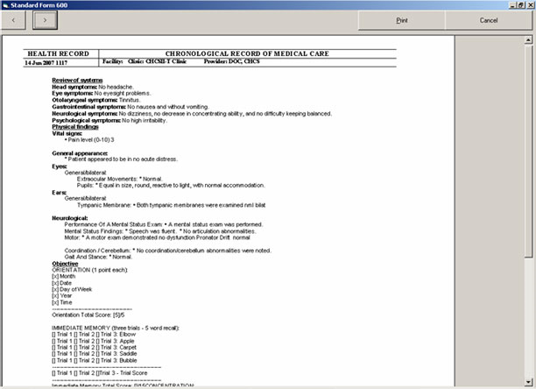
Introduction
In the traditional patient record, data are available in written format (free text and sometimes numeric)
Usually many medical terms are ill-defined and are perhaps even ambiguous except for the author of the patient record
Many patient data are becoming available in computer based patient records (CPRs) and the use of these data for purposes other than traditional archiving is becoming feasible.
Decision Support Systems may support care such as checking for drug interactions and contraindications → however, many of them will not be feasible unless the free text has a certain structure.

Slide 5
Introduction (cont.)
Application Areas | Advantages of Coding Medical Data
Patient care Quality control by: uniform reporting of results comparing data with those from other units or centers protocol management increased insight Medical research, including epidemiology Planning and management | Data reduction Standardized terminology Enabling statistical overviews and research Support of management and planning Coupling with decision-support systems
Reasons for Storing Coded Medical Data in a Computer

Slide 6
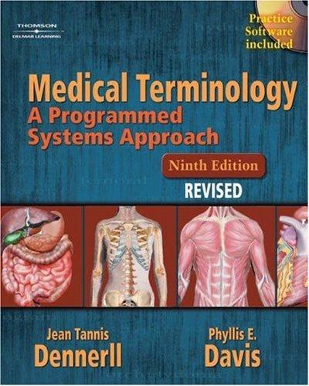
Introduction (cont.)
Medical Terminology

Slide 7
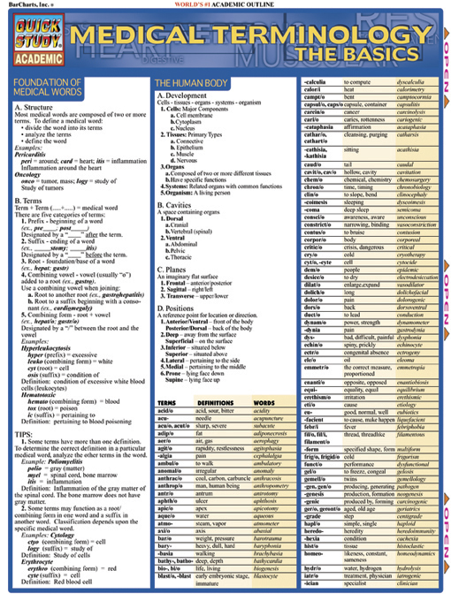
Introduction (cont.)
The free text leads to an infinite list of possible expressions. However statistical overviews and decision support systems can cope with only a finite number of classes.
The appropriate level of detail and the structure of the classification system depend on the purpose for which the classification system has been designed.
It must be possible to present all medically relevant expressions in CPRs without any data reduction. Therefore, standardized terminologies are used in these type of applications.

Slide 8
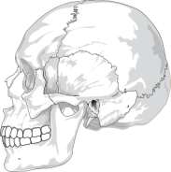
Introduction (cont.)
Three basic elements are used in the so-called semantic triangle: Object, Concept and Term.
Object: also called referents, are particular things in reality, and they are concrete (e.g. the stomach), as well as abstract (e.g. the mind).
Concept: a concept is a unit of thought formed by using the common properties of a set of objects (e.g. an organ)
Term: a term is a designation by a linguistic expression of a concept of an object in a specific language.
Concept
Bones…
Semantic Triangle
Term
Object
Skull
(English)

Slide 9
Introduction (cont.)
Concept
Harm…
Semantic Triangle
Term
Object
Wound
(English)

Slide 10
Introduction (cont.)
Concept
Harm…
Semantic Triangle
?
Term
Object
Wound
(English)
OK
(past tense of wind)

Slide 11
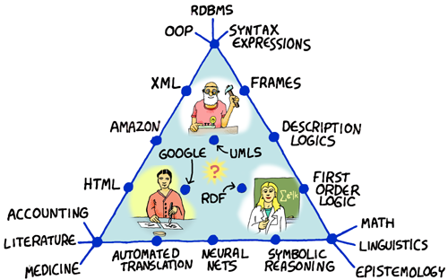
Introduction (cont.)

Slide 12
Classification Methods and Challenges

Slide 13
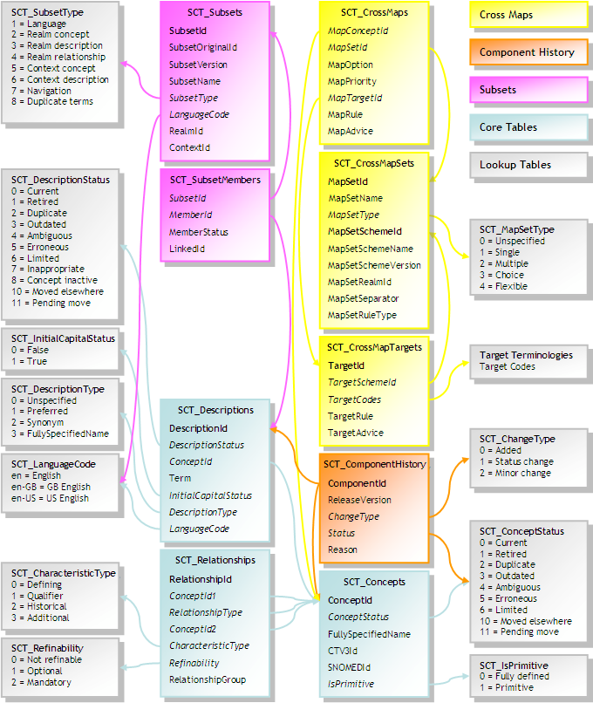
Classification Methods and Challenges
A classification is an ordered system of concepts within a domain, with implicit or explicit ordering principles → depends on their intended use.
A classification is based on prior knowledge and forms a key to the extension of knowledge.
The purpose of classification is to support the generation of health case statistics or to facilitate research such as classifying diagnosis of the patients into disease classes.
In a classification, concepts are ordered according to generic relations. Generic relations are relations of the type ‘A is a kind of B’. For example, pneumonia is a kind of lung disease, where pneumonia represents the narrower concept and lung disease represents the broader concept.
SNOMED-CT Schema

Slide 14
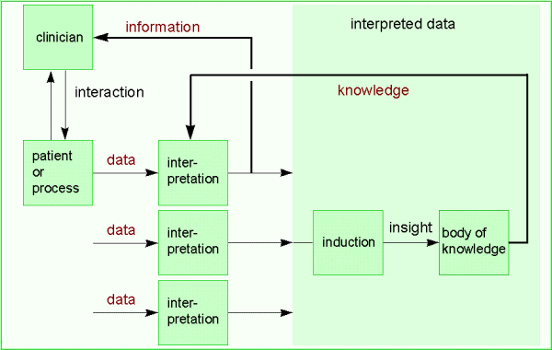
Classification Methods and Challenges (cont.)
A patient or a biological process generates data that are observed by the clinician. Information is derived from the data by interpretation, which is fed back to the clinician. By inductive reasoning with the interpreted data, collected from many similar patients or processes, new knowledge is obtained, which is added to the body of knowledge in medicine. This knowledge is used for the interpretation of other data.

Slide 15
Classification Methods and Challenges (cont.)
Classifications contain concepts within a certain domain. Example of domains are reason for encounter, diagnosis, and medical procedure. ICD9 is a classification of diagnosis.
A classification allows one to compare findings collected in different environments. For instance if we want to compute the number of beds required per age category in a hospital we could use the following age classes:
In this simple example, classifying is done according to a single criterion: age (differentiating criterion)
Babies | age | 0 - 3
Children | age | 4 -12
Teenagers | age | 13 -18
Adults | age | 19 - 64
Elderly | age | 65+

Slide 16
Classification Methods and Challenges (cont.)
Requirements for a classification | Additional requirements for computer-assisted coding systems
Domain completeness Non-overlapping classes (mutual exclusiveness) Suitable for its purpose Homogeneous ordering (one principle per level) Clear criteria for class boundaries Unambiguous and complete guidelines for application Appropriate level of detail | Allow for the use of synonyms Allow for the use of lexical variations Insensitive to spelling errors Reliability Consistent operation (insensitive to ordering of terms) Correct
Requirements for a classification and additional requirements for computer-assisted coding systems

Slide 17
Classification Methods and Challenges (cont.)
Ordering System
In classifications that use more than one ordering principle the situation is more complicated. In classifying diseases we deal with the following aspects among others: anatomic location, etiology, morphology and dysfunction.
Such an ordering throughout a classification is called an axis. Multiaxial classifications use several ordering simultaneously. In the International Classification of Primary Care (ICPC) the diagnoses are classified along two axes, one for the organ systems (an alphabetic characters) and one for the component (a number).
In ICPC the classes are chosen in such a way that for health care studies in primary care, each class will contain a sufficient number of cases. For the same reason for example all tropical diseases are grouped together which is not appropriate for tropical countries.

Slide 18
Classification Methods and Challenges (cont.)
First axis: organ systems
Second axis: components
Code | Organ System
A | General and unspecified
B | Blood
D | Digestive
F | Eye
H | Ear
K | Circulatory
L | Musculoskeletal
N | Neurological
P | Psychological
R | Respiratory
S | Skin
T | Endocrine and metabolic
U | Urology
W | Pregnancy and family planning
X | Female genital system
Y | Male genital system
Z | Social problems
Code | Component
1 - 29 | Symptoms and complaints
30 - 49 | Diagnostic screening and prevention
50 - 59 | Treatment and medication
61 - 61 | Test results
62 | Administrative
63 - 69 | Other
70 - 99 | Diagnoses
The Two-Axial ICPC

Slide 19
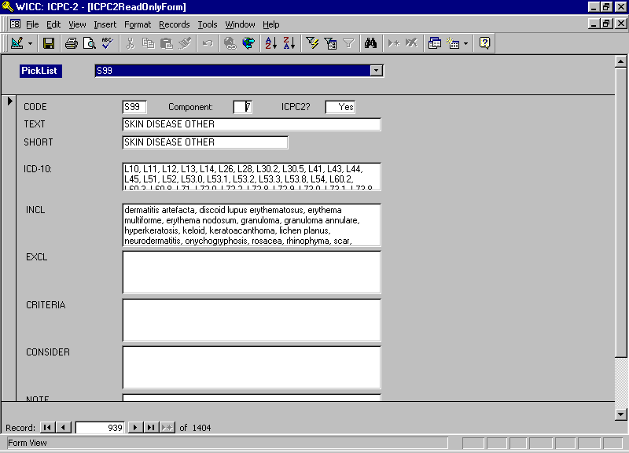
Classification Methods and Challenges (cont.)
The ICPC MS Access database

Slide 20
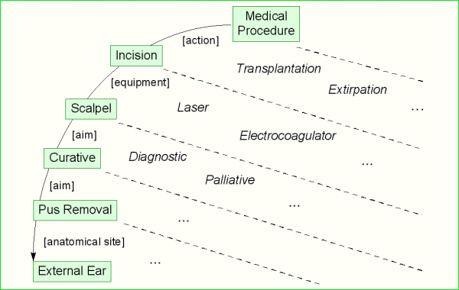
Classification Methods and Challenges (cont.)
Example of a multilevel classification of medical procedures.
The differentiating criteria are indicated between rectangles.
The criteria for membership in each subclass are not adopted here.

Slide 21
Classification Methods and Challenges (cont.)
Nomenclatures and Thesauri
One of the problems of uniform registration in health care is the lack of a common terminology.
A thesaurus is a list of terms used for a certain application area or domain. Examples are a list of diagnostic terms. A thesaurus is always intended to be complete for its domain. Sometimes it contains a list of synonyms for each preferred term which simulates the usage of standardized terminology.
In a nomenclature codes are assigned to medical concepts and medical concepts can be combined according to specific rules to form more complex concepts. This leads to a large number of possible code combinations. A nomenclature is useful in producing standardized reports such as discharge letters. SNOMED is a popular nomenclature.

Slide 22
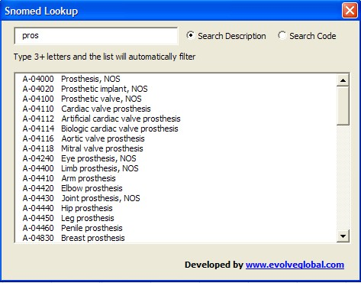
Classification Methods and Challenges (cont.)
The SNOMED lookup database

Slide 23
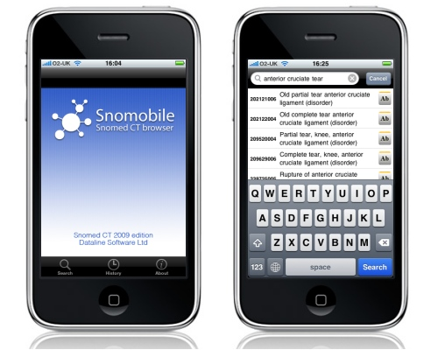
Classification Methods and Challenges (cont.)
The SNOMED mobile lookup database

Slide 24
Classification Methods and Challenges (cont.)
Codes
Coding is the process of assigning an individual object or case to a class or to a set of classes in the case of a multiaxial classification. In most classifications classes are designated by codes. Codes may be formed by numbers, alphabets or both.
Number codes: Sequential (each new class will be given the next unused number – adding new classes is easy), Random (hiding patient information), Reserved Series (for sets of classes when no expansion of the set of classes is expected)
Mnemonic codes: formed from one or more characters of its related class rubric which helps memorizing them. This coding is good for limited lists of classes. (ENT, …)
Hierarchical codes: are formed by extending an existing code with one or more additional characters for each additional level of detail. ICD9 uses hierarchical coding system.

Slide 25
Classification Methods and Challenges (cont.)
Juxtaposition codes: are composite codes consisting of segments. Each segment provides a characteristic of the associated class. ICPC uses juxtaposition coding system.
Combination codes: is based on ordering principles (20 actions, 10 equipments, 5 aims and 100 anatomical site = almost 100,000 classes). By using a six-digit combination code (four segments) for each principle a coding clerk has to distinguish only a limited number (135) codes.
Value addition codes: only powers of 2 are used as a representation of a data item or class. Example: 2⁰ = 1 for smoker/ 0 nonsmoker 2¹ = 2 for overweight / 0 for no overweight 2² = 4 for high blood pressure / 0 for no blood pressure number 7 represents 1+2+4 → smoker/overweight/high blood pressure and number 5 represents 1+0+4 → smoker/no overweight/high blood pressure

Slide 26
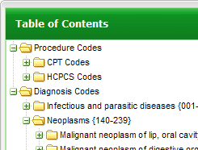
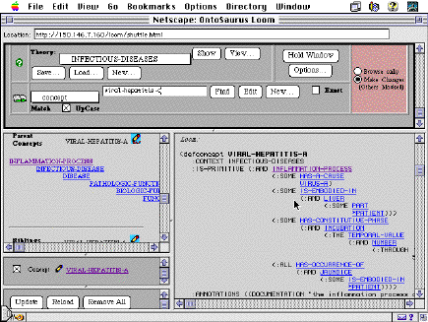
Classification Methods and Challenges (cont.)
Taxonomy
Taxonomy is the theoretical study of classification including its basic principles, procedures and rules (science of classification).
All objects in a group have some features in common that is they fall within the boundaries of a group. A group maybe further subdivided on the basis of another feature or character.
In ICD9, the classification and subdivision are preformed by the grouping of diseases in organ systems or by etiology.
The different chapters (main disease categories or etiological categories) of ICD-9 are subdivided into groups, the groups are divided into three-digit classes and so on.

Slide 27
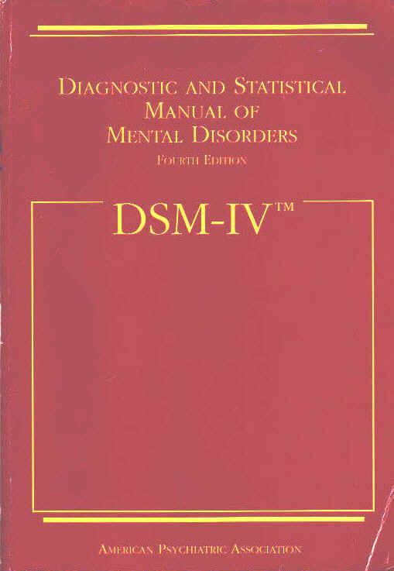
Classification Methods and Challenges (cont.)
Nosology
Nosology is usually defined as the science of the classification of diseases. It usually involves syndromes, disorders, injuries and diseases (taxonomy of diagnostic terms).
Nosology explains the definition of the diseases (only essential characteristics of the diseases) but nosography explains the description of the diseases (includes accidental characteristics that are correlated with the essence of the disease).
There is a growing feeling that classifications such as ICD, SNOMED and DSM-IV (Diagnostic and Statistical Manual for Mental Disorders) do not justice to the way in which diagnostic terms are actually used in heath care and that a new paradigm is needed.

Slide 28
Classification Methods and Challenges (cont.)
ARA Criteria for the Classification of Rheumatoid Arthritis
1. | Morning stiffness
2. | Arthritis of three or more joint areas
3. | Arthritis of hand joints
4. | Symmetric arthritis
5. | Rheumatoid nodules
6. | Serum rheumatoid factor
7. | Typical radiographic changes
At least four of the seven criteria must be fulfilled

Slide 29
Classification Challenges (cont.)
Classification problems concern the ordering of concepts in a way that is logically sound, elegant and user friendly. Coding problems concern the technical support to enable coding clerks to assign an individual case to the right class.
Classification Problems
Not all combinations that can generated are sensible. For example a “transplantation to remove an abscess” is not sensible. Sometimes they are ambiguous.
We cannot always apply each ordering principle to all diseases. For example using etiology as the ordering principle, we can classify “viral pneumonia” as a viral disease, but we cannot classify “pneumonia” with the same degree of certainty to any etiological class. Therefore pneumonia will be classified using an anatomical ordering principle such as pulmonary disease.
The dynamic nature of classification explains the continuous need for maintenance of classifications such as ICD and SNOMED. For example AIDS was first only classified as immune disease but then after they found out it has a viral cause, they also classified it as a viral disease.

Slide 30
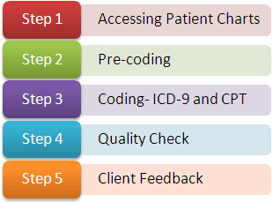
Classification Challenges (cont.)
Coding Problems
The basic problem is that the language used in the classification is rather different from the clinical language found in the patient record.
Two solutions are available:
Morpho-Semantic → grouping the stem words into similar categories
Synonym Thesaurus → pointing the unknown term to an existing entry in the classification by its synonyms

Slide 31
Classification History
(1629) First Attempt at registration was the London Bills of Mortality.
(1893) International List of Causes of Death (ILCD) by Jacques Bertillon
(1933) Standard Classified Nomenclature of Disease (SNOD)
(1938) Fifth edition of the ILCD was published by ISI (International Statistical Institute)
(1946) WHO officially becomes responsible to undertake ILCD and create a similar one for morbidity.
(1948) 6th revision of ILCD
(1955) 7th revision of ILCD
(1961) 5th and the last edition of SNOD
(1965) Systematic Nomenclature of Pathology (SNOP) with 4 axes
(1965) 8th revision of ILCD
(1975) 9th which is renamed to ICD-9 – later ICD-9CM (clinical modifications)
(1976) International Classification of Procedures in Medicine (ICPM)
(1979) Systematized Nomenclature of Human and Veterinary Med (SNOMED) 7-11 axes
(1989) 10th releasing ICD-10 (classification by etiology rather than manifestation of the diseases)

Slide 32
Classification Systems

Slide 33
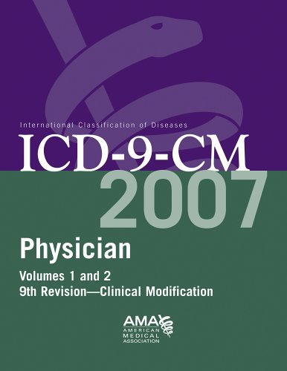
Classification Systems
ICD (International Classification of Diseases)
ICD the standard coding system for patient record abstraction. The first edition was published in 1900 and almost every 10 year is being revised.
WHO is responsible for its maintenance. The latest version is ICD-10 (at the time of the creation of this slide) which is released in 1992.
ICD consists of a core classification of three-digit codes, which are the minimum requirement for reporting mortality statistics to WHO. An optional fourth digit provides an additional level of detail.
At all levels, the numbers 0 to 7 are used for further detail, whereas the number 8 is reserved for all other cases and the number 9 is reserved for unspecified coding.

Slide 34
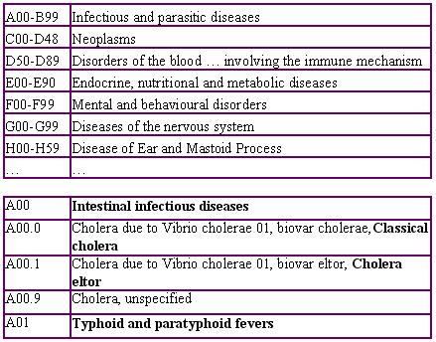
Classification Systems (cont.)
The basic ICD is meant to be used for coding diagnostic item terms but ICD-9 (and 10) also contain a set of expansions for other medical terms. For instance, ICD-9 also contains a list of codes starting with the letter “V” for reasons of encounter, or the letter “E” for external causes of death.
The U.S. National Center for Health Statistics has published ICD-9-CM which is fully compatible with ICD-9 but it contains an extra level of detail where needed such as medical procedures.
http://www.who.int/classifications/icd/en/

Slide 35
Classification Systems (cont.)
The ICD-10 chapter headings
http://www.who.int/classifications/apps/icd/icd10online/

Slide 36
Classification Systems (cont.)
Code |  |  |  | Disease
001 | - | 139 |  | Infectious and parasitic diseases
001 | - | 009 |  | Infectious diseases of the digestive tract
003 |  |  |  | Other Salmonella Infections
 | - |  | 003.0 | Salmonella gastroenteritis
 | - |  | 003.1 | Salmonella Septicemia
 | - |  | 003.2 | Localized Salmonella Infections
 | - |  |  | 003.20 | Localized Salmonella Infection, Unspecified
 | - |  |  | 003.21 | Salmonella Meningitis
 | - |  |  | 003.22 | Salmonella Pneumonia
 | - |  |  | 003.23 | Salmonella Arthritis
 | - |  |  | 003.24 | Salmonella Osteomyelitis
 | - |  |  | 003.29 | Other Localized Salmonella Infections
 | - |  | 003.8 | Other Specified Salmonella Infections
 | - |  | 003.9 | Salmonella Infections, Unspecified
Example of a Four-Digit Code Level in ICD-9 and the Five-Digit Code Level as Extended by the ICD-9-CM.

Slide 37
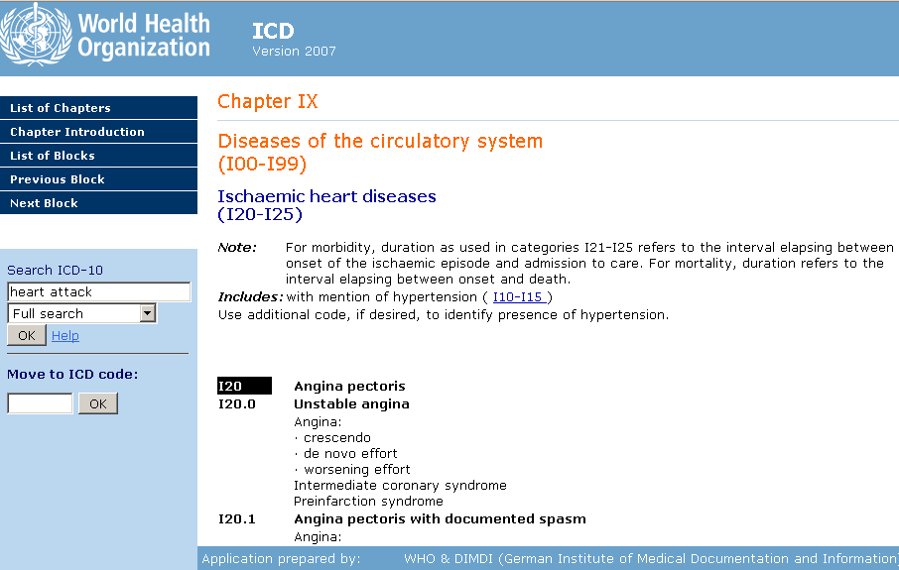
Classification Systems (cont.)
ICD10 on WHO’s website

Slide 38
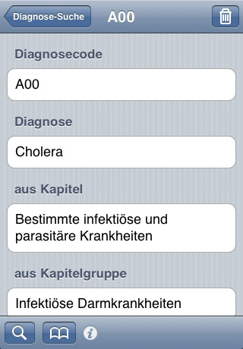
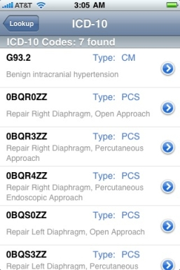
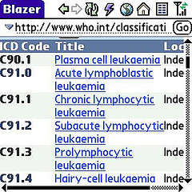
Classification Systems (cont.)
ICD9 and ICD10 on various mobile platforms

Slide 39
Classification Systems (cont.)
ICPC (International Classification of Primary Care)
The World Organization of National Colleges, Academies and Academic Associations of General Practitioners (WONCA) did not accept ICD-9 and came up with ICPC.
ICPC is less granular than ICD. ICPC contains not only diagnostic codes, but also codes for reasons for encounter (RfE), therapies and lab tests.
ICPC is a two-axis system: first one is oriented toward the body system (coded by letters) and the second one is the component (coded by two digit numbers). For example the diagnosis of pneumonia is coded as R81 (R for respiratory tract and 81 for the diagnostic component).
ICPC is used to encode encounters structured according to the SOAP (Subjective, Objective, Assessment and Plan) which helps it to organize patient-oriented information by disease episodes.

Slide 40
Classification Systems (cont.)
First axis: organ systems
Second axis: components
Code | Organ System
A | General and unspecified
B | Blood
D | Digestive
F | Eye
H | Ear
K | Circulatory
L | Musculoskeletal
N | Neurological
P | Psychological
R | Respiratory
S | Skin
T | Endocrine and metabolic
U | Urology
W | Pregnancy and family planning
X | Female genital system
Y | Male genital system
Z | Social problems
Code | Component
1 - 29 | Symptoms and complaints
30 - 49 | Diagnostic screening and prevention
50 - 59 | Treatment and medication
61 - 61 | Test results
62 | Administrative
63 - 69 | Other
70 - 99 | Diagnoses
The Two-Axial ICPC

Slide 41
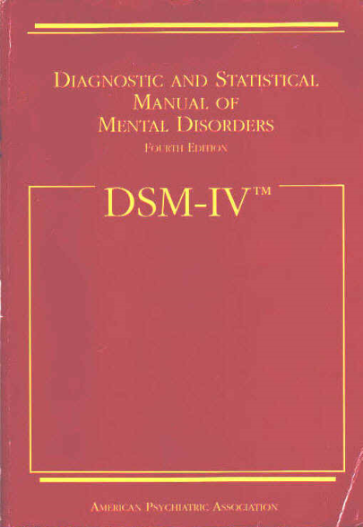
Classification Systems (cont.)
DSM (Diagnostic and Statistical Manual for Mental Disorder)
DSM was published by American Psychiatric Association (APA) in 1952. The latest version (at the time of the slide creation) DSM-V has been coordinated with the development of ICD-10. The classification is intended to be used by psychiatrists.
The etiology or the pathophysiological processes are only known for some mental disorders. Therefore DSM-V is non-theoretical with regard to etiology or the pathophysiological process except for disorders with an established etiology.
DSM is designed to describe the clinical manifestation of the disease along several axes. Therefore DSM is a multiaxial classification system based on the following axes: (1) clinical syndromes, (2) personality disorders and special developmental disorders, (3) relevant physical conditions, (4) severity of psychological stressors and (5) overall psychological functioning.

Slide 42
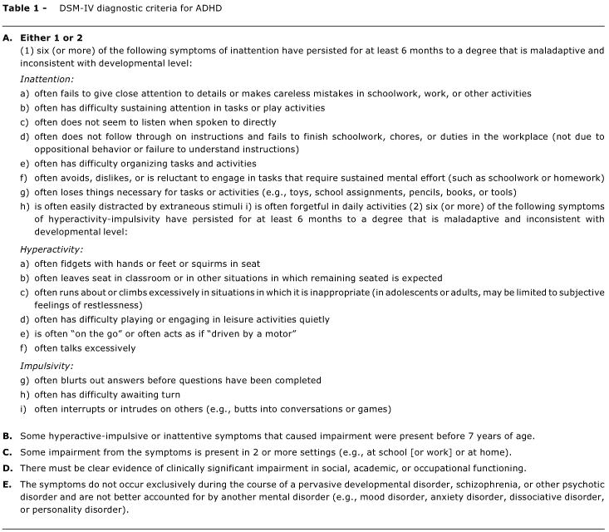
Classification Systems (cont.)
DSM IV diagnostic criteria for ADHD

Slide 43
Classification Systems (cont.)
SNOMED (Systematized Nomenclature of Human and Veterinary Medicine)
SNOMED allows for the coding of several aspects of a disease and therefore it is a multiaxial system.
SNOMED II had 7 axes but SNOMED international has 11 axes. Each of these axes forms a complete hierarchical classification systems.
A diagnosis in SNOMED may consist of four codes. For example the disease code D-13510 (Pneumococcal pneumonia) is equivalent to the combination of: T-28000 (topology code for Lung), M-40000 (morphology code for inflammation) and L-25116 (Living organism axis for Streptococcus pneumonia).
In SNOMED international almost all diagnostic terms of ICD-9-CM are incorporated in the disease module (D-codes).
SNOMED can be combined however the results are not always meaningful.

Slide 44
Classification Systems (cont.)
Axis | Definition | Description
T | Topography | Anatomic terms
M | Morphology | Changes found in cells, tissues and organs
L | Living organisms | Bacteria and viruses
C | Chemical | Drugs
F | Function | Signs and symptoms
J | Occupation | Terms that describe the occupation
D | Diagnosis | Diagnostic terms
P | Procedure | Administrative, diagnostic and therapeutic procedures
A | Physical agents and forces | Devices and activities associated with the disease
S | Social context | Social conditions and important relationships in medicine
G | General | Syntactic linkages and qualifiers
The 11 Axes of SNOMED International.

Slide 45
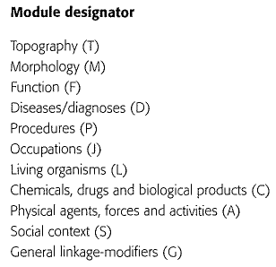
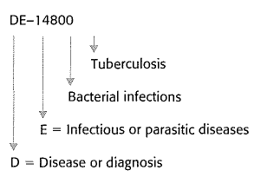
Classification Systems (cont.)
SNOMED codes are hierarchically structured. Implicit in the code, tuberculosis is an infectious bacterial disease.
The SNOMED International modules (or axes).
An example of SNOMED's nomenclature and classification. Some terms (e.g. tuberculosis) can be cross-referenced to others, to give the term a richer clinical context.

Slide 46
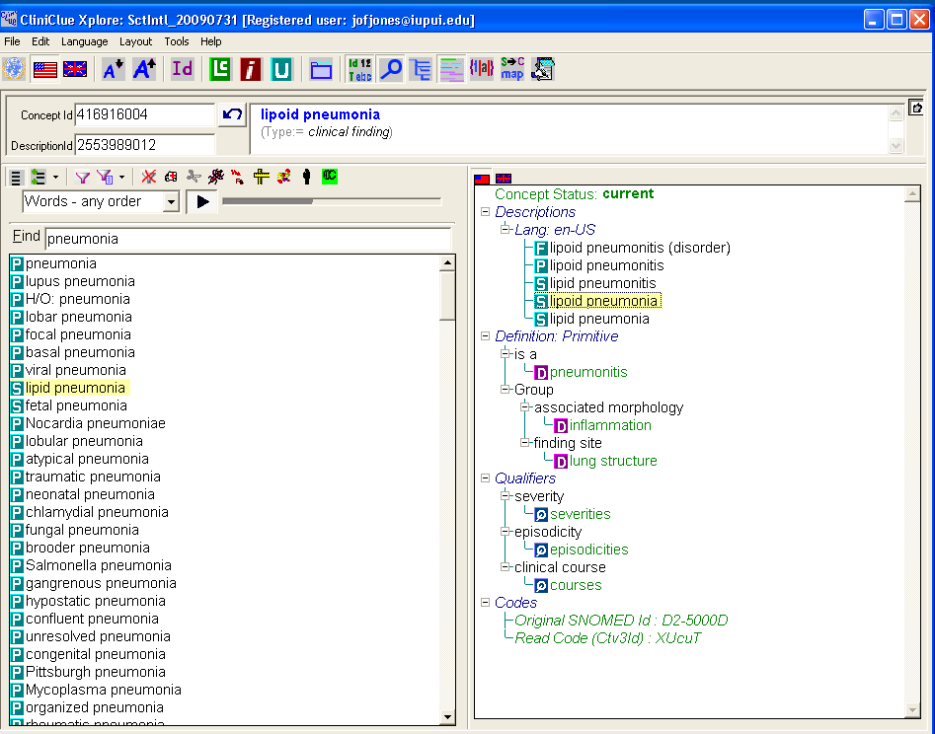
Classification Systems (cont.)
SNOMED browser

Slide 47
Classification Systems (cont.)
ICD-O (ICD for Oncology)
The second edition published in 1990 is an extension of the draft neoplasm chapter of ICD-10.
ICD-O combines a four-digit topography code based on ICD with a morphological code that includes a neoplasm behavior code and a code for histological grading and differentiation.
ICD-O codes have been adopted in the morphology axes of SNOMED. ICD-O is widely used for cancer registration.
CPT (Current Procedural Terminology)
CPT is mainly in U.S. for billing and reimbursement.
It provides a coding scheme for diagnostic and therapeutic procedures that define procedures with codes based on the cost.

Slide 48
Classification Systems (cont.)
ICPM (International Classification of Procedures in Medicine)
ICPM was published in 1976 by WHO for trial purposes. It contained chapters on diagnostic, laboratory, preventive, surgical and other procedures.
Unfortunately it was not continued. The procedural part of ICD-9-CM is based on ICPM. ICPM is mandatory in Germany and Netherlands for reimbursement and administration purposes.
RCC (Read Clinical Classifications)
RCC or Read Code was developed privately by a British GP (James Read) in the early 1980s.
The British National Health Service (NHS) adopted it in 1990.
RCC is specially designed to include all of the possible terms used in a CPR (Computerized Patient Record). Synonym, acronym and eponym equivalents are also available.
RCC has a hierarchical structure with a five digit alphanumeric code. RCC is also cross referenced with ICD-9 and ICD-9-CM.

Slide 49
Classification Systems (cont.)
Diseases
Occupations
History/symptoms
Examinations/signs
Diagnostic procedures
Radiology/diagnostic imaging
Preventive procedures
Operative procedures
Other therapeutic procedures
Administration
Drugs/appliances
Health status measurements
Diagnosis Related Groups (DRGs)
Domains Covered by the British RCC

Slide 50
Classification Systems (cont.)
Level | Term | RCC | ICD-9-CM
1 | Infectious/parasitic diseases | A | 001-139
2 | Viral disease with exanthem | A5 | 050-057
3 | Rubella | A56 | 056
4 | Rubella + neurological complications | A560 | 0560
5 | Rubella + encephalomyelitis | A5601 | 056.01
Example of RCC mapping to ICD-9-CM

Slide 51
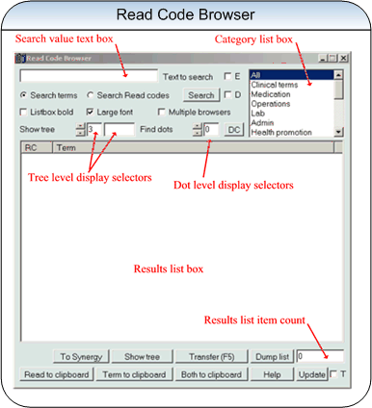
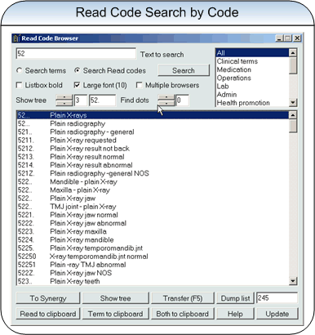
Classification Systems (cont.)
RCC browser

Slide 52
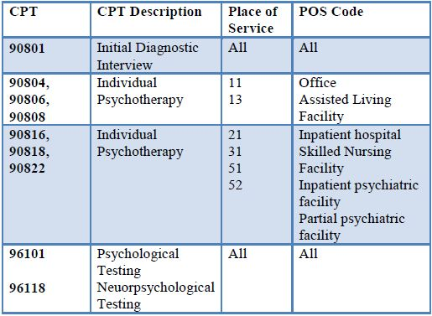
Classification Systems (cont.)
Current Procedural Terminology (CPT)
The American Medical Association developed the Current Procedural Terminology (CPT) in 1966 to provide a precoordinated coding scheme for diagnostic and therapeutic procedures that has since been adopted in the United States for billing and reimbursement.
Sample CPT codes used for physician procedure reporting

Slide 53
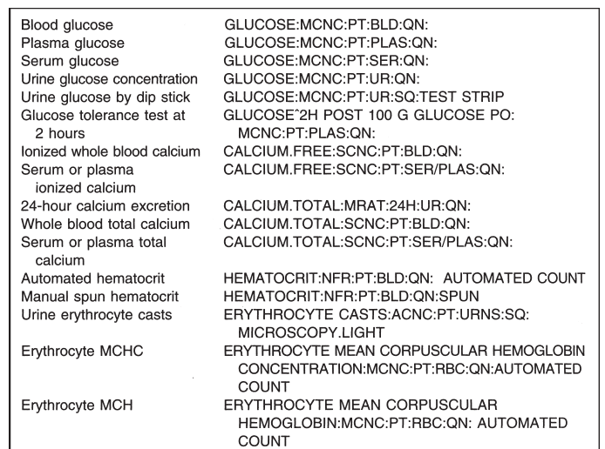
Classification Systems (cont.)
LOINC
Originally called Laboratory Observations, Identifiers, Names and Codes (LOINC), the system has been extended to include non-laboratory observations (vital signs, electrocardiograms), so Logical has replaced Laboratory to reflect the change.
LOINC Code examples

Slide 54
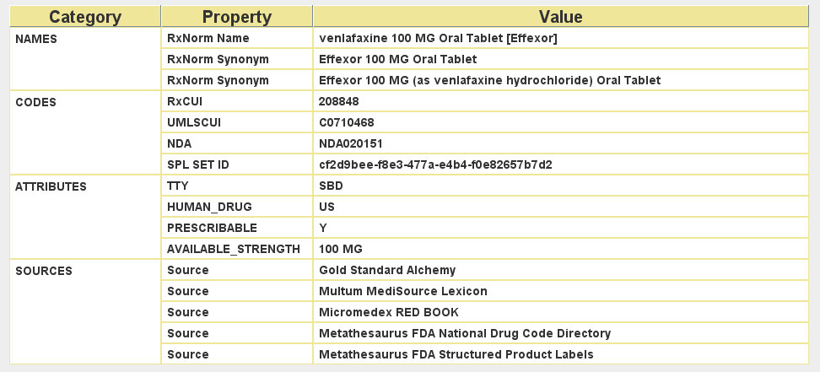
Classification Systems (cont.)
RxNorm & NDC
The WHO Drug Dictionary is an international classification of drugs that provides proprietary drug names used in different countries.
Drugs are classified according to the Anatomical-Therapeutic-Chemical (ATC) classification, with cross-references to manufacturers and reference sources.
The National Drug Codes (NDC), produced by the FDA, is applied to all drug packages.
RxNorm is the results of a collaboration between the FDA, the NLM, the VA, and the pharmacy knowledge base vendors.

Slide 55
Classification Systems (cont.)
ATC (Anatomic Therapeutic Chemical Code)
ATC has been developed for the systematic and hierarchical classification of drugs.
ATC is the result of the addition of the Chemical codes in 1970s by the Norwegian Medical Depot to the European Pharmaceutical Market codes.
Advantages of ATC:
It identifies a drug product, including the active substances, the route of administration, and the dose.
It is both therapeutically and chemically oriented.
It is accepted by WHO
Disadvantage of ATC: it does not cover combination products, dermatological preparations, and locally compounded preparations.

Slide 56
Classification Systems (cont.)
Five Levels of the ATC Code Illustrated by the Code for Furosemide
ge | Description
C | Cardiovascular system (1st level, anatomical main group)
C03 | Diuretics (2nd level, therapeutic main group)
C03C | High-level diuretics (3rd level, therapeutic subgroup)
C03CA | Sulfanomides (4th level, chemical/therapeutic subgroup)
C03CA01 | Furosemide (5th level, subgroup for chemical substance)
At the lowest (5th) level the code also contains information on the defined daily dosage (DDD), the unit of measurement, and the route of administration

Slide 57
Classification Systems (cont.)
Unit | Unit Abbreviation | Route of Administration | Abbreviation for Route of Administration
gram | g | Inhalation | Inhal
milligram | mg | Nasal | N
microgram | mcg | Oral | O
unit | E | Parenteral | P
thousand units | TE | Rectal | R
million units | ME | Sublingual/ buccal | SL
millimole | mmol | Transdermal | Td
milliliter | ml | Vaginal | V
Units and Administration Routes Defined in the ATC code

Slide 58
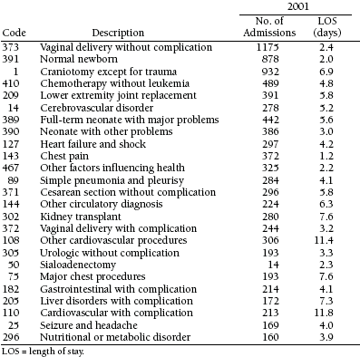
Classification Systems (cont.)
DRG (Diagnosis Related Group)
DRG codes are based on ICD-9-CM and other factors not included in ICD-9.
The grouping of the codes are based on factors that affect the cost of treatment and the length of stay in the hospital, such as severity, complications, and type of treatment.
DRG may be used for budgeting. Because factors related to the delivery of care are included, their usefulness for budgeting is disputable.
Some disease groups are clustered which is called case mix.

Slide 59
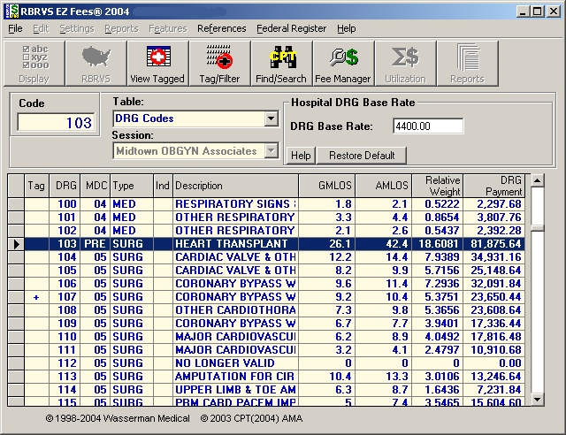
Classification Systems (cont.)
DRG Browser

Slide 60
Classification Systems (cont.)
MeSH (Medical Subject Headings)
MeSH is developed and maintained by the National Library of Medicine (NLM) in U.S.
MeSH is used to index the world medical literature.
Within MeSH a concept may appear as a narrower concept (hierarchical format).
MeSH forms the basis for the Unified Medical Language System (UMLS) also developed by NLM.
UMLS is not a classification system, rather is a project to enhance retrieving information from biomedical sources.

Slide 61
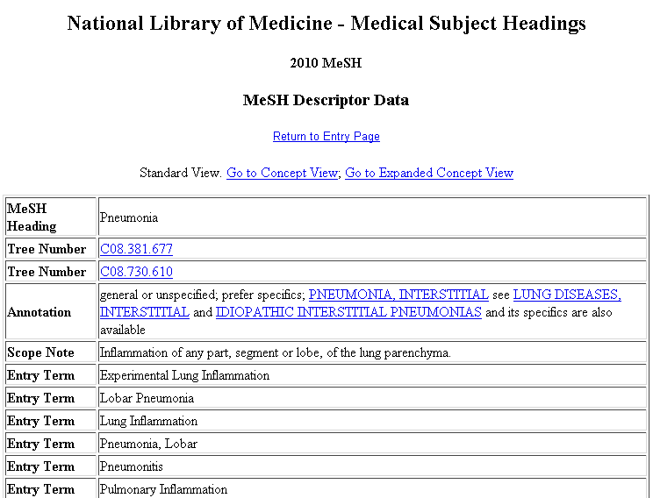
Classification Systems (cont.)
Mesh for Pneumonia

Slide 62
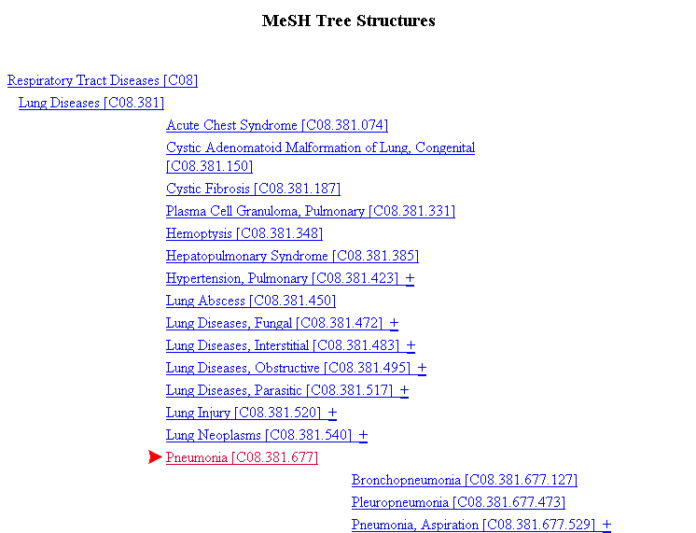
Classification Systems (cont.)
Mesh for Pneumonia

Slide 63
Unified Medical Language System (UMLS)

Slide 64
Unified Medical Language System (UMLS)
The UMLS project is a long-term research and development project at the U.S. National Library of Medicine (NLM) whose goal is to develop resources that will support intelligent information retrieval from a wide range of disparate biomedical information sources.
The project is directed by a multidisciplinary team, including physicians, computer and information scientists, and linguists, and involves collaboration with many medical informatics research groups.
The project work has resulted in a set of knowledge sources and accompanying programs that are updated regularly.
Online access to the UMLS knowledge sources is provided through the Internet-based UMLS Knowledge Source Server, which includes an application programming interface (API) and a World Wide Web interface.
The Web site requires an access code and may be found at http://umlsks.nlm.nih.gov/

Slide 65
Unified Medical Language System (cont.)
UMLS Metathesaurus
The Metathesaurus contains information about biomedical concepts and terms from a large number of controlled terminologies and thesauri. The Metathesaurus adds information to the concepts, including semantic types, definitions, and inter-concept relationships.
The following terminologies are used:
the Systematized Nomenclature of Medicine (SNOMED International),
the Read Thesaurus,
the International Classification of Diseases - Clinical Modification (ICD9-CM),
the Universal Medical Device Nomenclature System,
the WHO Adverse Drug Reaction Terminology,
the Classification of Nursing Diagnoses (NANDA),
the Home Health Care Classification of Nursing Diagnoses and Interventions,
the Physicians' Current Procedural Terminology (CPT),
the Medical Subject Headings (MeSH),
the Diagnostic and Statistical Manual of Mental Disorders (DSM-IV), and
the Thesaurus of Psychological Index Terms
In addition, translations of some of the terminologies into languages other than English are included.

Slide 66
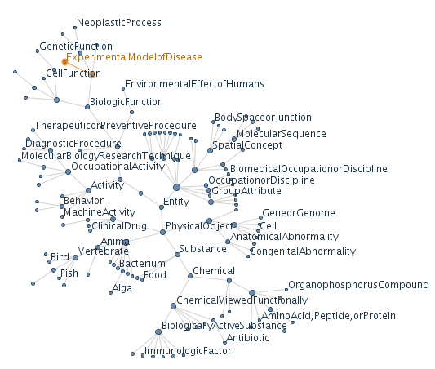
Unified Medical Language System (cont.)
UMLS Semantic Network
The Semantic Network, through its high-level semantic types, or categories, provides a consistent categorization of all concepts represented in the Metathesaurus. The links between the semantic types provide the structure for the Network and represent important relationships in the biomedical domain.
There are semantic types for organisms, anatomical structures, biologic function, chemicals, events, physical objects, and concepts or ideas. The primary relationship is the "is_a" link, and there are five major categories of additional relationships: physical, spatial, temporal, functional, and conceptual relationships.

Slide 67
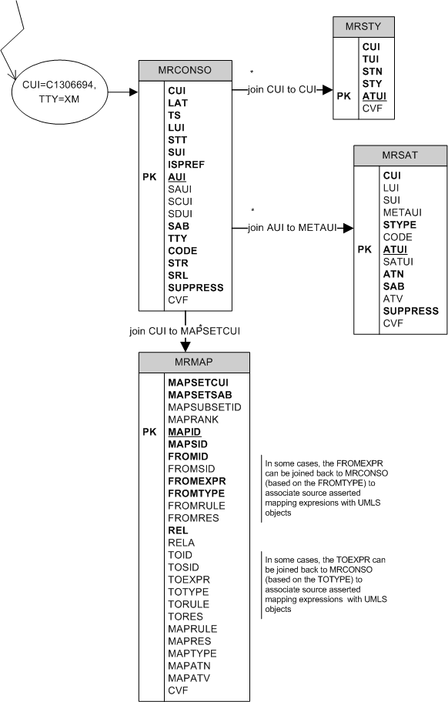
Unified Medical Language System (cont.)
SPECIALIST Lexicon
The SPECIALIST lexicon is an English language lexicon with many biomedical terms. It has been developed in the context of the SPECIALIST natural language processing project at NLM. The lexicon entry for each word or term records syntactic, morphological, and orthographic information. Lexical entries may be single or multi-word terms and are selected for coding from a variety of sources, including lexical items from MEDLINE citation records.
UMLS Information Sources Map
The Information Sources Map contains information about the scope, location, vocabulary, syntax rules, and access conditions of biomedical databases of all kinds.

Slide 68
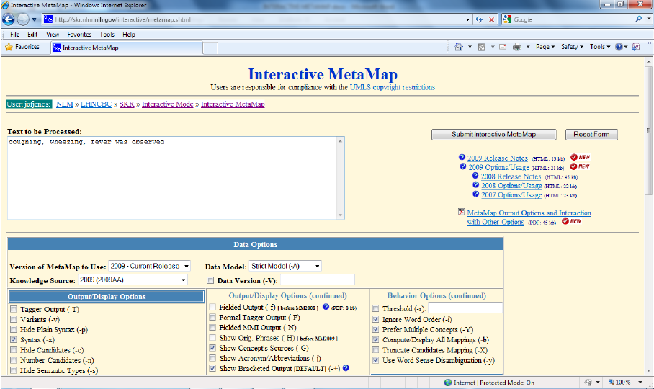
Unified Medical Language System (cont.)
Interactive MetaMap

Slide 69
Additional Resources

Slide 70
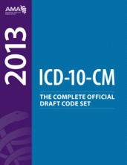
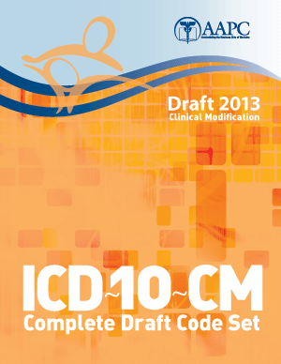
Resources – Books

Slide 71
Resources – Web
Standardized Coding Organizations:
ICD: www.who.int/classifications/icd/en/
SNOMED: www.nlm.nih.gov/research/umls/Snomed/snomed_main.html
CPT: www.ama-assn.org/ama/pub/physician-resources/solutions-managing-your-practice/coding-billing-insurance/cpt.page
LOINC: loinc.org
RxNorm: www.nlm.nih.gov/research/umls/rxnorm/

Slide 72
Summary
Introduction
Classification Methods & Challenges
Classification Systems
Dx: ICD, ICPC, DSM, SNOMED, ICD-O, ICPM, RCC, DRG
Procedures: CPT/ICD-CM
Lab: LOINC
Rx: ATC, RxNorm, NDC
Research: MeSH
Unified Medical Language System
Resources
Books
Web

