Slide 1
Health IT for Disease Management:
Population Health IT Implications
Summer Institute / HIT Series
Hadi Kharrazi MHI MD PhD
kharrazi@jhu.edu
Johns Hopkins University
⬥ School of Public Health
⬥ School of Medicine
1.5 hrs / ~55 slides

Slide 2
Overview
Background
  Chronic Diseases
  Population Health Management
  Promise of Health IT
Consumer Health Informatics Solutions
  Concept and Definitions
  Categories and Sample Systems
  Behavioral Change Models
Resources
  Books
  Web

Slide 3
Background

Slide 4
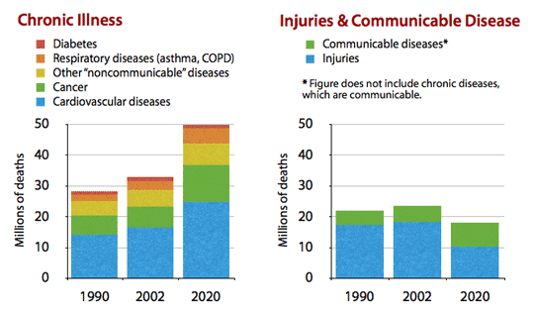
Copyright Yach D. et.al.
Background – Chronic Diseases → Global
Annual Global Mortality by Category (Chronic vs non-Chronic)

Slide 5
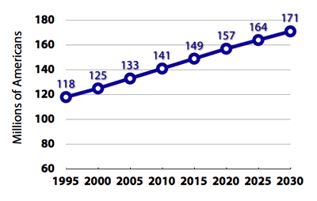
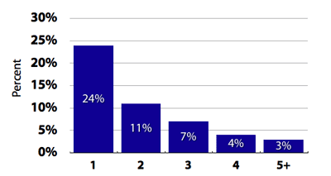
Background – Chronic Diseases → US
Almost one out of every two U.S. adults reported having at least one of six chronic illnesses of cardiovascular disease, cancer, chronic obstructive pulmonary disease, asthma, diabetes or arthritis in 2008.
Seven out of 10 deaths among Americans each year are from chronic diseases. Heart disease, cancer and stroke account for more than 50% of all yearly deaths.
In 2012, 9.3% of the US population, had diabetes (8.3% in 2010). Diabetes is the leading cause of kidney failure, non-injury lower-limb amputations and blindness among 20 to 74 year-olds.
One in three U.S. adults have hypertension or high blood pressure. Nearly 70% of first heart attacks and 77% of first strokes occur in people with hypertension.
Prevalence of Chronic Diseases in the US
Number of Chronic Conditions Suffered by Americans

Slide 6
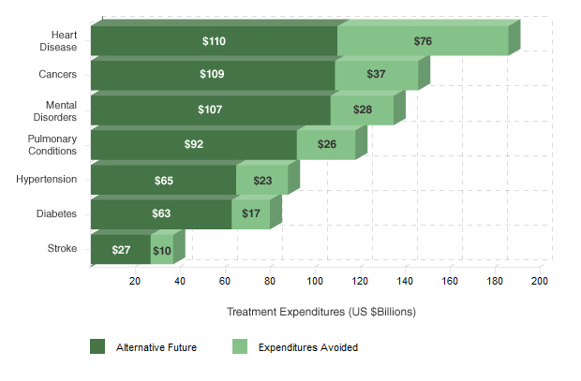
Copyright Milken Institute
Background – Chronic Diseases in the US → Cost Breakdown
Avoidable treatment expenditure (2023 projections)

Slide 7
Background – Population Health Management → Definition
Population health has been defined as “the health outcomes of a group of individuals, including the distribution of such outcomes within the group”.
The population health improvement model highlights three components: (1) the central care delivery and leadership roles of the primary care physician; (2) the critical importance of patient activation, involvement and personal responsibility; and (3) the patient focus and capacity expansion of care coordination provided through wellness, disease and chronic care management programs.
To accomplish all of this, a provider organization must supply proactive preventive and chronic care to all of a provider’s patients, both during and between encounters with the healthcare system. This requires providers to maintain regular contact with patients and support their efforts to manage their own health. At the same time, care managers must manage high-risk patients to prevent them from becoming unhealthier and developing complications.
AHRQ → “practice-based population health (PBPH) is an approach to care that uses information on a group of patients within a primary care practice or group of practices to improve the care and clinical outcomes of patients within that practice.”

Slide 8
Background – Population Health Management → Triple Aims
Better Health for the Population
Lower Cost Through Improvements
Better Care for the Individuals
Triple Aims developed by the Institute for Healthcare Improvement (IHI)

Slide 9
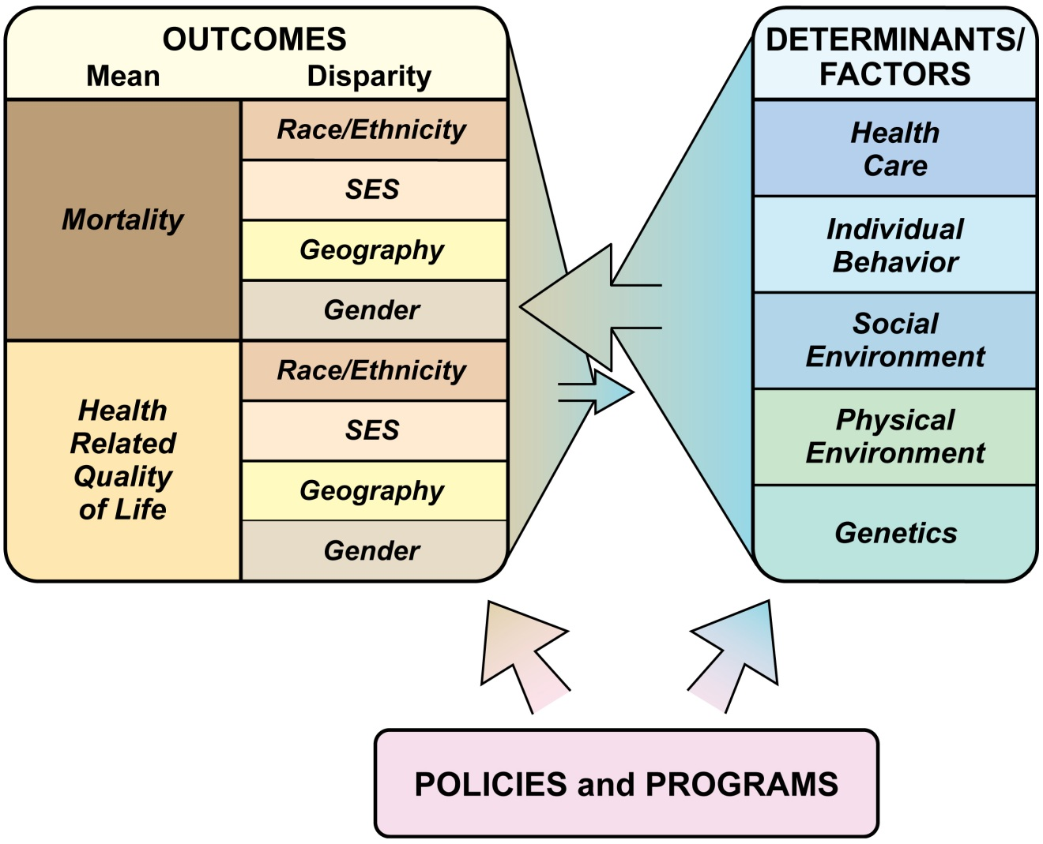
Background – PHM → Conceptual Framework
Conceptual Population Health Framework
Copyright Kindig et.al.

Slide 10
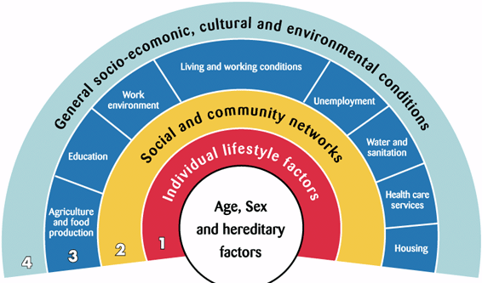
Background – PHM → Conceptual Framework
Copyright Dahlgren et.al.
Conceptual Population Health Framework

Slide 11
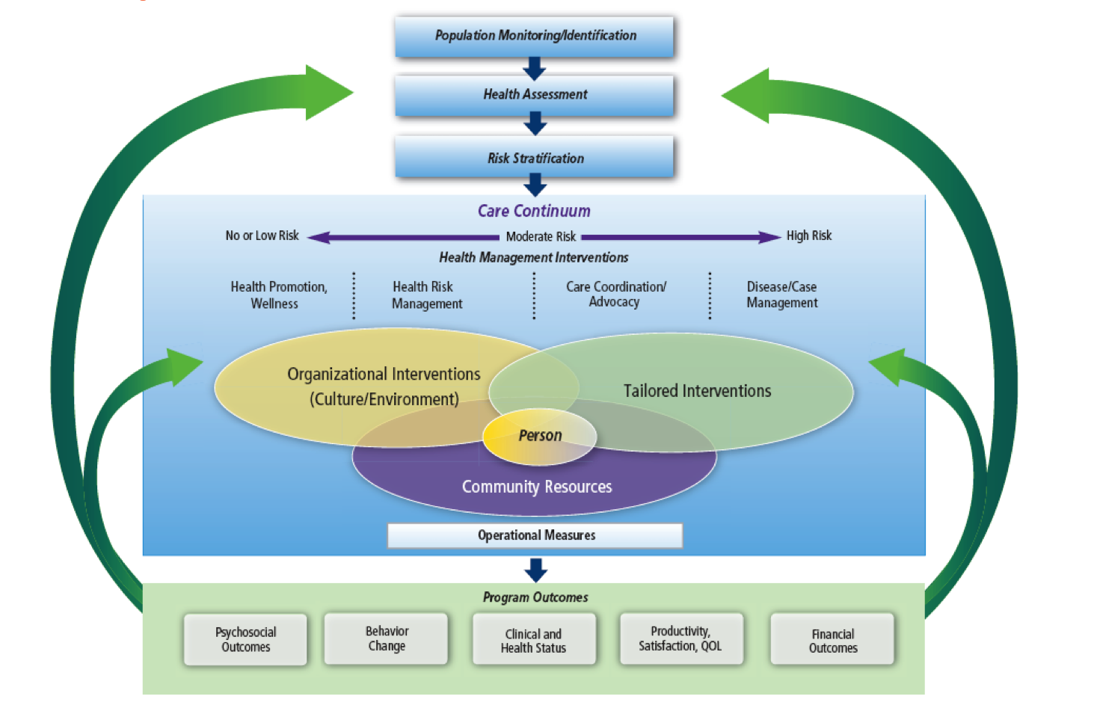
Background – PHM → Management Framework
Copyright Care Continuum Alliance
Risk Stratification and Prediction
Consumer Health Informatics
Patient Monitoring & Tele-Health
Population Health / Disease Management Platforms
Conceptual Population Health Management Framework

Slide 12
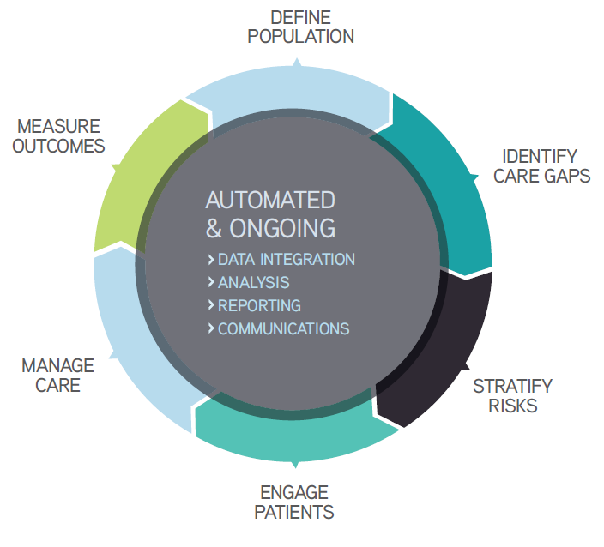
Background – PHM → Management Framework
Copyright iHT²
Population Health / Disease Management Platforms
Patient Monitoring & Tele-Health
Risk Stratification and Prediction
Consumer Health Informatics
Conceptual Population Health Management Framework

Slide 13
Background – PHM → Promise of Health IT
Copyright Hadi Kharrazi
Case Management
Provider # 1
Provider # 2
HIE
Risk Prediction
Care Coordination
Community
Health Records
Private
Businesses
& Web
Patient
Provider
Population
Manager
Or Payer
Public Health
Home Healthcare
EHR
Claims
CPOE
CDSS
Other
ICT (email)
Tele-monitoring
EHR
RIS
LIS
MIS
Registries
Consumer Health Informatics
Inpatient Monitoring
Pat. Safety
CQMs
Surveillance
Systems
Information Seeking
PHR and Patient Portals
Syndromic Surveillance
Bio-Surveillance
Educational & Social Networking
Self-management (behavioral change)
mHealth
Population health stakeholders and health IT platforms/tools

Slide 14
Background – PHM → Role of Consumer Health Informatics
Biomedical informatics methods, techniques, and theories
Basic Research
Population
HIT
Bioinformatics
Public Health
Informatics
Applied Research
Imaging
Informatics
Clinical
Informatics
Consumer Health
Informatics
Molecular Research
Health Research
Population Health Informatics as an emerging domain

Slide 15
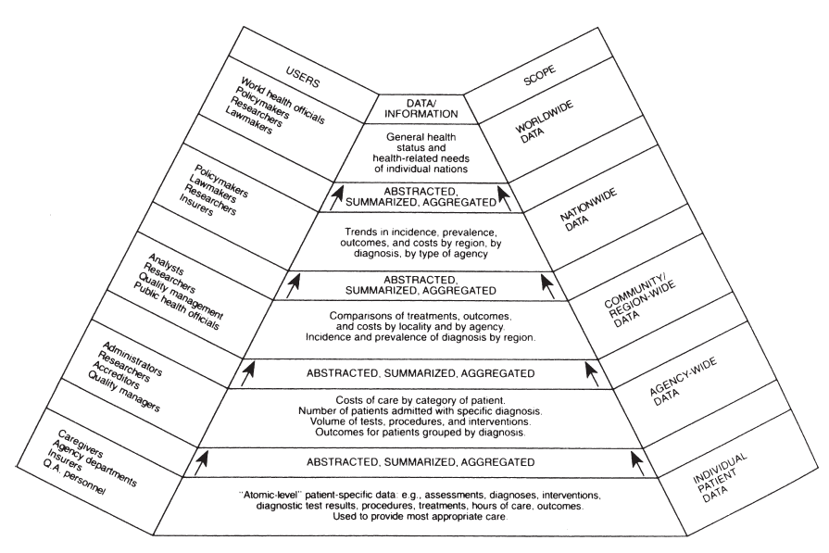
Background – PHM → Atomic Patient Level Data to Public Health
Examples of uses for atomic-level patient data collected once but used many times.

Slide 16
Consumer Health Informatics
(Concepts and Use Cases)

Slide 17
Consumer Health Information (CHI) – Concept & Definition
Concept of Consumer Health Informatics (CHI): CHI is the intersection of Health Information (HI) and Health Education (HE)
Health information consumer is “a person who seeks information about health promotion, disease prevention, treatment of specific conditions, and management of various health conditions and chronic illnesses” (AMIA CHI WG).
CHI definitions:
  “CHI is the study of development and implementation of computer and telecommunication applications and interfaces designed to be used by health consumers” (US GAO).
  “CHI is the use of modern computers and telecommunications to support consumers in obtaining information, analyzing their unique health care needs and helping them make decisions about their own health” (Academic)
CHI focuses on: (1) consumer needs and preference → customization of information; (2) consumer behavior → integration of behavior change models; (3) target wellness in addition to chronic diseases / modifiable risks → healthy users (exercise, diet, travel, outbreaks and others).

Slide 18

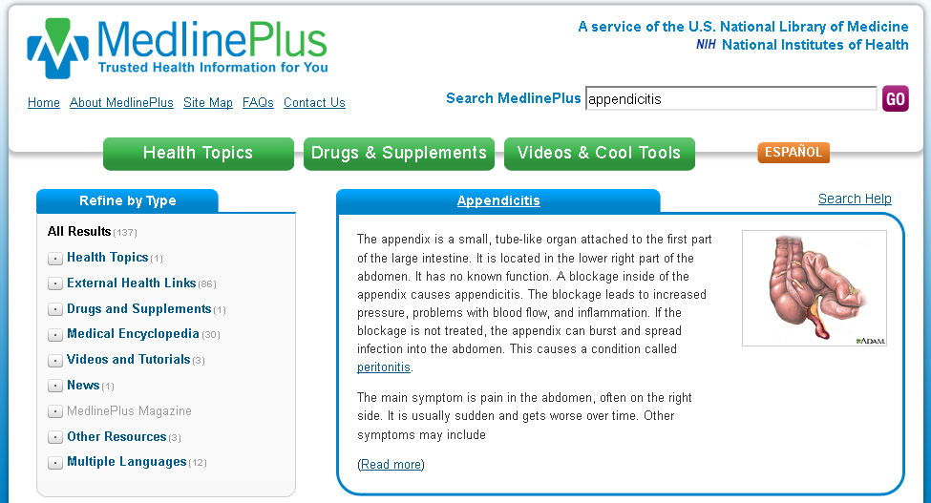
CHI – Systems → Information Seeking
webmd.com & medlineplus.com
Consumer Health Information Seeking Behavior (>80% of population) → Health Promotion Strategies
Notes:
kilobyte (kB)
megabyte (MB)
gigabyte (GB)
terabyte (TB)
petabyte (PB)
exabyte (EB)
zettabyte (ZB)
yottabyte (YB)

Slide 19
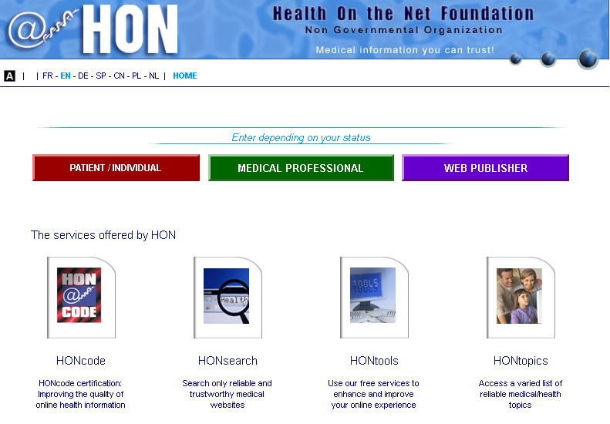
CHI – Systems → Information Seeking (cont.)
hon.ch
Validation of Healthcare Information on the Web
Notes:
kilobyte (kB)
megabyte (MB)
gigabyte (GB)
terabyte (TB)
petabyte (PB)
exabyte (EB)
zettabyte (ZB)
yottabyte (YB)

Slide 20

CHI – Systems → Information Seeking (cont.) → Definitions and Measures
http://chirr.nlm.nih.gov/definition.php
Consumer Health Information Seeking Definitions and Measures
Notes:
kilobyte (kB)
megabyte (MB)
gigabyte (GB)
terabyte (TB)
petabyte (PB)
exabyte (EB)
zettabyte (ZB)
yottabyte (YB)

Slide 21
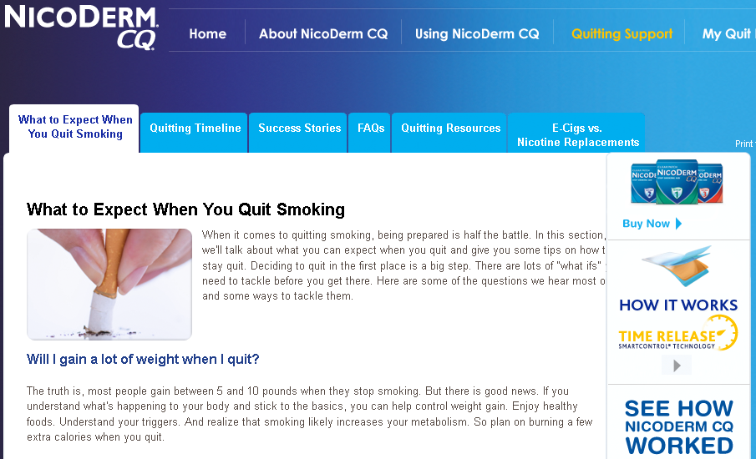
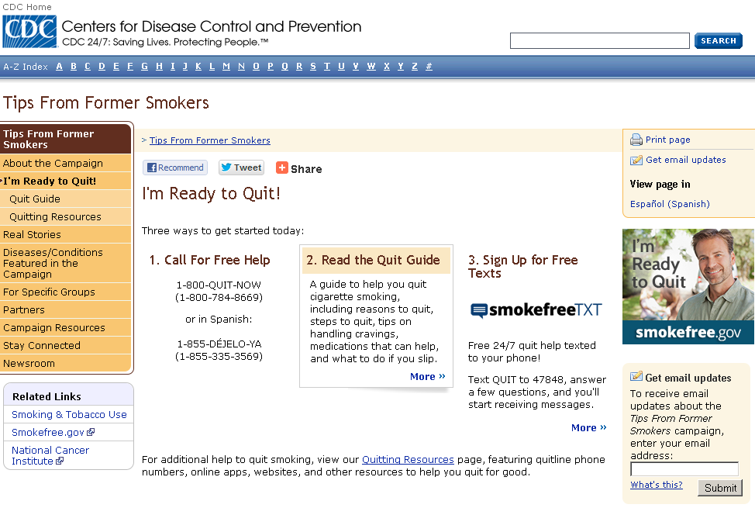

CHI – Systems → Education
Various educational sites for smoking cessation (federal, state and commercial)
Notes:
kilobyte (kB)
megabyte (MB)
gigabyte (GB)
terabyte (TB)
petabyte (PB)
exabyte (EB)
zettabyte (ZB)
yottabyte (YB)

Slide 22
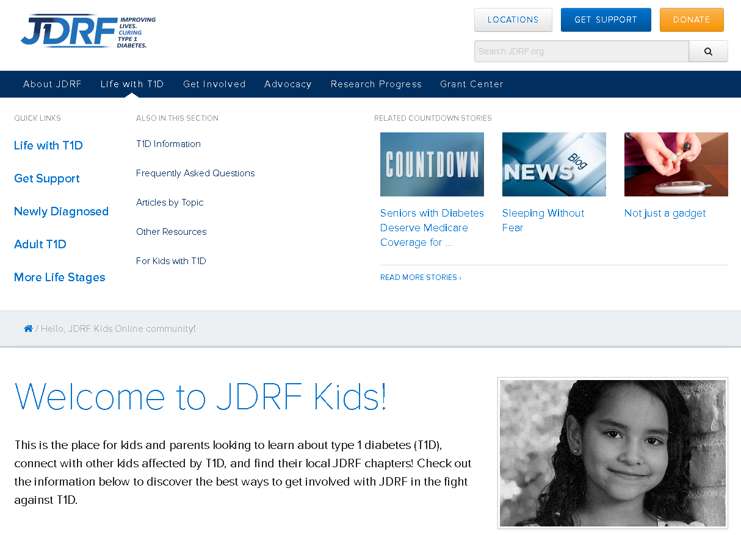
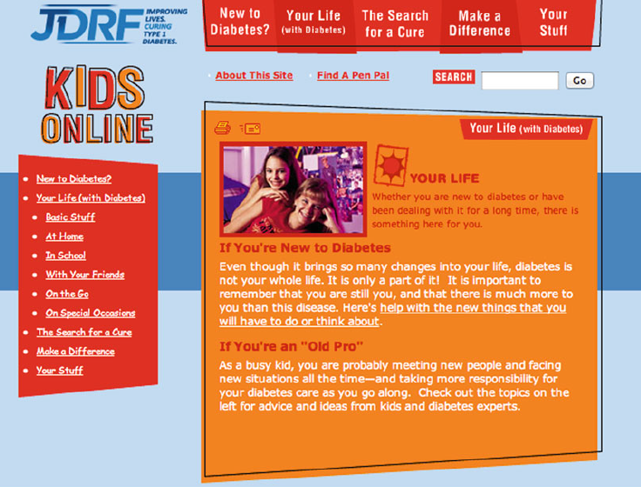
CHI – Systems → Education (cont.)
http://jdrf.org/hello-jdrf-kids-online-community/
Customization of health data based on age and other demographic data (human computer interaction issues)
Notes:
kilobyte (kB)
megabyte (MB)
gigabyte (GB)
terabyte (TB)
petabyte (PB)
exabyte (EB)
zettabyte (ZB)
yottabyte (YB)

Slide 23
CHI – Systems → Personal Health Records (PHRs) → Definition
Definition: “A personal health record, or PHR, is a health record where health data and information related to the care of a patient is maintained by the patient.”
Main questions:
  Who owns the data? Who controls the data?
  How confidentiality and security will be handled in a PHR system?
  Who will pay for the record? What is the business model? Federal funding/incentives or Health Record Banking?
  Should we have a national PHR system?
  Who can access the PHR data?
  How to resolve conflict of patient-entered data with provider-entered data?

Slide 24
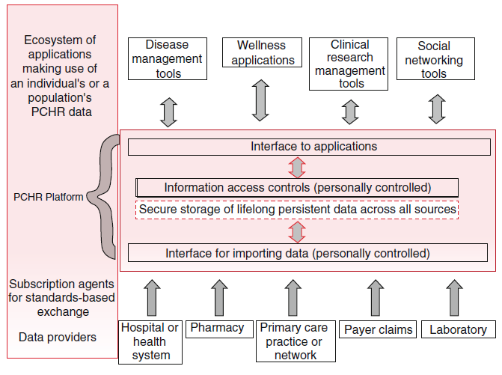
CHI – Systems → PHRs → Architecture / Data Connections
Copyright K. Johnson
An architecture for a personally controlled health record system (PCHR). The PCHR has a secure repository of data with subsequent accesses controlled by the patient or her proxy.
Notes:
kilobyte (kB)
megabyte (MB)
gigabyte (GB)
terabyte (TB)
petabyte (PB)
exabyte (EB)
zettabyte (ZB)
yottabyte (YB)

Slide 25


CHI – Systems → PHR → Integrated Patient Portals
myopennotes.org
Integrated Patient Portals (e.g., across multiple providers)
Notes:
kilobyte (kB)
megabyte (MB)
gigabyte (GB)
terabyte (TB)
petabyte (PB)
exabyte (EB)
zettabyte (ZB)
yottabyte (YB)

Slide 26

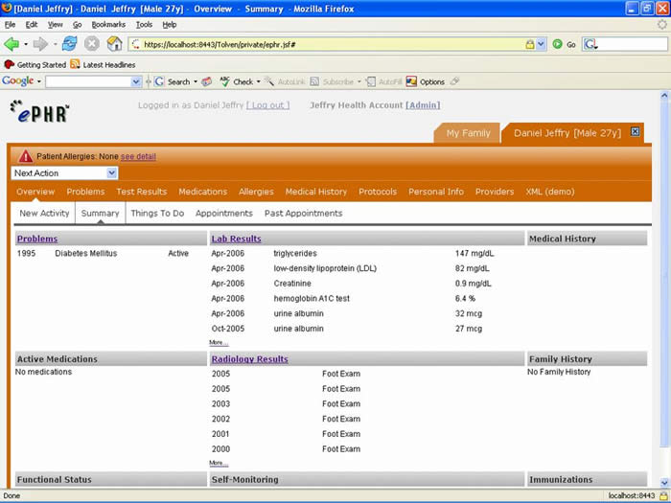


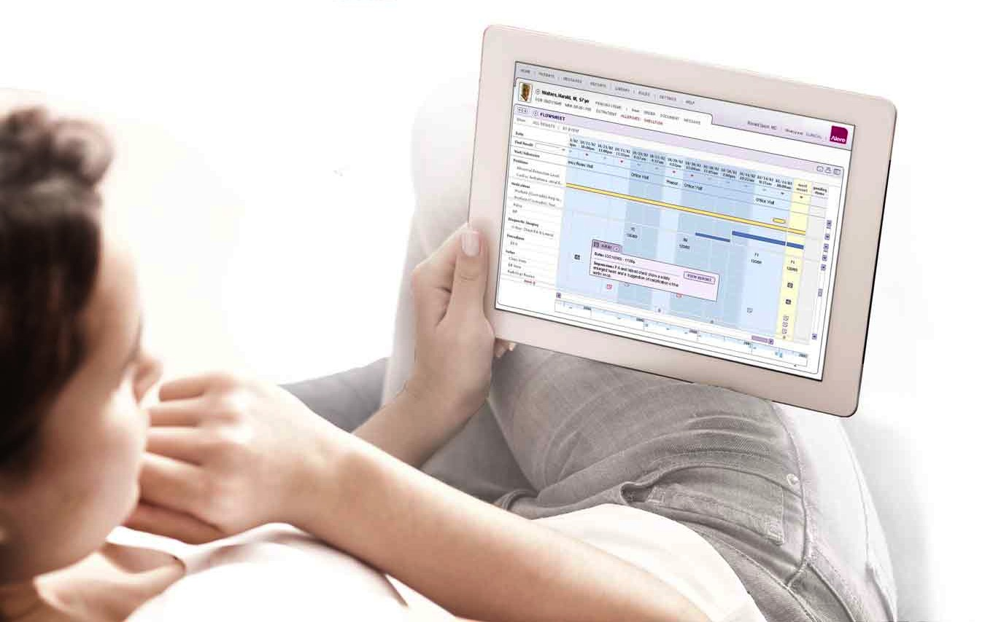
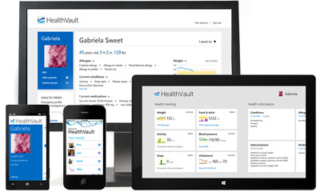
CHI – Systems → PHR → Advanced PHRs
myphr.com
Sample Personal Health Records (PHRs)
Notes:
kilobyte (kB)
megabyte (MB)
gigabyte (GB)
terabyte (TB)
petabyte (PB)
exabyte (EB)
zettabyte (ZB)
yottabyte (YB)

Slide 27
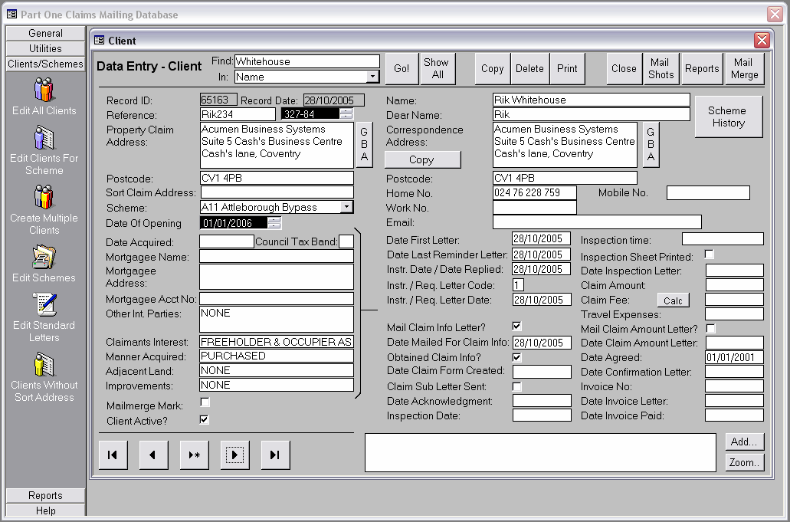

CHI – Systems → PHR → Patient Decision Support Systems
PHR-based DSS
Notes:
kilobyte (kB)
megabyte (MB)
gigabyte (GB)
terabyte (TB)
petabyte (PB)
exabyte (EB)
zettabyte (ZB)
yottabyte (YB)

Slide 28
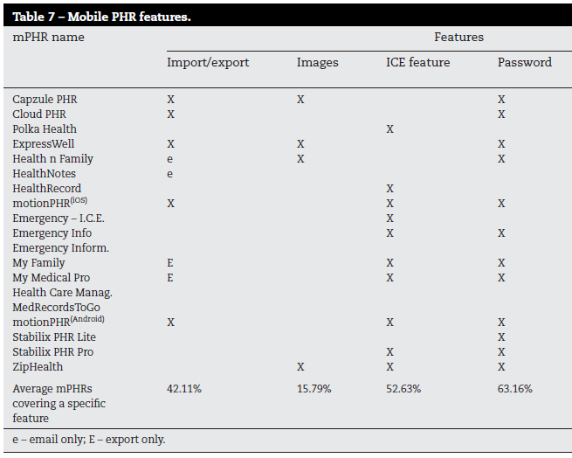
CHI – Systems → PHR → mobile PHRs
Copyright Hadi Kharrazi
Features of mobile PHRs
Notes:
kilobyte (kB)
megabyte (MB)
gigabyte (GB)
terabyte (TB)
petabyte (PB)
exabyte (EB)
zettabyte (ZB)
yottabyte (YB)

Slide 29
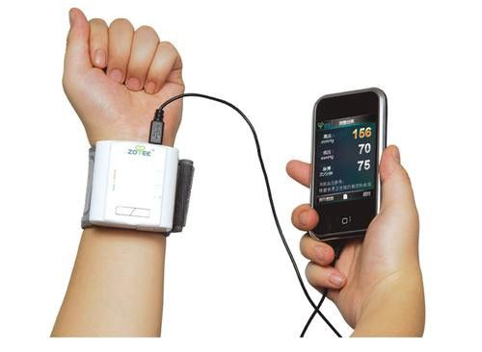
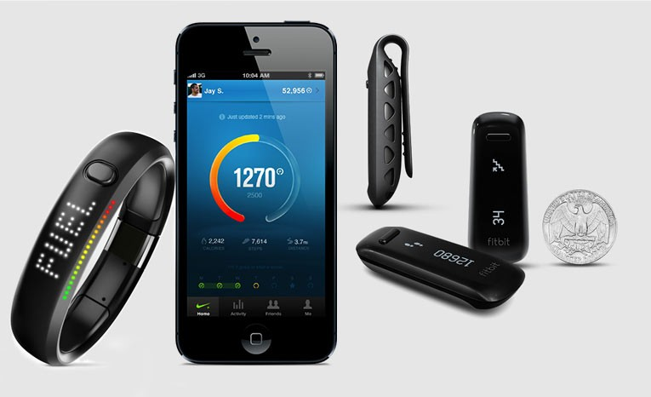

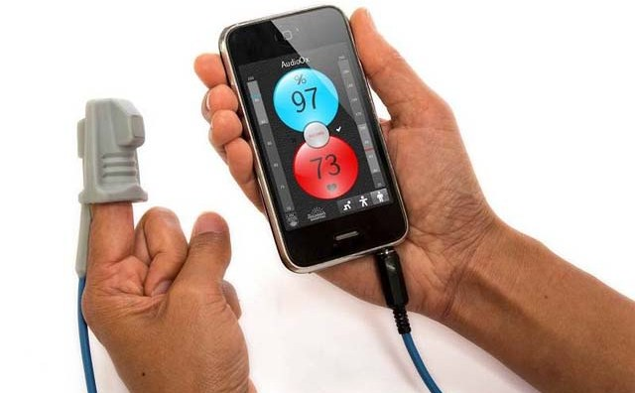
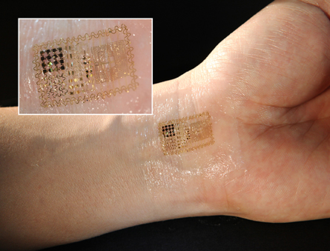
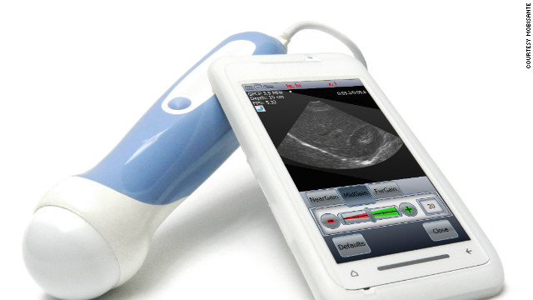
CHI – Systems → mHealth → Wearables
mHealth (mobile health)
Notes:
kilobyte (kB)
megabyte (MB)
gigabyte (GB)
terabyte (TB)
petabyte (PB)
exabyte (EB)
zettabyte (ZB)
yottabyte (YB)

Slide 30
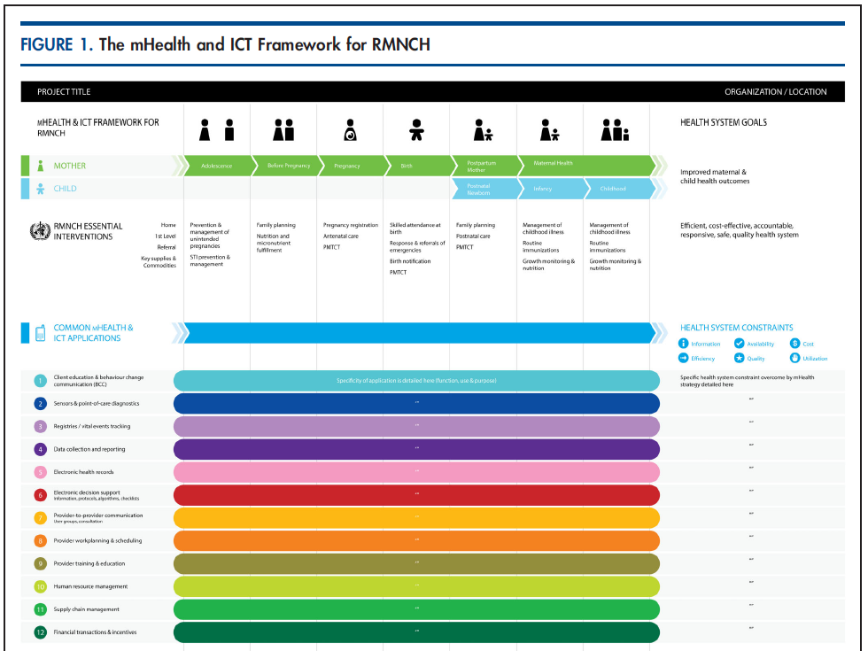
CHI – Systems → mHealth → Conceptual Models for Specific Domains
Copyright A. Labrique
The mHealth and ICT Framework for reproductive, maternal, newborn, and child health
Notes:
kilobyte (kB)
megabyte (MB)
gigabyte (GB)
terabyte (TB)
petabyte (PB)
exabyte (EB)
zettabyte (ZB)
yottabyte (YB)

Slide 31

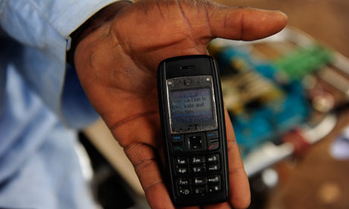
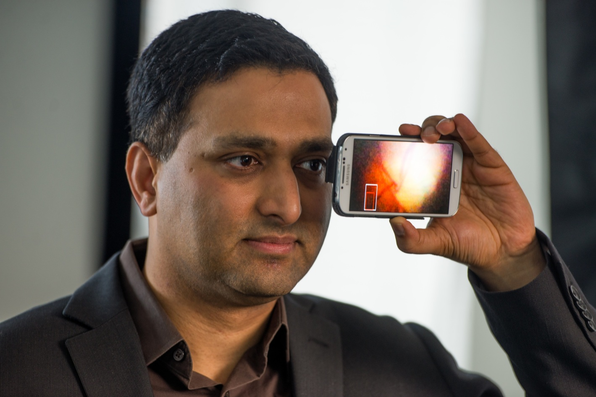
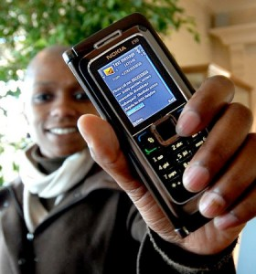
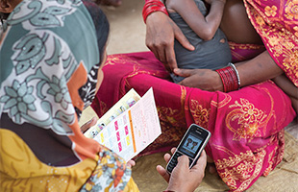
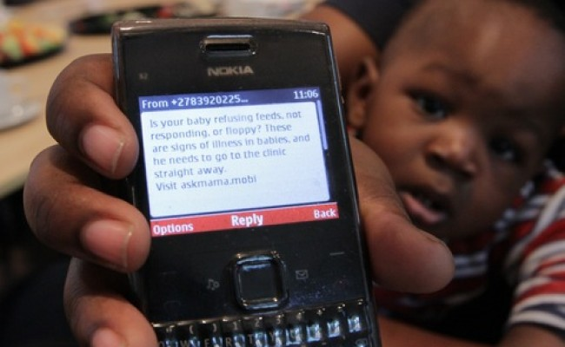
CHI – Systems → mHealth → Developing Countries
Copyright A. Labrique
jhumhealth.org
mHealth application in developing countries
Notes:
kilobyte (kB)
megabyte (MB)
gigabyte (GB)
terabyte (TB)
petabyte (PB)
exabyte (EB)
zettabyte (ZB)
yottabyte (YB)

Slide 32
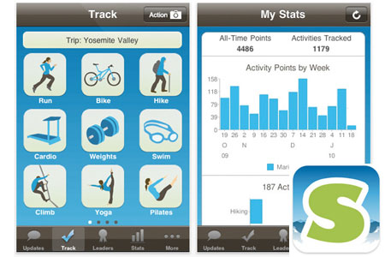
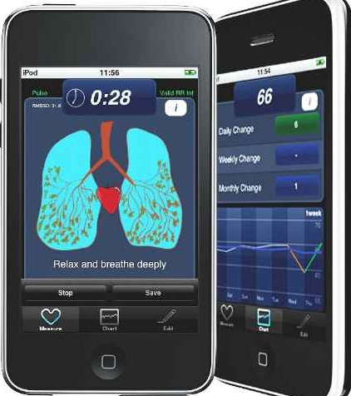

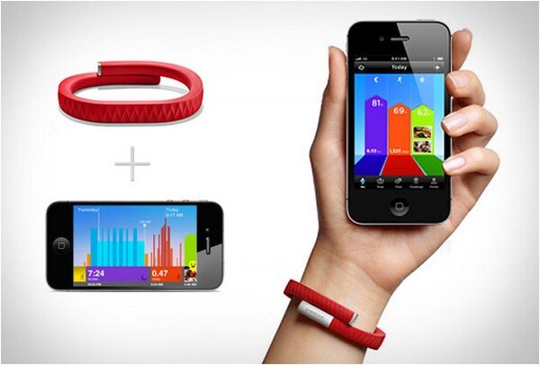
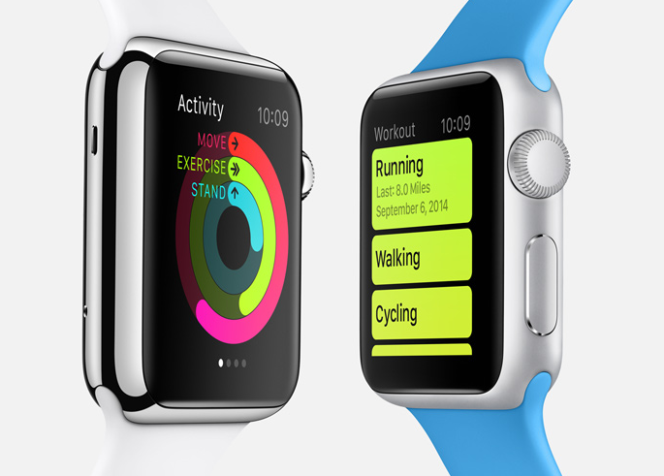
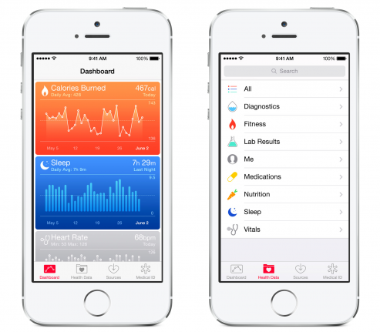
CHI – Systems → mHealth → Developed Countries
Copyright A. Labrique
mHealth application in developed countries (wellness and remote monitoring)
Notes:
kilobyte (kB)
megabyte (MB)
gigabyte (GB)
terabyte (TB)
petabyte (PB)
exabyte (EB)
zettabyte (ZB)
yottabyte (YB)

Slide 33
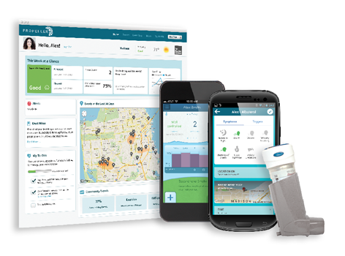
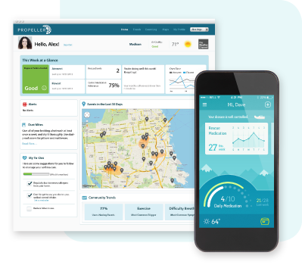
CHI – Systems → mHealth → Disease Management and Public Health
Track your asthma attacks
And then shared it with your community
Copyright propellerhealth.com

Slide 34
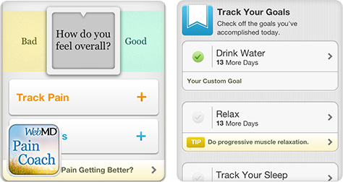
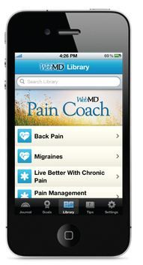
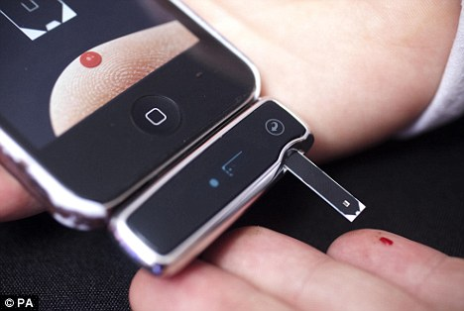
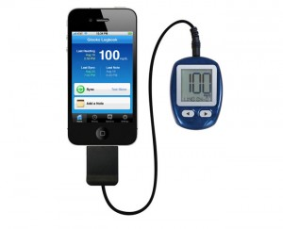
CHI – Systems → mHealth → Disease Management and Chronic Diseases
Disease Self-Management (e.g., pain and diabetes)

Slide 35
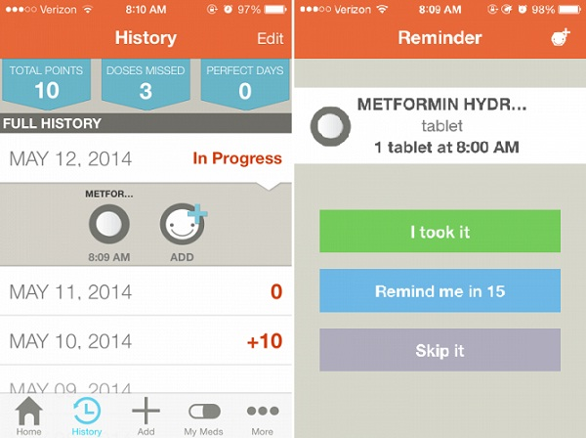
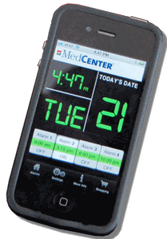

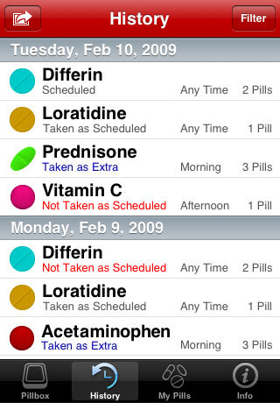

CHI – Systems → mHealth → Disease Management and Medication Adherence
Medication Adherence

Slide 36
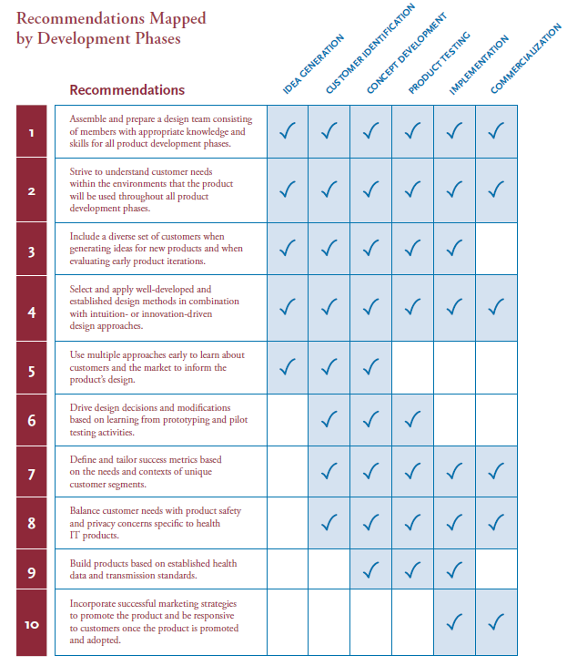

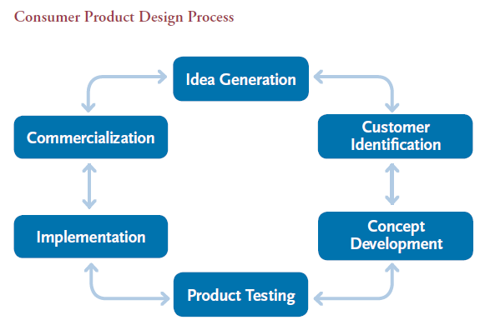
CHI → mHealth → Guidelines
AHRQ Design and Development Guidelines
Notes:
kilobyte (kB)
megabyte (MB)
gigabyte (GB)
terabyte (TB)
petabyte (PB)
exabyte (EB)
zettabyte (ZB)
yottabyte (YB)

Slide 37
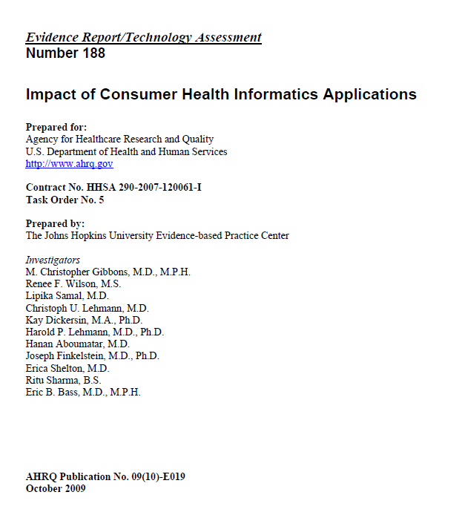
CHI – Systems → mHealth → Impact
AHRQ – Evidence of Consumer Health Informatics Applications
Notes:
kilobyte (kB)
megabyte (MB)
gigabyte (GB)
terabyte (TB)
petabyte (PB)
exabyte (EB)
zettabyte (ZB)
yottabyte (YB)

Slide 38
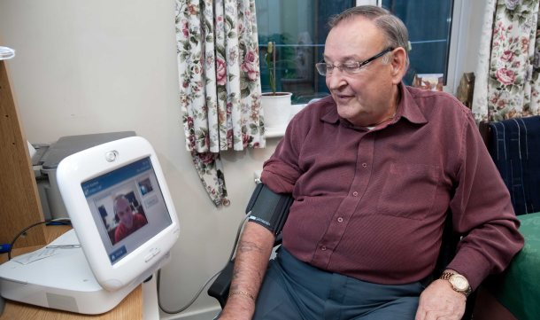

CHI – Systems → mHealth → Tele-health
Tele-Health / Tele-medicine
Notes:
kilobyte (kB)
megabyte (MB)
gigabyte (GB)
terabyte (TB)
petabyte (PB)
exabyte (EB)
zettabyte (ZB)
yottabyte (YB)

Slide 39

CHI – Systems → Public Health → Consumer Health Maps
healthmaps.org
Consumer Surveillance Tools (e.g., Health Maps)
Notes:
kilobyte (kB)
megabyte (MB)
gigabyte (GB)
terabyte (TB)
petabyte (PB)
exabyte (EB)
zettabyte (ZB)
yottabyte (YB)

Slide 40



CHI – Systems → Public Health (cont.)
Consumer-oriented Biosurveillance Tools
Notes:
kilobyte (kB)
megabyte (MB)
gigabyte (GB)
terabyte (TB)
petabyte (PB)
exabyte (EB)
zettabyte (ZB)
yottabyte (YB)

Slide 41
Consumer Health Informatics
(Health Games)

Slide 42
CHI – Systems → Health Games
Health games are interactive applications that can motivate users to actively engage about their healthcare.
Health games can be specialized in one of the following domains:
  medical training (virtual reality games)
  health education (health edugames)
  psychological therapy (behavioral change/self-care games/coach games)
  physical rehabilitation (exergames)
  cognitive rehabilitation (memory games)
  stress relief (distraction games)
Notes:
kilobyte (kB)
megabyte (MB)
gigabyte (GB)
terabyte (TB)
petabyte (PB)
exabyte (EB)
zettabyte (ZB)
yottabyte (YB)

Slide 43








CHI – Systems → Health Games (cont.)
gamesforhealth.org / healthgamesresearch.org
Sample Health Games
Notes:
kilobyte (kB)
megabyte (MB)
gigabyte (GB)
terabyte (TB)
petabyte (PB)
exabyte (EB)
zettabyte (ZB)
yottabyte (YB)

Slide 44

CHI – Systems → Health Games (cont.)
Scoping Review of Health Games - distribution of health game categories
Notes:
kilobyte (kB)
megabyte (MB)
gigabyte (GB)
terabyte (TB)
petabyte (PB)
exabyte (EB)
zettabyte (ZB)
yottabyte (YB)

Slide 45

CHI – Systems → Health Games (cont.)
Scoping Review of Health Games - number of publications per clinical context
Notes:
kilobyte (kB)
megabyte (MB)
gigabyte (GB)
terabyte (TB)
petabyte (PB)
exabyte (EB)
zettabyte (ZB)
yottabyte (YB)

Slide 46



CHI – Systems → Health Games (cont.)
gamesforhealth.org / healthgamesresearch.org
Health Games Resources
Notes:
kilobyte (kB)
megabyte (MB)
gigabyte (GB)
terabyte (TB)
petabyte (PB)
exabyte (EB)
zettabyte (ZB)
yottabyte (YB)

Slide 47
Behavioral Change Models

Slide 48

CHI – Behavioral Change Models (BCM) → Levels
Behavioral change models of psychology are categorized as: Individual (HBM, TPB, SCM), Interpersonal and Community.
Notes:
kilobyte (kB)
megabyte (MB)
gigabyte (GB)
terabyte (TB)
petabyte (PB)
exabyte (EB)
zettabyte (ZB)
yottabyte (YB)

Slide 49
CHI – BCM → Levels (cont.)
Diffusion of Innovations
Organizational Change
Community Level
Social Learning Theory
Interpersonal
Social Marketing Precede-Proceed
Individual
Health Belief Model
Stages of Changes Model
Consumer Info-Processing
Theory of Planned Behavior
The Behavior Modification Inverse Pyramid
Notes:
kilobyte (kB)
megabyte (MB)
gigabyte (GB)
terabyte (TB)
petabyte (PB)
exabyte (EB)
zettabyte (ZB)
yottabyte (YB)

Slide 50
CHI – BCM → Health Belief Model
INDIVIDUAL
PERCEPTIONS
MODIFYING FACTORS
LIKELIHOOD
OF ACTION
Socio-demographics: age, gender, duration, etc
Perceived benefit
Perceived barriers
Perceived Susceptibility
Perceived Threat
Intention to Take Action
Self-efficacy
Cues to Action
Health Belief Model
Notes:
kilobyte (kB)
megabyte (MB)
gigabyte (GB)
terabyte (TB)
petabyte (PB)
exabyte (EB)
zettabyte (ZB)
yottabyte (YB)

Slide 51
CHI – BCM → Stages of Changes Model
Stages of Changes Model
Notes:
kilobyte (kB)
megabyte (MB)
gigabyte (GB)
terabyte (TB)
petabyte (PB)
exabyte (EB)
zettabyte (ZB)
yottabyte (YB)

Slide 52
CHI – BCM → Theory of Planned Behavioral
Theory of Planned Behavioral
Notes:
kilobyte (kB)
megabyte (MB)
gigabyte (GB)
terabyte (TB)
petabyte (PB)
exabyte (EB)
zettabyte (ZB)
yottabyte (YB)

Slide 53
Additional Resources

Slide 54

Resources – Books
Title | Consumer Health Informatics
Authors | Debora Lewis
Year | 2005
Hardcover | 258 pages
Publisher | Springer
Language | English
ISBN | 038723991X

Slide 55

Resources – Books (cont.)
Title | Biomedical informatics: Computer Applications in HealthCare and Biomedicine.
Authors | Shortliffe, E.H. and Cimino, J.J (eds)
Year | 2006
Hardcover | 1024 pages
Publisher | Springer; 3rd edition (May 15, 2006)
Language | English
ISBN | 0387289860

Slide 56
Resources – Web
Associations:
  AMIA (American Medical Information Association): www.amia.org
  IMIA (International Medical Information Association): www.imia-medinfo.org
  HIMSS (Healthcare Information and Management Systems Society): www.himss.org
  Academy Health (HIT Interest Group): www.academyhealth.org
Government and Non-for-profit:
  ONC: www.healthit.gov
  CMS MU: www.cms.gov/Regulations-and-Guidance/Legislation/EHRIncentivePrograms
  HL7: hl7.org
Journals:
  JAMIA (Journal of AMIA): jamia.bmj.com
  JMIR (Journal of Medical Internet Research): www.jmir.org
  IJMI (International Journal of Medical Informatics): www.ijmijournal.com
  HIJ (Health Informatics Journal): jhi.sagepub.com
  ACI (Applied Clinical Informatics): aci.schattauer.de

Slide 57

Resources – Web (cont.)
  AMIA (American Medical Information Association): www.amia.org

Slide 58
Summary
Background
  Chronic Diseases
  Population Health Management
  Promise of Health IT
Consumer Health Informatics Solutions
  Concept and Definitions
  Categories and Sample Systems
  Behavioral Change Models
Resources
  Books
  Web

