Slide 1
Clinical Decision Support Systems & Population Health Analytic
Summer Institute / HIT Series
Hadi Kharrazi MHI MD PhD
kharrazi@jhu.edu
Johns Hopkins University
⬥ School of Public Health
⬥ School of Medicine
2 hrs / ~100 slides

Slide 2
Overview
CDSS Overview
CDSS Design to Implementation
Knowledge Management
  Acquisition
  Generation
  Representation
  Guidelines
  Integration
Case Studies
  Indiana (Regenstrief)
  Vanderbilt
  Harvard (BWI)
  Utah (Intermountain)
CDSS in Practice
  Diagnostic DSS
  Patient DSS
  Population DSS
CDSS Legal
Resources
  Books
  Web

Slide 3
CDSS Overview

Slide 4
CDSS Overview → Reasoning
Deduction
Deductive reasoning is based on the principles of logical implication. It allows us to infer conclusions, the degree of truth of which is only a function of the degree of truth of the premises. The results of logical inference may be used as a premise for further deductions. Thus, if A implies B and if B implies C, then, via transitivity, A implies C.
Induction
Inductive reasoning makes generalizations based on specific examples to formulate general rules. Inductive reasoning produces inferences that are valid to a certain degree of credibility or probability.
Abduction
Abductive reasoning is referred to as the scientific method. It attempts to establish links between observations such as cause and effect. Hypotheses may help formulate a rule to establish a link between the preceding and subsequent facts (e.g., a diagnosis hypothesis), or they may concern the formulation of a new rule (e.g., a scientific discovery).

Slide 5
CDSS Overview → Reasoning (cont.)
Deduction
Induction
Abduction
Premise,
pre-existing fact
Premise,
pre-existing fact
Premise,
pre-existing fact
?
Logical Rule
Rule, Law
Rule, Law
?
?
?
Conclusion, resulting fact
Conclusion, resulting fact
Conclusion, resulting fact
Different types of reasoning

Slide 6
CDSS Overview → Steps in Medical Decision
Identify the Problem
Diagnostic decisions begin with the primary interpretation of clinical data. Abductive reasoning is used.
Structure the Problem
Several interpretations of the same data or parts of that data are possible. Diagnostic hypotheses are formulated by structuring the information. Reasoning may be deductive (e.g., for a pathognomonic sign), inductive (e.g., diagnosing a transmissive disease in a population of subjects at risk), or abductive.
Choose the Solution
Starting from a number of working hypotheses, the expected signs and symptoms may be obtained by deduction and, if necessary, by the complementary examinations required to obtain them. By induction and/or abduction, the physician may eliminate hypotheses that do not correspond to the observations. The results of complementary examinations may help to reduce the uncertainty over the clinical situation and eliminate hypotheses or solicit new ones.

Slide 7
CDSS Overview → Steps in Medical Decision (cont.)
Identify
the problem
Possible alternatives
Possible patient states
Clinical information that cannot be obtained
Structure
the problem
Develop a strategy
Account for frequency of diseases
Search for pertinent data
Choose
the solution
Comparative evaluation of different hypothesis
Synthesis and choice
Structure of the decision-making process

Slide 8
CDSS Overview → History of CDSS
Definition: Computer-based clinical decision support (CDSS) can be defined as the use of the computer to bring relevant knowledge to bear on the health care and well being of a patient.
Efforts to automate aspects of health care began in earnest as far back as the early 1960s. CDSS has been more a research pursuit than a practical one.
Common types of decision support → recognizing that a laboratory test result is out of normal range; a medication being ordered has a dangerous interaction with another; determining that a patient is now due for a flu shot.
Transition from academic settings into the commercial application has been slow and harder than expected
Relationship between CDSS and healthcare providers has gone through different phases – health informatics maturation.

Slide 9
CDSS Overview → History of CDSS (cont.)
Relationship between computers as source of clinical decision support
and providers and recipients of health care

Slide 10
CDSS Overview → History of CDSS (cont.)
Necessity of CDSS:
  Demand for prevention has increased due to the rise in medical error (Institute of Medicine report → To Err Is Human)
  Computer-based physician order entry (CPOE) systems, coupled with CDSS, have been proposed as a key element of systems’ approaches to improving patient safety.
  CDSS have the potential to change the way medicine has been taught and practiced.
Features of CDSS:
  Aim: make data available, optimize problem-solving and decision making
  User: provide it to a healthcare provider or scientist
  Data: select knowledge that is pertinent, and/or to process data to create the pertinent knowledge
  Engine: carry out some sort of inferencing process, algorithm, rule, or association
  Action: perform some action, usually to make a recommendation

Slide 11
CDSS Overview → Components of CDSS
Components of clinical decision support

Slide 12
CDSS Overview → Types of CDSS
A variety of systems can potentially support clinical decisions (e.g. Medline and any literature database)
Decision support systems have been incorporated in healthcare information systems for a long time, but these systems usually have supported retrospective analyses of financial and administrative data.
Although these retrospective approaches can be used to develop guidelines, critical pathways, or protocols to guide decision making at the point of care, such retrospective analyses are not usually considered to be CDSS.
CDSS differ among themselves in: the timing at which they provide support (before, during, or after the clinical decision is made), how active or passive the support is, how easy they are for clinicians to access, and whether the information provided is general or specialty-based, and if it is knowledge based or non-knowledge based.

Slide 13
CDSS Design to Implementation

Slide 14
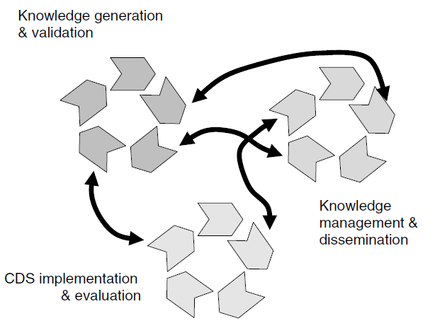
CDSS Design to Implementation
Three intersecting and interacting life cycles underlying clinical decision support systems technology.

Slide 15
CDSS Design to Implementation (cont.)
(1) Knowledge Generation and Validation (KG)
(2) Knowledge Management and Dissemination (KM)
(3) CDSS Implementation and Evaluation (IE)
(1) KG (2) KM (3) IE

Slide 16
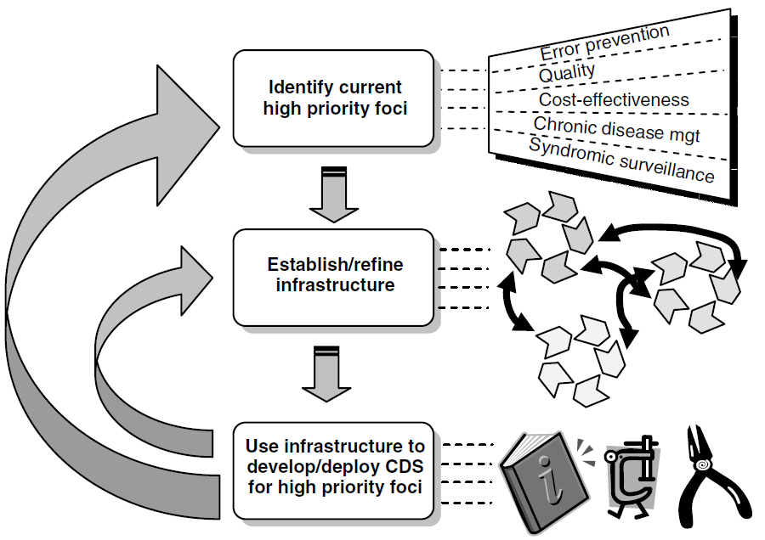
CDSS Design to Implementation (cont.)
The strategy proposed is an iterative one.
A key challenge is to get it started.
Priorities for CDSS are likely to fall into five main areas (top). The three interrelated life cycle processes involved in generation of knowledge, knowledge management, and incorporation into functional CDSS require infrastructure for supporting them (middle). The result of applying these life cycle processes to the priority areas will be knowledge bases and authoring and implementation tools (lower). The whole process iterates as we learn more about how to create infrastructure to support it, and as priorities change.

Slide 17
CDSS Design to Implementation (cont.)
An idealized conceptual model of CDS design components and their
interactions with the host application environment.

Slide 18
Knowledge Management
(Acquisition, Generation, Representation, Integration)

Slide 19
Knowledge Acquisition (KA)

Slide 20
KM → Knowledge Acquisition
The classical view of knowledge engineering (top) vs interactive transfer via a computer model (bottom)

Slide 21
KM → Knowledge Acquisition → Computer Based KA (cont.)
The expert indicates what corrections need to be made and is able to
verify that the revised rule is what was intended

Slide 22
KM → Knowledge Acquisition → Computer Based KA (cont.)
A mixed-initiative knowledge-acquisition dialog between MYCIN and
an infectious disease expert

Slide 23
Knowledge Generation (KG)

Slide 24
KM → Knowledge Generation → Methods for DSS
Decision support systems utilize a broad variety of methods besides simple algorithms. Each of these methods uses particular means of reasoning:
Method | Reasoning | Explanations | Learning
Mathematical models | Algorithmic | No | No
Statistical and Probabilities | Inductive | Limited | Automatically by Induction
Expert Systems | Deductive, Abductive | Yes | Difficult, Supervised
Neural Network | Inductive | No | Supervised or Automatic
Methods for Decision Support Systems

Slide 25
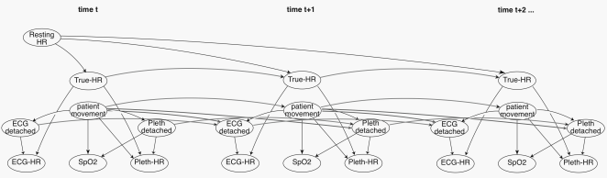
KM → Knowledge Generation → Methods for DSS (cont.)
Decision support models in health care can be: quantitative and qualitative
Quantitative Models: is often based on well-defined statistical methods and makes use of training sets of patient data. Prior probabilities for the occurrence of diseases are generally incorporated into the statistical models.
Qualitative Models: uses features that are generally proposed by experts and that are based on clinical studies. In this category the decision support methods use symbolic reasoning methods such as logical deduction (Boolean logic – If Then)
Some DSS systems may incorporate both models → Bayesian Network (Quantitative and Qualitative).

Slide 26
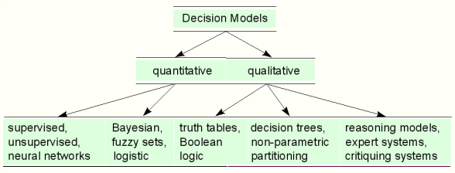
KM → Knowledge Generation → Methods for DSS (cont.)
Decision-support models in health care can be grouped into different categories. The main categories are the quantitative (statistical) and the qualitative (heuristic) decision-support models, which can also be further split into subcategories.

Slide 27
KM → Knowledge Generation → Quantitative Methods for DSS (cont.)
Supervised Learning: In supervised learning the researcher tells the computer the disease or health status of each patient in the training set.
The computer is then asked to order the features according to discriminatory power between disease A and disease B.
Unsupervised Learning: In unsupervised learning the computer is also given the training set of features. However the truth (information on what disease belongs to which patient) is not known.
The computer is then used to discover by what clusters of feature sets the difference disease groups can best be characterized. This process is called clustering.
Disease | Sign A | Sign B | Sign C
A | Yes | No | 5.67
A | No | No | 5.98
B | No | Yes | 7.89
A | Yes | Yes | 5.91
B | No | Yes | 6.72
Disease | Sign A | Sign B | Sign C
? | Yes | No | 5.67
? | No | No | 5.98
? | No | Yes | 7.89
? | Yes | Yes | 5.91
? | No | Yes | 6.72

Slide 28
KM → Knowledge Generation → Supervised Learning Models (cont.)
Classification tree for the bivariate outcome problem. Cases are recursively partitioned according to the attribute-value pair that best divides the cases into ‘‘euthyroid’’ or not. The resulting partitions easily can be visualized in this simplified two dimensional problem.

Slide 29
KM → Knowledge Generation → Supervised Learning Models (cont.)
Computer-Derived Decision Tree for the Classification of
Patients with Acute Chest Pain

Slide 30
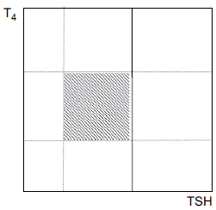
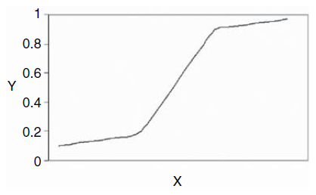
KM → Knowledge Generation → Supervised Learning Models (cont.)
Logistic regression model
Without variable transformation, logistic regression will not work for all cases
because the problem is not linearly separable.

Slide 31
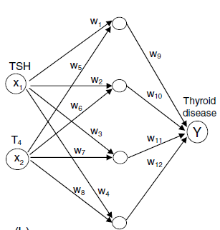
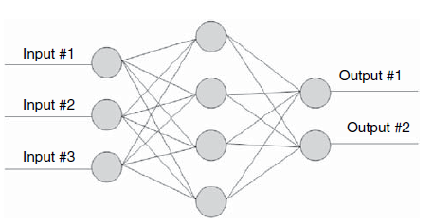
KM → Knowledge Generation → Supervised Learning Models (cont.)
Artificial neural network with a hidden layer of nodes. For didactic purposes, activation functions in this example correspond to step functions that define partitions similar to the ones in the classification tree.

Slide 32
KM → Knowledge Generation → Supervised Learning Models Evaluation (cont.)
Evaluation of Supervised Models
Discrimination assesses how well the models can potentially discriminate positive and negative cases. Area under ROC curve can be used.
Calibration assesses how close the model’s estimated probability is to the ‘‘true’’ underlying probability of the outcome of interest.
  Poor calibration is often caused by limited representation of the population to which models will be applied at the model construction phase
Receiver Operating Characteristic (ROC) Graph
In pattern recognition the goal is to map entities to classes → classification accuracy is compared among methods
Classification → true positive, false positive, true negative, false negative
Sensitivity = TP / TP + FN → TP Rate = sensitivity
Specificity = TN / TN + FP → FP Rate = 1 - specificity

Slide 33
KM → Knowledge Generation → Supervised Learning Models Evaluation (cont.)
Decision Model
 |  | + | -
Truth | + | TP | FN | 100%
 | - | FP | TN | 100%
Relationships between True Positive (TP), True Negative (TN),
False Positive (FP), and False Negative (FN).

Slide 34
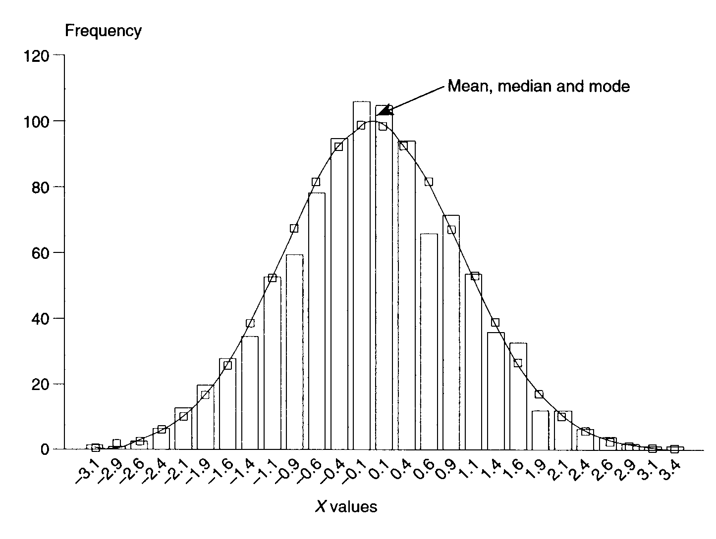
KM → Knowledge Generation → Supervised Learning Models Evaluation (cont.)
Normal distribution + Histogram

Slide 35
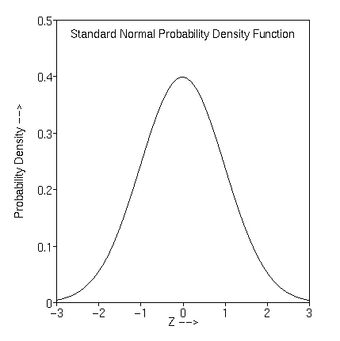
KM → Knowledge Generation → Supervised Learning Models Evaluation (cont.)
Normal Population
True Negative
False Positive
Normal distribution + Normal Population
Example: WBC more than a certain amount means…

Slide 36
KM → Knowledge Generation → Supervised Learning Models Evaluation (cont.)
Disease Population
False Negative
True Positive
Normal distribution + Disease Population
Example: WBC more than a certain amount means…

Slide 37
KM → Knowledge Generation → Supervised Learning Models Evaluation (cont.)
Normal Population
Disease Population
True Negative
True Positive
Ideal test
Example: WBC more than a certain amount is 100% diagnostic of the disease

Slide 38
KM → Knowledge Generation → Supervised Learning Models Evaluation (cont.)
Normal Population
Disease Population
True Negative
True Positive
False Negative
False Positive
Real test
Example: WBC more than a certain amount is somehow diagnostic of the disease

Slide 39
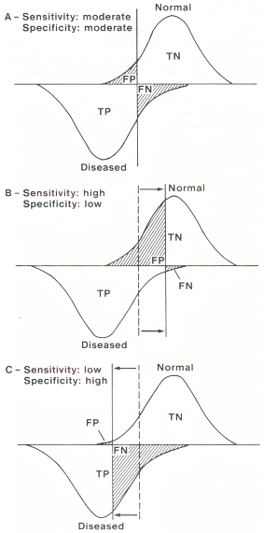
KM → Knowledge Generation → Supervised Learning Models Evaluation (cont.)
Sensitivity = TP/(TP+FN)
Specificity = TN/(FP+TN)
Sensitivity and Specificity

Slide 40
KM → Knowledge Generation → Supervised Learning Models Evaluation (cont.)
Sensitivity = TP/(TP+FN)
Specificity = TN/(FP+TN)
Sensitivity and Specificity

Slide 41
KM → Knowledge Generation → Supervised Learning Models Evaluation (cont.)
Sensitivity = TP/(TP+FN)
Specificity = TN/(FP+TN)
Sensitivity and Specificity

Slide 42
KM → Knowledge Generation → Supervised Learning Models Evaluation (cont.)
Decision Model (Test Outcome)
 |  | + | -
Truth (Gold Standard) | + | a (TP) | b (FN) | a / (a + b) | Sensitivity
 | - | c (FP) | d (TN) | d / (c + d) | Specificity
 |  | a / (a + c) | d / (b + d) | a + b + c + d
 |  | Positive Predictive Value | Negative Predictive Value
FP: Type I error (p-value)
FN: Type II error
Sensitivity and Specificity details

Slide 43
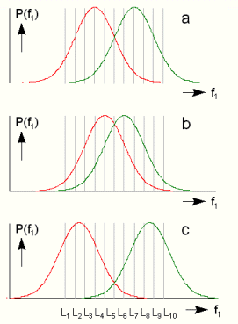
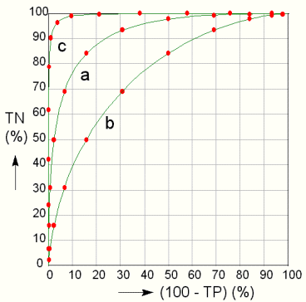
KM → Knowledge Generation → Supervised Learning Models Evaluation (cont.)
Ideal shift
Sensitivity
1-Specificity
ROC Curves of the left diagrams
The Receiver Operating Characteristic (ROC) curve is used to assess the accuracy of a continuous measurement for predicting a binary outcome

Slide 44
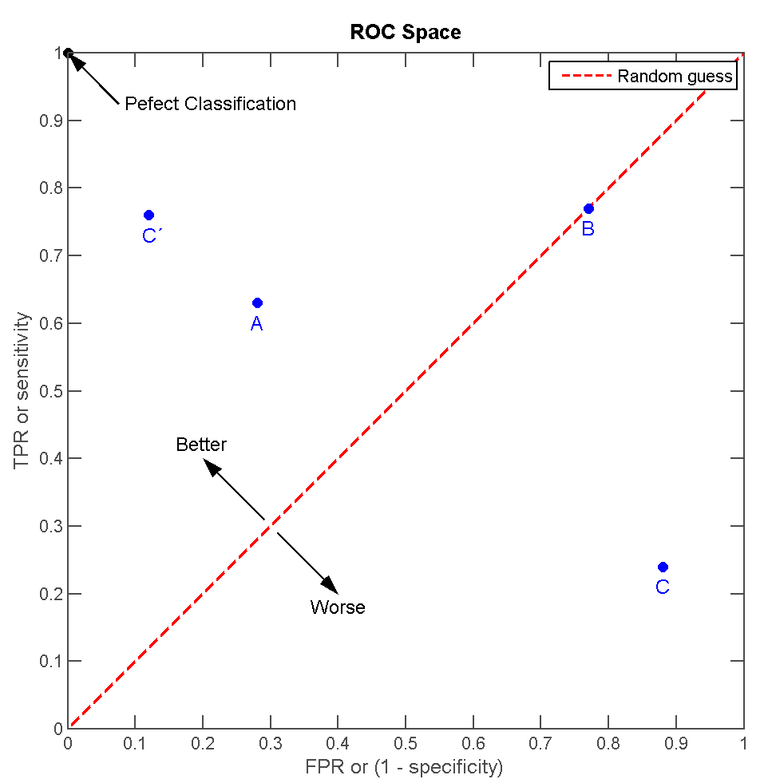
KM → Knowledge Generation → Supervised Learning Models Evaluation (cont.)
The ROC graph is a two-dimensional graph that depicts the trade-offs between benefits (true positive rate) and costs (false positive rate).
Benefit
Liberal
Perfect
Conservative
Poor
No benefit or
Type I error
Cost or Type II error

Slide 45
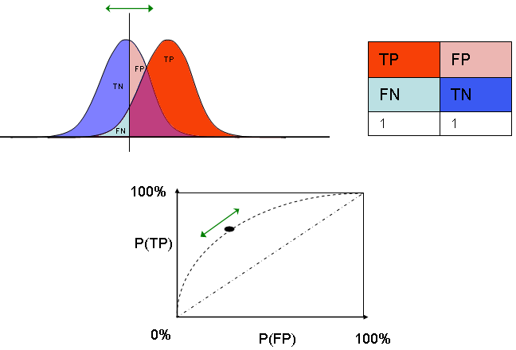
KM → Knowledge Generation → Supervised Learning Models Evaluation (cont.)
Plotting the ROC point for each possible threshold value results in a curve.
See https://sachsmc.shinyapps.io/plotROC for an interactive ROC curve.

Slide 46
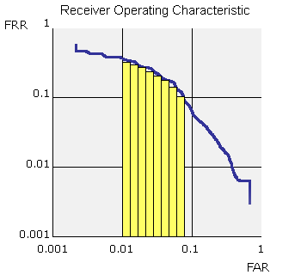
KM → Knowledge Generation → Supervised Learning Models Evaluation (cont.)
The area under the ROC curve (AUC) provides a single statistic (the C-Statistic) for comparing classifiers → accuracy of the classifiers.
The value of AUC ranges from 0.5 (flipping a coin) to 1 (best class). Calculation can be based on trapezoids under the curve.

Slide 47
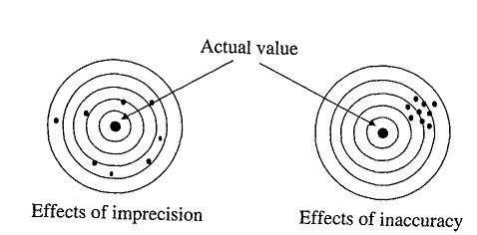
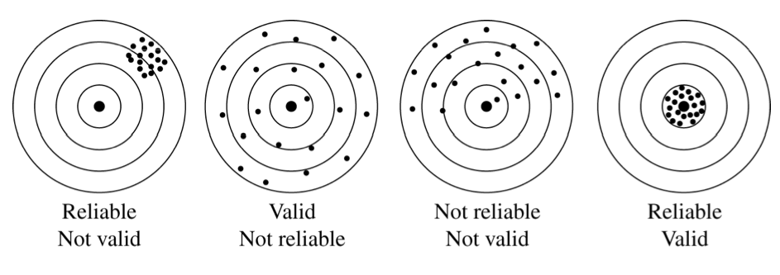
KM → Knowledge Generation → Supervised Learning Models Evaluation (cont.)
Precision (reliability) refers to the fidelity of the measurement; if the measurement is repeated on the same subject, the same result will be obtained.
Accuracy (validity) refers to the tendency of measured values to be symmetrically grouped around the variable's true value.

Slide 48
KM → Knowledge Generation → Unsupervised Learning Models (cont.)
KNN
NN
Nearest neighbor (NN) classifier. There are two classes: A (triangles) and B (diamonds). The circle represents the unknown sample, X. For the NN rule, the nearest neighbor of X comes from class A, so it would be labeled class A. Using the k-NN rule with k = 4, three of the nearest neighbors of sample X come from class B, so it would be labeled as B.

Slide 49
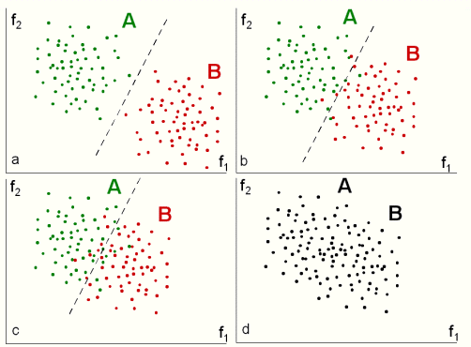
KM → Knowledge Generation → Unsupervised Learning Models (cont.)
Unsupervised Learning (Clustering)

Slide 50
KM → Knowledge Generation → Expert Systems
Knowledge Base
(knowledge rules
provided by experts)
Fact Database
(patient data)
Inference Engine
(software that provides system’s reasoning)
User Interface
(communication software)
General architecture of an expert system

Slide 51
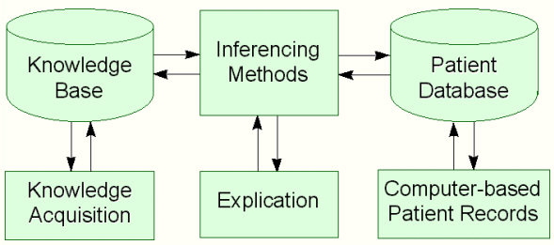
KM → Knowledge Generation → Expert Systems (cont.)
Representation of the elements involved in heuristic reasoning. For inferencing, different strategies can be used: forward reasoning and backward reasoning.

Slide 52
KM → Knowledge Generation → Systematic Review and Meta-Analysis
Evidence-Based Medicine (EBM) → formalizes the principles and methods of reviewing and synthesizing evidence that have been developing over several decades.
Systematic Review (SR): comprehensive, rigorous, and unbiased review and synthesis of up-to-date evidence provides the most reliable information to inform health practice.
Meta-Analysis (MA): a systematic review that uses statistical methods to combine results across several studies to address specific questions
Meta-Analysis Example → A meta-analysis combining 33 studies found a highly statistically significant result of approximately 20 percent reduction of overall mortality by the adoption of streptokinase therapy; however, FDA did not approve its use till two larger studies showed the same results in 1988. Thousands of lives could have been saved meanwhile!

Slide 53
KM → Knowledge Generation → Systematic Review and Meta-Analysis (cont.)
Standard forest plot (left panel) and a cumulative meta-analysis (right panel) of
intravenous streptokinase therapy for acute myocardial infarction;

Slide 54
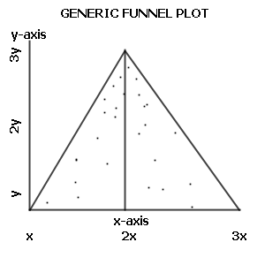
KM → Knowledge Generation → Systematic Review and Meta-Analysis (cont.)
Publication Bias → unpublished studies with negative results threaten the validity of a meta-analysis. The inverted funnel plot is the most popular method used to detect publication bias → small studies have greater variability (wide end of funnel) and larger studies have smaller variability (narrow neck of funnel) → missing publications will show an asymmetric funnel suggesting publication bias
Large size studies
Small size studies

Slide 55
Knowledge Representation (KR)

Slide 56
KM → Knowledge Representation
Decision rule represented as production rules (right). This collection of production rules represents the same knowledge as the decision tree (left).

Slide 57
KM → Knowledge Representation
category
slots
customized
(curly braces)
Sample Arden Syntax MLM.
A medical logic module consists of slots organized into three categories: maintenance, library, and knowledge.
Site-specific mappings—in this example, an event definition, a query string, and a destination definition from a fictional organization—are enclosed by curly braces.
Comments are delimited by /**/
LHS
If-Then
RHS
(can act as a
subroutine)
Priority → conflict resolution
clinical urgency

Slide 58
KM → Knowledge Representation (cont.)
Example of GELLO encoding a simple guideline.

Slide 59
Knowledge Integration (KI)

Slide 60
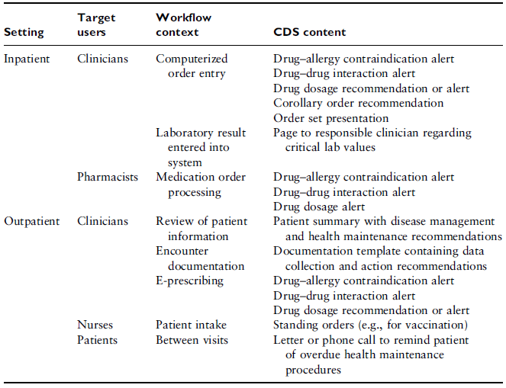
KM → Knowledge Integration
Commonly leveraged CDS opportunities within the clinical workflow

Slide 61
Case Studies
(Indiana, Vanderbilt, Harvard, Utah)

Slide 62

Regenstrief Institute
(Indiana University)
History of Regenstrief Medical
Record System (RMRS) CDSS

Slide 63
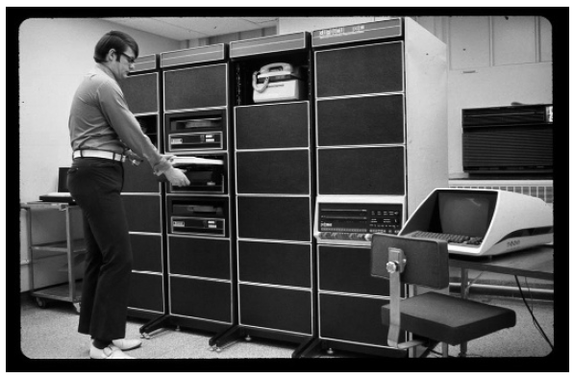
Case Studies → Indiana (cont.)
The first Regenstrief mainframe, a PDP-11/44.

Slide 64
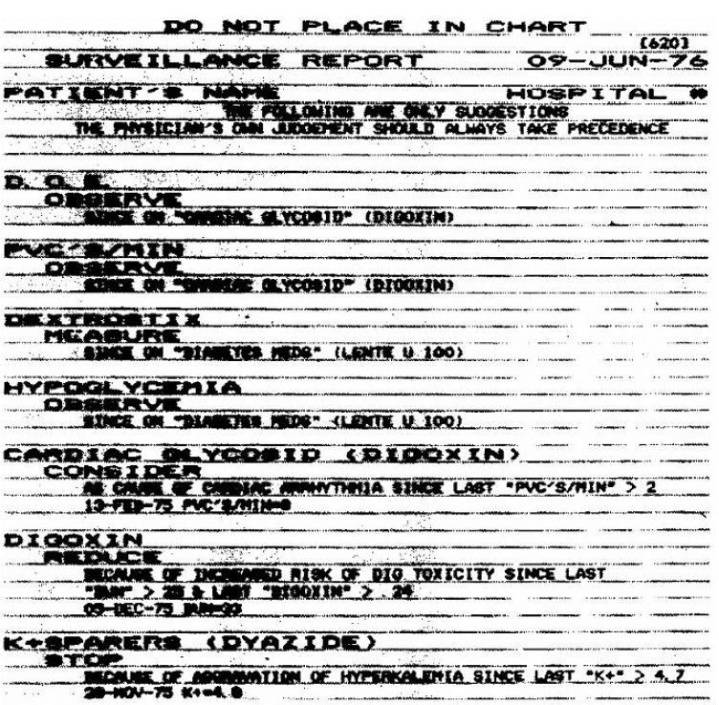
Case Studies → Indiana (cont.)
An example of a reminder report.
Processes that ran overnight culled through medical record data to generate these printed reports used during subsequent patient encounters

Slide 65
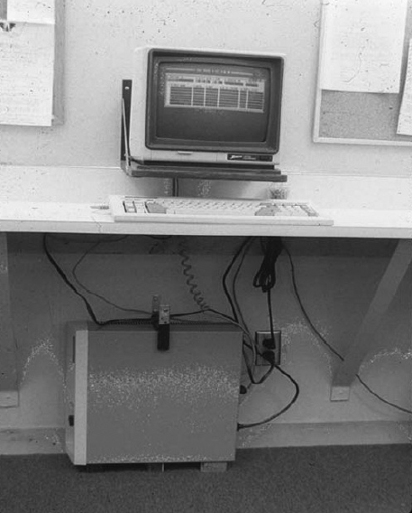
Case Studies → Indiana (cont.)
An early Medical Gopher station in Wishard Memorial Hospital

Slide 66
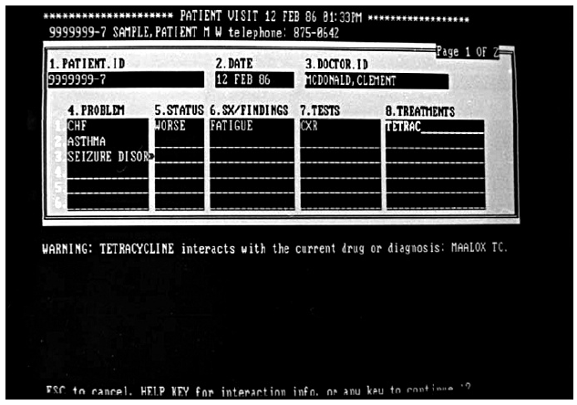
Case Studies → Indiana (cont.)
Screen shot from the first version of the Medical Gopher. It provided an immediate forum to generate reminders in real time for providers as they ordered therapies for patients.

Slide 67
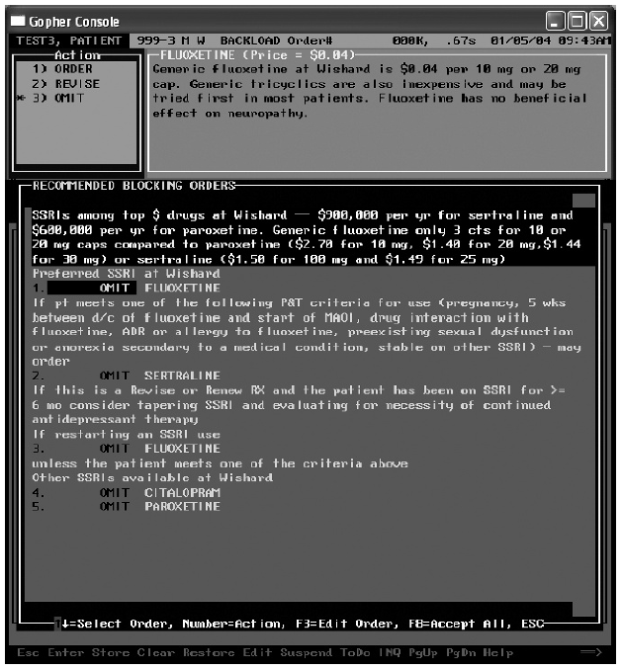
Case Studies → Indiana (cont.)
An example of suggested orders in the Medical Gopher based upon cost and
efficacy data.
Suggestion after ordering an expensive SSRI antidepressant

Slide 68
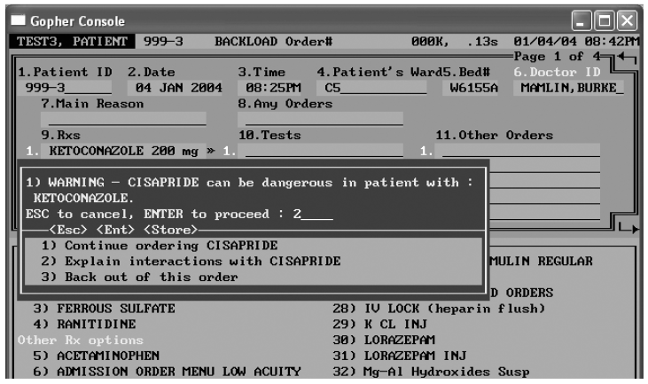
Case Studies → Indiana (cont.)
Drug-drug interaction

Slide 69
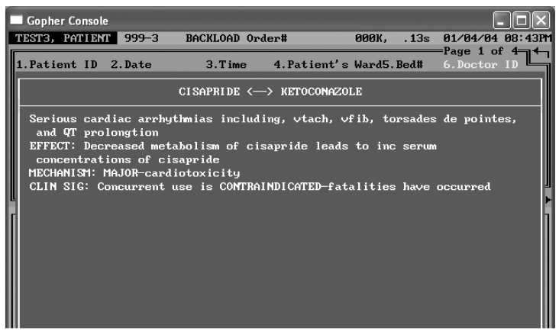
Case Studies → Indiana (cont.)
Drug-drug interaction details

Slide 70
CDSS in Practice
(Diagnostic DSS, Patient DSS, Population DSS)

Slide 71
Population DSS (Pop-DSS)

Slide 72
Population DSS → Introduction
Biomedical informatics methods, techniques, and theories
Basic Research
DSS
Bioinformatics
CDSS
Public Health
Informatics
Applied Research
Imaging
Informatics
Clinical
Informatics
Consumer Health
Informatics
Molecular Research
Health Research
Biomedical informatics as a basic science

Slide 73
Population DSS → HIE and Population HIT → Clinical Informatics
If patient has x, y then do z
CDSS
Administrative
EHR
EMR
JHH EPR
Accounting
Clinical Information Systems
Clinical Inpatient
Clinical Informatics
Clinical Outpatient
Laboratory
Imaging
QM, KD…
Non-clinical
Notes:
Patient oriented
Very personalized
No population health embedded

Slide 74
Population DSS → HIE and Population HIT → Public Health Informatics
Public Health Informatics
Registries
EHR
1
Commun. Diseases
Reports
EHR
2
Public Health
Claims
Non-clinical
?
Syndromic Surveillance
?
Quality Measures
Periodic public reports and alerts
Notes:
Manual process → time consuming → increased latency
Manual process → higher risk of errors
Too many abstraction layers → too public → can’t reverse back to the individual patient

Slide 75
Population DSS → HIE and Population HIT → HIE Role
EHR
n
Public Health Informatics
Other sources
Registries
Commun. Diseases
EHR
…
HIE
EHR
1
Public Health
Syndromic Surveillance
Quality Measures
Notes:
Helps standardize data → e.g. consistent federated IHIE
Almost real time with much less manual effort
Can get back to the individual patient (e.g., communicable diseases) but not focused on the DSS that needs to provide

Slide 76
Population DSS → HIE and Population HIT → Population Health Informatics
Population Health Info.
Population Health Analytics
Population Health Data-warehouse
PubHI to CI
CI to PubHI
Personal Health Records
Insurance Data
Rx Data
Admin data repositories
CI to PubHI
PubHI to CI
Clinical Informatics
EHRs
1…n
HIE
Public Health Informatics
Public Health
A
B
C
Notes:
Helps standardize data → e.g. consistent federated IHIE
Almost real time with much less manual effort
Can get back to the individual patient (e.g., communicable diseases) but not focused on the DSS that needs to provide

Slide 77
Population DSS → HIE and Population HIT → CDS Continuum
If patient has x, y, has gene w, lives in Baltimore, is high risk, is Hispanic, has insurance q,
and more population health rules…, and you don’t have an MRI then do z”
If patient has x, y
then do z
If patient has x, y with insurance q then do z’
If patient has x, y and is in high risk population
then do z’
If patient has x, y, and gene w
then do z’
If patient has x, y and you don’t have an MRI
then do z’
If patient has x, y and is Hispanic then do z’
If patient has x, y and lives in Baltimore
then do z’
Bioinformatics
Clinical Informatics
Organizational Info.
Public Health Info
Population Health Informatics
HIE
Notes:
Helps standardize data → e.g. consistent federated IHIE
Almost real time with much less manual effort
Can get back to the individual patient (e.g., communicable diseases) but not focused on the DSS that needs to provide

Slide 78

Population DSS → Groupers → Johns Hopkins ACG
ADGs
32
Patient Info
ID – Age – Gender –
Resource Use
ACGs
102 / 6
ACG
System
Predictive
Models
(ACG-PM)
Diagnosis
ICD 9 – ICD10
EDCs
267 / 30
Markers
Frailty – Hosdom
Coordination
Rx Gap
Pharmaceuticals
NDC, ATC
Rx-MG
64

Slide 79
Population DSS → Groupers → eACG (EHR-based ACG)
acg.jhsph.edu
ACG system offers a unique approach to measuring morbidity that improves accuracy and fairness in evaluating provider performance, identifying patients at high risk, forecasting healthcare utilization and setting equitable payment rates.
Management Applications
High
Disease Burden
Case-
Management
Disease
Management
Practice
Resource
Management
Needs
Assessment
Quality
Improvement
Payment/
Finance
Single High Impact Disease
Users
Users & Non-Users
Population Segment
Notes:
kilobyte (kB)
megabyte (MB)
gigabyte (GB)
terabyte (TB)
petabyte (PB)
exabyte (EB)
zettabyte (ZB)
yottabyte (YB)

Slide 80
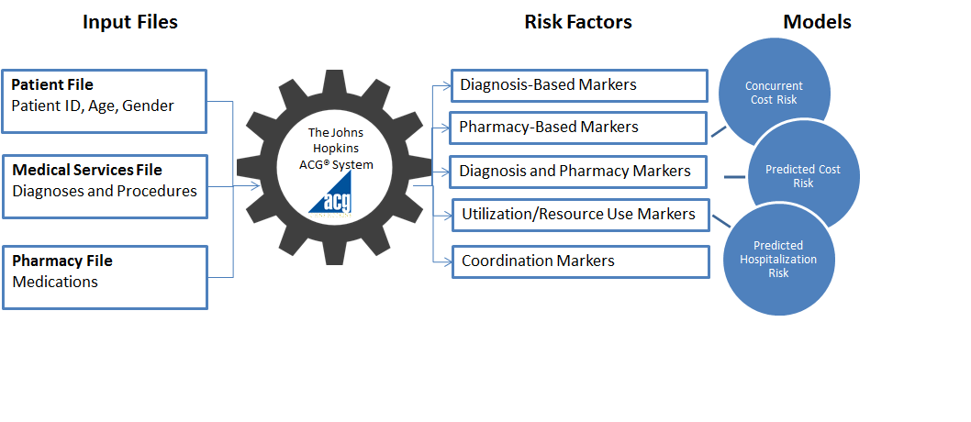
Population DSS → Groupers → eACG (EHR-based ACG) (cont.)
Billions of dollars per year are now routinely exchanged using ACGs in almost every US State and in 16 + nations. Healthcare of as many as 100+ million patients is actively managed and monitored using ACGs on all continents. Over 700+ peer reviewed articles have been published that apply and evaluate ACGs.
Other EHR-only data: Lab results; Vital Signs; Medical and Family history…
New applications: Real time population health / community surveillance; Real time clinical action for individual consumer; Functional Status / Frailty
Notes:
kilobyte (kB)
megabyte (MB)
gigabyte (GB)
terabyte (TB)
petabyte (PB)
exabyte (EB)
zettabyte (ZB)
yottabyte (YB)

Slide 81
Population DSS → Groupers → ACG History (1975 – 2015)
Federal grant
develops
“Ambulatory
DRGs”
Prestigious “Impact Award”
from Academy - Health
1st public risk adjusted
capitation in US
ACGs spread
around the
the globe
Comm. with
CSC (DST)
20th
Anniversary
1975 1980 1990 1995 2000 2005 2010 2015 Near Future
Early work
on children’s
patterns
of morbidity
Software tools
for health plans/providers
ACGs spread
across US
“ACGs”
becomes
suite of many
tools
Biggest
technology
dissemination
in JHU history
Integration with EMRs and Pop DSS

Slide 82
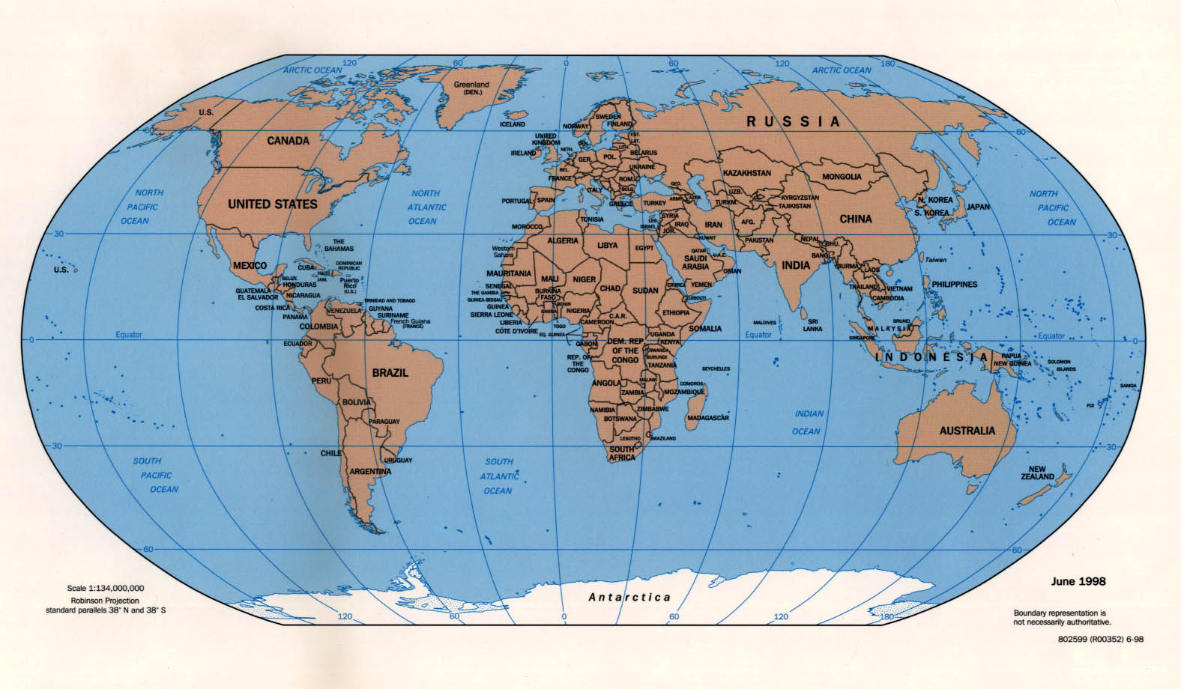
Population DSS → Groupers → ACG Global Footprint
Established Users
Ongoing or Recently Completed Pilots

Slide 83


Population DSS → VHA Population Health Framework and BMI Trajectory
Aim (1): Contextualize obesity factors within VHA’s population health framework
Aim (2): Design a scalable pop-health ‘technical’ platform and develop a pilot for obesity
Aim (3): Derive and evaluate “VHA’s Obesity Trajectory Population-based Risk Prediction Model” to measure the GIS-clustered population-based factors that affect the management of obesity
Prevalence of obesity among VHA population
(Limited to 29,322 visits occurred in one day of 2013; generated using CDW data)
Notes:
kilobyte (kB)
megabyte (MB)
gigabyte (GB)
terabyte (TB)
petabyte (PB)
exabyte (EB)
zettabyte (ZB)
yottabyte (YB)

Slide 84
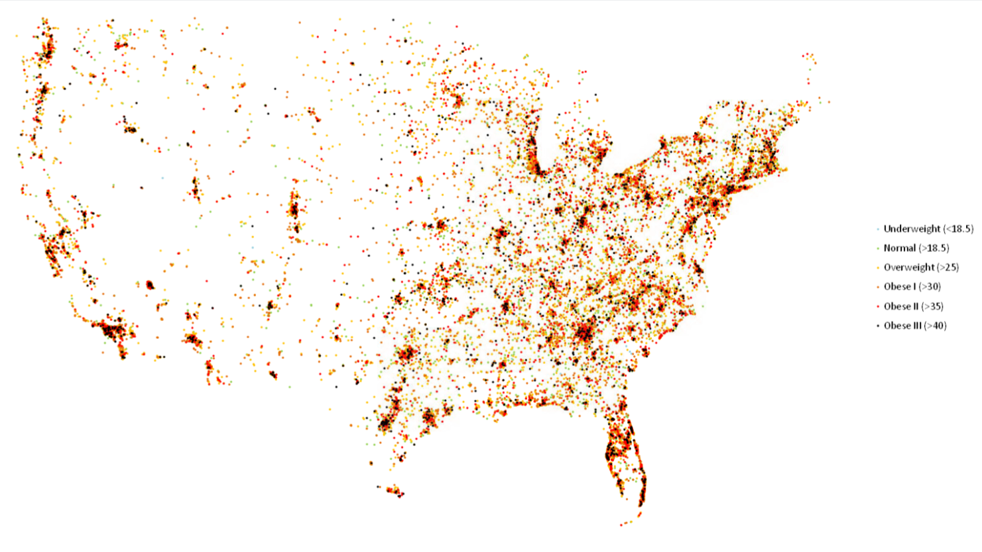

Population DSS → VHA Population Health Framework and BMI Trajectory (cont.)
Geographic distribution of obesity among VHA population
(Limited to 29,322 visits occurred in one day of 2013; generated using CDW data)
Notes:
kilobyte (kB)
megabyte (MB)
gigabyte (GB)
terabyte (TB)
petabyte (PB)
exabyte (EB)
zettabyte (ZB)
yottabyte (YB)

Slide 85
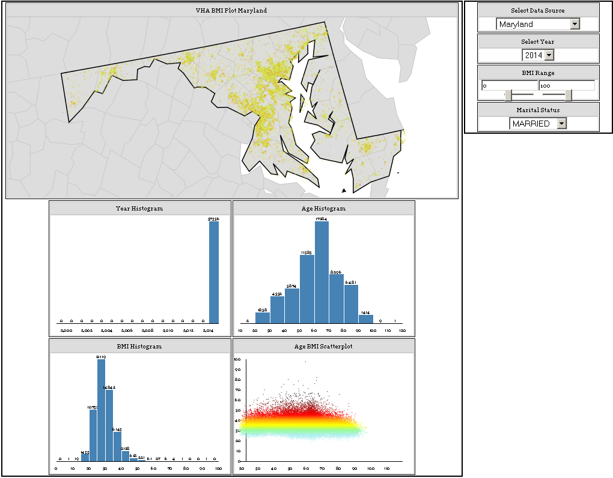
Population DSS → VHA Population Health Framework and BMI Trajectory (cont.)
Interactive Web-based Real-time Geo-Temporal Exploration of Obesity Data
(Showing averages of 2014 for MD)
Notes:
kilobyte (kB)
megabyte (MB)
gigabyte (GB)
terabyte (TB)
petabyte (PB)
exabyte (EB)
zettabyte (ZB)
yottabyte (YB)

Slide 86
CDSS Legal

Slide 87

CDSS Legal
Negligence theory (malpractice) holds that service providers must uphold the standards of the community for quality and reliability.
Strict product liability (injuries and compensation) applies when the purchaser is harmed as a result of a defect in that product.
Since the patient and not the care provider is the individual who physically suffers from errors in the clinical process while the purchasers are the care providers, it could be argued that strict product liability would not apply to DSS systems.

Slide 88
CDSS Legal (cont.)
Formal legal precedents for dealing with clinical decision-support systems are lacking at present.
Under negligence law (which governs medical malpractice), a product or activity must meet reasonable expectations for safety. The principle of strict liability, on the other hand, states that a product must not be harmful.
As with other medical technologies, physicians will be liable in such circumstances if the use of consultant programs has become the standard of care in the community.
The evaluation of complex decision-support tools is challenging; it is difficult to determine acceptable levels of performance when there may be disagreement even among experts with similar training and experience.
Current policy of the Food and Drug Administration (FDA) in the United States indicates that such tools will not be subject to federal regulation if a trained practitioner is assessing the program’s advice and making the final determination of care (in contrast medical devices are subject to federal laws)

Slide 89
CDSS Legal (cont.)
FDA identifies four types of devices:
  Educational and Bibliographic Software (exempt from regulation)
    Software intended only for use in performing traditional library functions
    Accounting, communication, educational software
  Software Components (incorporated in medical devices - regulated)
    infusion pumps; pacemakers; ventilators
    magnetic resonance imaging devices; diagnostic X-ray systems
    clinical laboratory instruments; blood grouping instruments
  Software Accessories (attached to medical devices - regulated)
    radiation treatment planning; conversion of pacemaker telemetry data
    conversion, transmission or storage of medical images
    off-line analysis of EEG data; digital analysis of EEG data
    calculation of rate response for a cardiac pacemaker
  Stand-Alone Software (CDSS – regulation is debated)
    blood bank software systems
    DDSS, CDSS, HIS, EHR, EMR

Slide 90
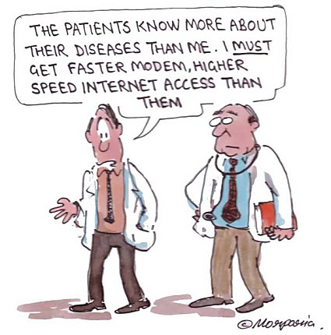
CDSS Legal (cont.)

Slide 91
Additional Resources

Slide 92

Resources – Books
Title | Change the name of the book!
Authors | Robert A Greenes
Year | 2007 / 2011
Hardcover | Yes
Publisher | Elsevier
Language | English
ISBN | 978-0-12-369377-8

Slide 93
Resources – Web
Associations:
  AMIA (American Medical Information Association): www.amia.org
  IMIA (International Medical Information Association): www.imia-medinfo.org
  HIMSS (Healthcare Information and Management Systems Society): www.himss.org
  Academy Health (HIT Interest Group): www.academyhealth.org
Government and Non-for-profit:
  ONC: www.healthit.gov/policy-researchers-implementers/clinical-decision-support-cds
  Open CDS: www.opencds.org
  HIMSS: www.himss.org/library/clinical-decision-support
  AHRQ: healthit.ahrq.gov/ahrq-funded-projects/clinical-decision-support-cds-initiative
Journals:
  JAMIA (Journal of AMIA): jamia.bmj.com
  JMIR (Journal of Medical Internet Research): www.jmir.org
  IJMI (International Journal of Medical Informatics): www.ijmijournal.com
  HIJ (Health Informatics Journal): jhi.sagepub.com
  ACI (Applied Clinical Informatics): aci.schattauer.de

Slide 94
Summary
CDSS Overview
CDSS Design to Implementation
Knowledge Management
  Acquisition
  Generation
  Representation
  Guidelines
  Integration
Case Studies
  Indiana (Regenstrief)
  Vanderbilt
  Harvard (BWI)
  Utah (Intermountain)
CDSS in Practice
  Diagnostic DSS
  Patient DSS
  Population DSS
CDSS Legal
Resources
  Books
  Web

