Slide 1
Health Information Exchange
Summer Institute / HIT Series
Hadi Kharrazi MHI MD PhD
kharrazi@jhu.edu
Johns Hopkins University
⬥ School of Public Health
⬥ School of Medicine
2 hrs / ~90 slides

Slide 2
Overview
Introduction
History of HIE
  CHIN, CHMIS, SBCCDE, EDI, ONC, NeHC, SI.Framework, HISPC, NHII/NwHIN, HIO
HIE Architecture
HIE Services
HIE Sustainability
  Federal (HITECH) Impact
  States Impact
HIE Examples
  Indiana HIE
  CRISP
HIE and Population Health IT
HIE Future
Summary

Slide 3
History of HIE

Slide 4
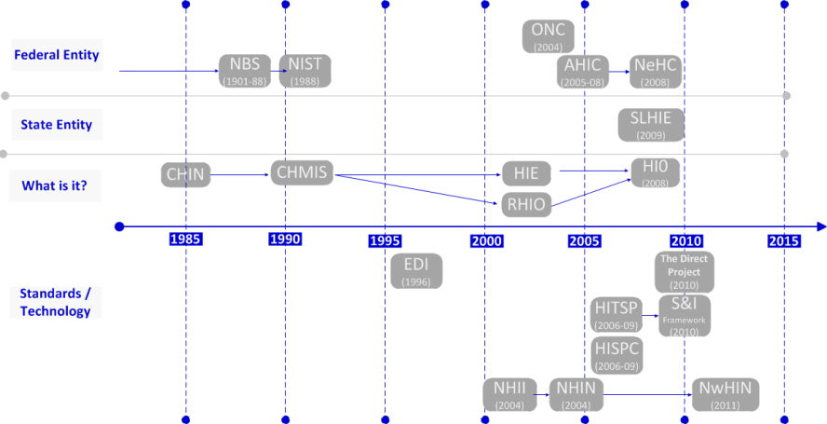
History of HIEs
Copyright HiMSS

Slide 5
History of HIEs → Community Health Information Networks (CHIN)
A community health information network (CHIN) is an organizational and technical entity designed and operated to facilitate the electronic data interchange and integration of various types of health care information for the benefit of those organizations and health care professionals that participate in the network. (~1985)
Most CHINs disappeared but two of CHINs did survive over time:
  Wisconsin Health Information Network (www.wishin.org)
  Utah Health Information Network (www.uhin.org)
Main challenge for CHIN:
  “The real killer why CHINs did not get any further than they did is that very few of them paid attention to sustainability” (Overhage)
  CHINs received tens of millions of dollars from foundations and vendors, but lacked a business plan to become self-sufficient after they burned through their initial wave of funding and community enthusiasm for their projects.
Copyright HiMSS

Slide 6
History of HIEs → Community Health Management Info. Networks (CHMIN)
Create both a data network and a data repository to measure cost and quality from competing providers in a given community. (~1991)
Seven states were funded: MN, IA, OH, VT, WA, NY, TN
MN has the most successful CHMIS: Legislation partially funded the Minnesota Health Data Institute as a partnership between the Commissioner of Health and a 20-member Board (with stakeholders). Law also asked for standard electronic transmissions, unique patient identifiers and privacy protections. MedNet was built in 1995 for transmitting claims, eligibility and enrollment.
Main challenge for CHMIS:
  VT → Difficulty arose in securing long-term cooperation.
  TN → It lacked a broad community base of stakeholders.
  IA → The cost of the data repository was problematic.
  OH → Independent community networks limited revenue to CHMIS.
  General issues with CHIMS: (1) separate network idea instead of using current networks; (2) Internet technology was just becoming available; (3) no incremental steps to generate short-term outcomes; (4) too many stakeholders were involved.
Copyright HiMSS

Slide 7
History of HIE → Santa Barbara County Care Data Exchange (SBCCDE)
A secure regional network for electronically sharing healthcare data among doctors, healthcare facilities and patients. Shared patient information included test results and reports. (~1998-2006)
California HealthCare Foundation funded it ($10M).
CareScience was the vendor (CEO David Brailer)
Main challenge for SBCCDE:
  Funding: Participating healthcare entities did not contribute.
  Vendors: Software development delayed.
  Community: No demand from local community.
  Governance: Neither physicians nor hospital administrators had control or provided input.
  Legal Issues: No consensus from lawyers across participating entities.
  Data Privacy: Participating entities could not find consensus.
  More at: Fried BM. What killed the Santa Barbara County Care Data Exchange? iHealthbeat. March 14, 2007.
Copyright HiMSS

Slide 8
History of HIE → Electronic Data Interchange (EDI)
Without a standards-based approach to data sharing between organizations, the on-going evolution of exchanging data might have remained a difficult obstacle for the entire healthcare industry.
EDI was developed by National Institute of Standards and Technology (NIST) (~1996)
In its initial stage, EDI primarily focused on financial and administrative data. As automation of clinical information has grown since 1996, a number of bodies have continued to work on EDI for all types of healthcare data:
    ANSI
    HL7
    CAQH
    CORE
    Others to evolve
Copyright HiMSS

Slide 9

History of HIE → Office of the National Coordinator for HIT (ONC)
ONC, a principal federal entity with the Department of Health & Human Services, is charged with coordination of nationwide efforts to implement and use the most advanced health information technology and the electronic exchange of health information. (~2004 / 2009 legislated)
Mission:
  Promote development of a nationwide Health IT infrastructure for electronic use and exchange of information
  Provide leadership in the development, recognition, and implementation of standards / certification of Health IT products
  Health IT policy coordination
  Strategic planning for Health IT adoption and health information exchange
  Establish governance for the Nationwide Health
  Information Network (NwHIN)
  More: http://healthit.hhs.gov
Copyright HiMSS

Slide 10




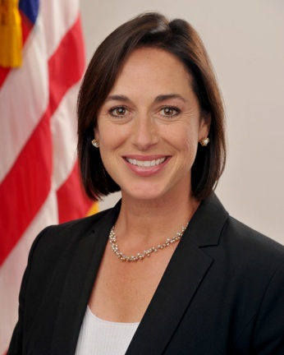
History of HIE → ONC (cont.)
ONC National Coordinators:
  David J. Brailer, MD PhD (May 2004)
  Robert M. Kolodner, MD (Sep 2006)
  David Blumenthal, MD (Mar 2009)
  Farzad Mostashari, MD MSc (Apr 2011)
  Karen DeSalvo, MD MPH MSc (Jan 2014)
D. Brailer
R. Kolodner
D. Blumenthal
F. Mostashari
K. DeSalvo
Copyright HiMSS

Slide 11
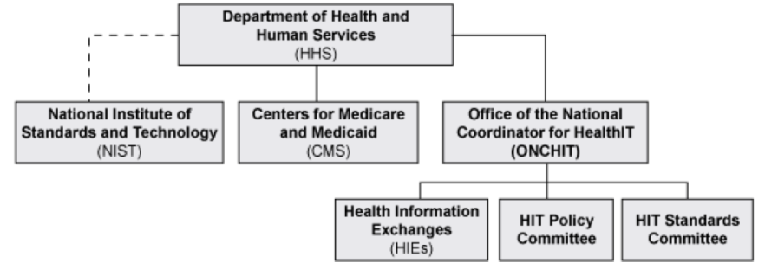
History of HIE → ONC (cont.)
ONC relationship with DHHS
Copyright HiMSS

Slide 12
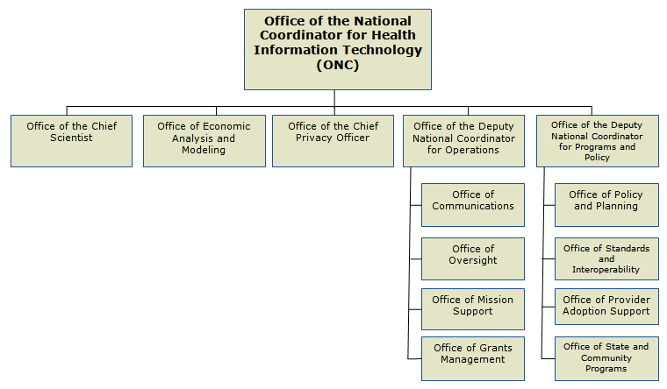
History of HIE → ONC (cont.)
ONC Organizational Structure
Copyright HiMSS

Slide 13
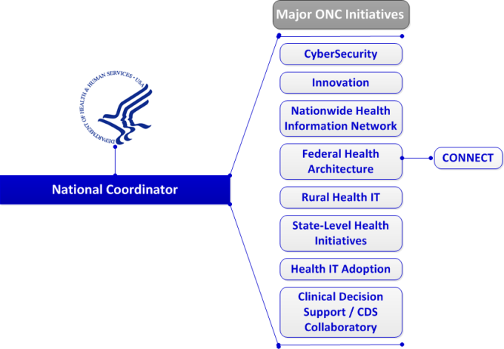
History of HIE → ONC (cont.)
Eight Major ONC Initiatives
Copyright HiMSS

Slide 14

History of HIE → National eHealth Collaborative (NeHC)
A public-private partnership that enables secure
and interoperable nationwide health information
exchange to advance health and improve
healthcare. (~2012)
Mission:
  Address barriers that might thwart the nation's progress toward interoperability.
  Work to educate, connect and encourage healthcare stakeholders who are critical to the successful deployment of health information technology and health information exchange nationwide.
NeHC University is a web-based education program designed to provide stakeholders with timely and relevant information on health information technology and health information exchange in the US.
More: www.nationalehealth.org
Copyright HiMSS

Slide 15
…HIE → The Standards & Interoperability Framework (S&I Framework)
The Standards and Interoperability (S&I) Framework is a set of integrated functions, processes, and tools being guided by the healthcare and technology industry to achieve harmonized interoperability for healthcare information exchange. (~2012)
Mission/Goals:
  Linkage of objectives, challenges, use cases, requirements, and standards across the solution development lifecycle
  Repeatable mechanisms for harmonization and integration of existing standards, as well as identification of new standards
  Development of tools that enable consistent, robust, and testable solutions (e.g., test suite to validate an implementation against a specification)
  Integration of multiple Standard Development Organizations (SDOs) with different expertise across the solution development lifecycle
  Leveraging of federal guidance and best practices.
More: www.siframework.org
Copyright HiMSS

Slide 16
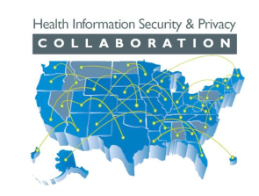
…HIE > Health Information Security and Privacy Collaboration (HISPC)
Address the privacy and security challenges
presented by electronic health information
exchange through multi-state collaboration.
Harmonize state privacy law.
(award ~2006 – 2009 then membership).
Two tools were developed:
Comparative Analysis Matrix (CAM): collection of almost 150 subject matter areas typically addressed by state law that involve or may impact the use and disclosure of health information.
Assessment Tool:
  assist stakeholders to identify and obtain consensus on priority recommendations for legislation
  enable a state to identify and analyze relevant state statutes and establish a priority order for potential statute modernization efforts
  allow states to identify non-legislative solutions to address identified issues.
Copyright HiMSS

Slide 17
History of HIE → National Health Information Infrastructure (NHII)
A healthcare standardization initiative for the development of an interoperable health information technology system. (~2004)
Mission: Build an interoperable system of clinical, public health and health information technology + encourage public-private partnership with a Federal leadership role.
The NHII evolved into the Nationwide Health Information Network (NwHIN):
NHII (2004) → NHIN (2010) → NwHIN (2011)
NHII Projects:
  Phase I (May 2007): build prototype and show determination of need → Accenture, CSC, IBM, Northrup Grumman
  Phase II (Oct 2007): specification of factory → 9HIEs (TN, DL, IN, CA, NM, VA, Y, NC, WV)
  Phase III (2011): production phase → ~35 participants
Copyright HiMSS

Slide 18
History of HIE → Nationwide Health Information Network (NwHIN)
A set of standards, services and policies that enable secure health information exchange over the Internet. (~current)
Mission: Facilitate exchange of healthcare information being developed under governance of ONC.
Stakeholders:
  Care delivery organizations (CDOs) using EHRs
  Consumer organizations operating personal health records (PHRs)
  HIEs with multi-stakeholder entities
  Specialized participants (data for secondary uses)
Exchange participants: DoD, VA, SSA, CDC, MedVirginia, KP, Regenstrief Institute, HealthBridge, NC-HIE, Inland NWHS
Granted funding for multiple Beacon Communities
Copyright HiMSS

Slide 19
History of HIE → Health Information Organization (HIO)
HIE (verb): The electronic movement of health-related information among disparate organizations according to nationally recognized standards in an authorized and secure manner.
HIO (noun): An organization that oversees and governs the exchange activities of health-related information among independent stakeholders and disparate organizations according to nationally recognized standards in an authorized and secure manner.
An HIO can be described by many acronyms, including:
  State Level Health Information Exchange (SLHIE)
  Regional Health Information Exchange (RHIO)
  Regional Health Information Network (RHIN)
  Health Information Exchange Networks (HIE[N])
  Others: Integrated Delivery Systems (IDNs); Physician practices HIEs; Payer-led HIEs; and, Disease-specific HIEs.
Copyright HiMSS

Slide 20
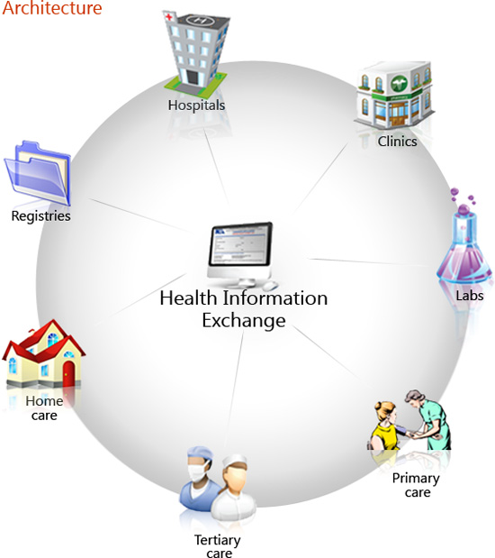
History of HIE > HIO (cont.)
Health Information Organizations

Slide 21
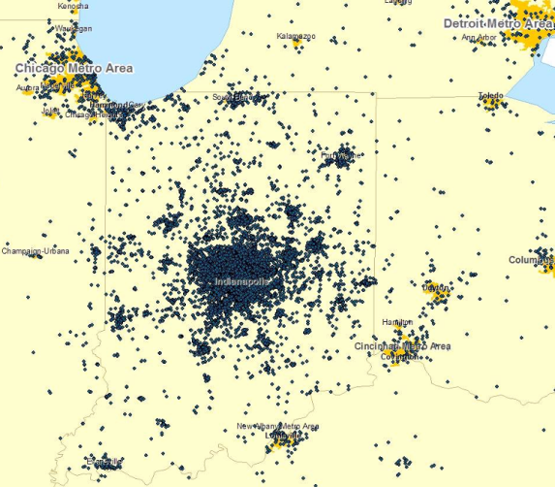
History of HIE > HIO (cont.)
Health Information Organizations
Copyright Regenstrief Institute

Slide 22
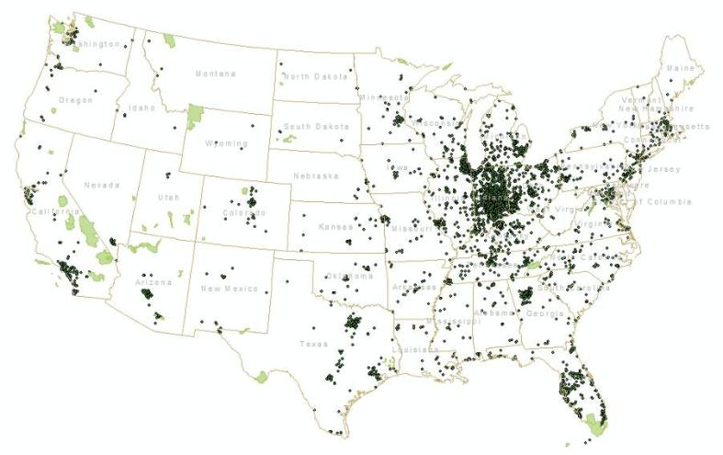
History of HIE > HIO (cont.)
Nationwide Health Information Network (NwHIN)
Copyright Regenstrief Institute

Slide 23
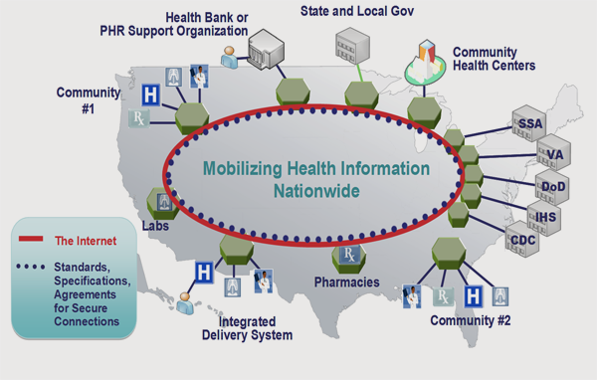
History of HIE → HIO to NwHIN
Nationwide Health Information Network (NwHIN)
Copyright HiMSS

Slide 24
HIE Architecture

Slide 25
HIE Architecture
Architecture is a formal description of a system or a detailed plan of the system at component level, used to guide its implementation.
It includes the structure of components, their interrelationships and the principles and guidelines governing their design and evolution over time.
Four commonly used subsets of an overall enterprise architecture: Business (or business process) architecture; Application architecture; Data architecture; and, Technical architecture.
HIE technical architectures:
  Centralized (Monolithic data repository)
  Federated (Consistent & Inconsistent)
  Hybrid
  Switch (Service Oriented / Web Services)
  Patient Centric (PHR oriented)
Copyright HiMSS

Slide 26
HIE Architecture → Centralized
Data is accumulated and managed in a single and centralized repository
The state HIO has full control over the data and the ability to authenticate
HIO is responsible for patient ID, data storage and privacy
Users interact with centrally located and standardized content
Example: UK NHS planned HIE
Advantages:
  Simplicity / efficiency
  Data are consistent + no patient linkage issues
Disadvantages:
  Doesn’t scale well
  Single point of control – must trust the custodian
  Requires exceptional leadership
  Everyone has to accept the same identifier
  Needs robust communication infrastructures
Copyright HiMSS

Slide 27
HIE Architecture → Centralized (cont.)
PHRs
EHRs
Data Repository
Claims
Registries
PACS
LABs
Centralized HIE
Copyright Regenstrief Institute

Slide 28
HIE Architecture → Federated
Peer-to-peer architecture.
Network permits users access only when needed.
Multiple patient id technologies: Master Patient Indices (MPI) and Record Locator Service (RLS).
Inconsistent: includes non-standardized data such as different patient identifiers; different data models (basic way to organize the data); different identifiers for observations (e.g. hemoglobin, Hgb or WB Hemoglobin); and, different units
Consistent: data gathered centrally in separate physical files, “mirrors” of remote sites; and, standardized at the time it comes in.
Examples:
  Inconsistent: Santa Barbara County Care Data Exchange
  Consistent: Indiana HIE
Copyright HiMSS

Slide 29
HIE Architecture → Federated (cont.)
Advantages:
  Data ownership can be managed by defining business policies
  Individual organizations able to control their own data
  Benefits of scale
  Builds on existing infrastructure – no need for new computers
  More opportunities for creativity (within the specified architecture)
  the only examples of working interoperable healthcare systems
Disadvantages:
  Requires more coordination
  May be slower than monolithic database
  Have to solve the patient identifier problem
  Also needs robust communication infrastructure in place
Copyright HiMSS

Slide 30
HIE Architecture → Federated (cont.)
EHRs
PHRs
Claims
Registries
PACS
LABs
Federated Inconsistent HIE
Copyright Regenstrief Institute

Slide 31
HIE Architecture → Federated (cont.)
EHRs
PHRs
MPI
Claims
Registries
PACS
LABs
Federated Consistent HIE
Copyright Regenstrief Institute

Slide 32
HIE Architecture → Hybrid
A mix of Centralized and Federated models
Centralization or distribution is dependent on specific requirements
MPI is used to link patient records across databases
User interface brings together patient information from various sources
Advantages and disadvantages depend on the centralized and federated components of the hybrid model
Copyright HiMSS

Slide 33
HIE Architecture → Hybrid (cont.)
PHRs
EHRs
Data
Repository
Claims
EHRs
LABs
Claims
MPI
Registries
PACS
LABs
Hybrid HIE
Copyright Regenstrief Institute

Slide 34
HIE Architecture → Switch
Data gathered centrally in separate physical files, “mirrors” of remote sites
Standardized at the time it comes in
No data storage
Example: Utah Health Information Network (UHIN)
Copyright HiMSS

Slide 35
HIE Architecture → Switch (cont.)
PHRs
EHRs
Data
Standardization Machine
Claims
Registries
PACS
LABs
Switch HIE
Copyright Regenstrief Institute

Slide 36
HIE Architecture → Patient Centric
Standardized data set managed by each individual
Infrastructure at clinical sites to interact with data
Advantages:
  Direct patient control
  Patient controls access
  Security is in the hands of the person at risk
  Can serve as a token
Disadvantages:
  Update problems – hard to get the data to the card when asynchronously generated (i.e. after patient leaves)
  Risk of loss
  Does not facilitate research or public health use
  Patient authentication
Copyright HiMSS

Slide 37
HIE Architecture → Patient Centric (cont.)
EHRs
Other…
Claims
Registries
PACS
LABs
Patient Centric HIE (e.g., PHR controlled)
Copyright Regenstrief Institute

Slide 38
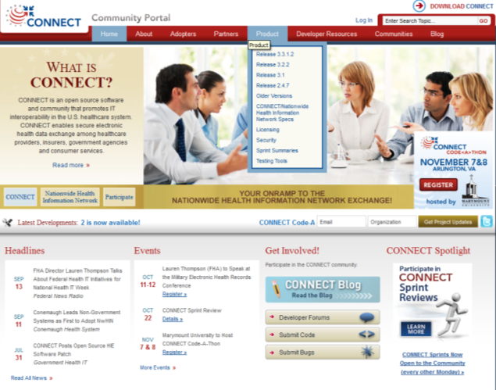
HIE Architecture → Useful Resources
http://www.connectopensource.org/

Slide 39
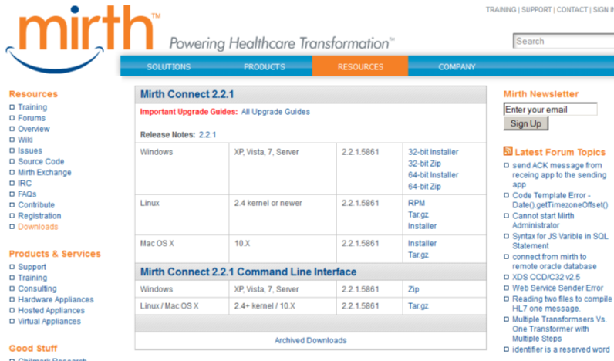
HIE Architecture → Useful Resources (cont.)
http://www.mirthcorp.com/community/downloads

Slide 40
HIE Services

Slide 41
HIE Services → Core Services
Each HIE may have data services that vary based on defined requirements.
Presentation Services
  Format data displays to meet end user interaction and display device requirements.
  Examples: login, patient look-up, request patient records, view data
Business Application Services
  Key functional components that house rules and execute business logic on clinical data to render.
  Examples: e-Prescribing, EMR, lab, radiology, eligibility checking, problem list/visit history
Data Management Services
  Manage application access to data storage and processing of data in the storage layer.
  Examples: data persistence/access, value/code sets, key management
Copyright HiMSS

Slide 42
HIE Services → Core Services (cont.)
Data Storage Services:
  Provide reliable, secure data storage for efficient access by data management services.
  Examples: message logs, XML Schemas, Provider/User Directory
Integration Services:
  Manage integration services across the different layers of the technology stack.
  Examples: message translation/transport, HL7 mapping, EMR adapter
System Management Services:
  Provide system and application administrative and management support.
  Examples: system configuration, audit/logging, exception handling
Copyright HiMSS

Slide 43
HIE Services → Core Services (cont.)
Security Services:
  Manage the implementation of security to control system access and protect confidentiality and integrity of data in the system.
  Examples: authentication/authorization, consent management, user roles, policy management
Some concrete examples:
  Clinical results delivery: Lab, Radiology, etc.
  Clinical information, notes & documents
  Medication history, summaries, alerts, etc.
  Immunizations, syndromic surveillance and public health data
  Electronic prescribing, refill information
  PHRs, patient-reported data
  EMT, 1st responder notes
  Claims transaction / electronic eligibility information
  Data quality and research support documents
Copyright HiMSS

Slide 44
HIE Services → Data Services by Constituency
Hospitals
  Clinical messaging
  Medication reconciliation
  Shared EHR
  Eligibility checking
Physicians
  Result reporting
  Secure document sharing
  Shared EHR
  Clinical decision support
  Eligibility checking
Laboratory
  Clinical messaging
  Orders
Public Health
  Needs assessment
  Biosurveilance
  Reportable conditions
  Results delivery
Consumers
  Personal Health Records
Researchers
  De-identified longitudinal clinical data
Payers
  Quality measure
  Claims adjustment
  Secure document transfer
Copyright HiMSS

Slide 45
HIE Services → Emerging Services
Next Generation Analytics
  Data warehouse, data analytics and business intelligence
  Quality reporting support
  Performance management
  Fraud and abuse identification and prevention
  Population monitoring and predictive profiling
  Care gap identification
  Care and disease management
  Public health monitoring and analysis
Copyright HiMSS

Slide 46
HIE Sustainability

Slide 47
HIE Sustainability
HIE Organizational Models:
  For-profit entity
  Non-profit entity (501-C3 and other non-profit designations )
  State agency or other government agency (e.g., State Level HIE)
Current Funding Options: (short-term!)
  Federal grants, federally funded IT programs and other contracts
  State grants and state funded contract programs
  Cash loans with scheduled payback
  In kind services
  Financial donations
Copyright HiMSS

Slide 48
HIE Sustainability (cont.)
HIE Revenue Types:
  Membership Fees: Stakeholders pay to support shared services for all users of the electronic HIE
  Transaction Fees: Fees for data-exchange services
  Program and Service Fees: HIO acts in a programmatic capacity and charges stakeholders for their participation
  Combination of Sources
  Other Funding Streams: This includes providing value-added services in the form of “EHR-lite” functionality
HIE sustainability challenges:
  Funding Challenges: Start-up funding; Interfaces; Interoperability; Integration; and, Maintenance
  Interoperability Challenges: evolution of standards
  Maintaining solid data integrity with data exchange: NLP challenges
  Privacy protection: Consent models; Segmentations
Copyright HiMSS

Slide 49
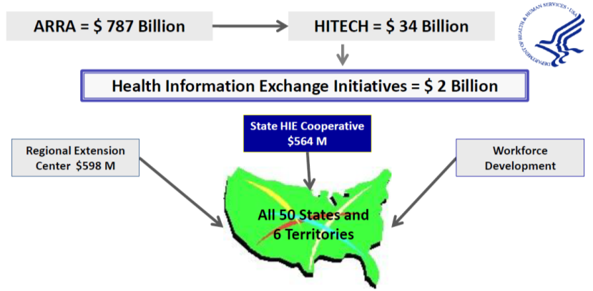
HIE Sustainability → Federal Impact
2009 The American Reinvestment and Recovery Act (ARRA) is signed into law which includes The Health Information Technology for Economic and Clinical Health Act (HITECH).
Copyright HiMSS

Slide 50
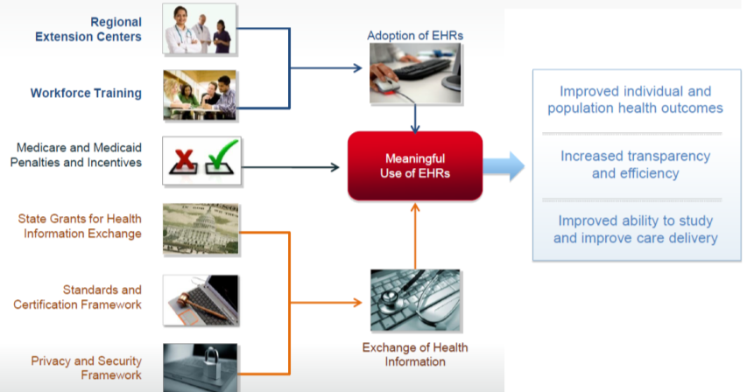
HIE Sustainability → Federal Impact (cont.)
The HITECH Act’s Framework for Meaningful Use of EHR
Copyright HiMSS

Slide 51
HIE Sustainability → Federal Impact (cont.)
Two Specific HITECH Programs Directly Supporting HIEs:
State Health Information Exchange
Facilitate and expand the secure electronic movement and use of health information among organizations according to nationally recognized standards. This program will be a federal-state collaboration aimed at the long-term goal of nationwide HIE (NwHIN) and interoperability. ($590M)
“Beacon” Community Program
Define best practices in the adoption and use of HIT that other communities may emulate. ($220M)
Copyright HiMSS

Slide 52

HIE Sustainability → Federal Impact (cont.)
HIT-Enabled Health Reform
Stage 3
Stage 1
Stage 2
2009 HITECH Policies
2011 Criteria
(Capture & Share)
2013 Criteria
(CDSS)
2015 Criteria
(Improved Outcome)
Meaningful Use

Slide 53
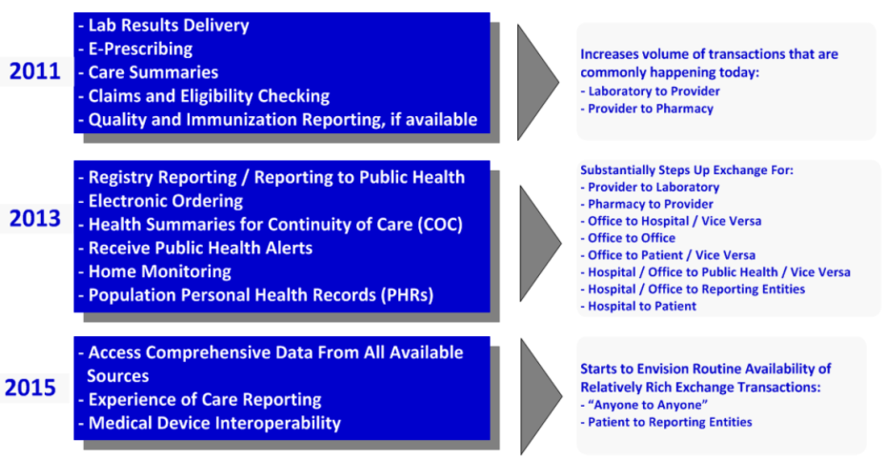
HIE Sustainability → Federal Impact (cont.)
Meaningful Use objectives requiring HIEs
Copyright HiMSS

Slide 54
HIE Sustainability → State Impact
The states themselves are an important entity in the progression of HIE initiatives. Some of the areas in which the states engage include:
State-Specific Office: To manage federal funds and support the strategic planning process for HIEs.
State Privacy Laws: There are nuances in the privacy laws and this information is critical to participants within each HIE.
Inter-State Commerce Issues: While most HIEs have a state-specific focus, there are other HIEs that span across borders to another state(s). Inter-State Commerce concerns must be considered for HIEs.
Trust Domains: In order to ensure security when accessing or storing information, Trust Domains have been created. They are a framework that takes into consideration those requirements and standards.
Copyright HiMSS

Slide 55
HIE Sustainability → State Impact (cont.)
State Privacy laws
Privacy laws at the state level are not identical.
If you participate in an HIE, a Business Associate Agreement (BAA) is required to ensure protection of privacy for patient information. These agreements must be provided to each party that interacts with another party. As a result, there could be a very large number of BAAs in place to view or exchange patient data.
Data Use and Reciprocal Support Agreement (DURSA): With the growing number of Business Associates that will be entering into an HIE, there was a need to simplify the arrangement between and among those associates. DURSA is a policy which allows one agreement to be signed for all participants within the NwHIN initiative.
Copyright HiMSS

Slide 56
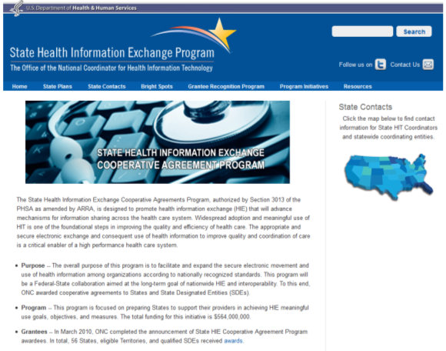
HIE Sustainability → State Impact (cont.)
To gain a better understanding of the HIE activities at each state level, http://statehieresources.org/ can provide a variety of information to assist you.
Copyright HiMSS

Slide 57
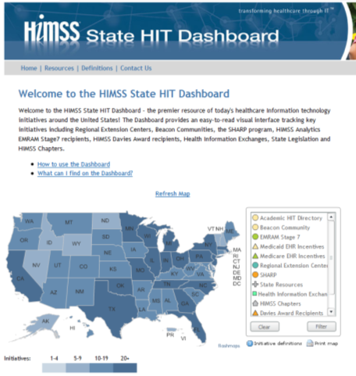
HIE Sustainability → State Impact (cont.)
More state level HIT initiatives at: http://www.himss.org/statedashboard/
Copyright HiMSS

Slide 58
HIE Examples: IHIE and CRISP

Slide 59

HIE Examples → IHIE (Regenstrief Institute)
Established in 1969 by philanthropist Sam Regenstrief
Regenstrief receives $3 million per year in core support from the Regenstrief Foundation
Annual operating budget of approximately $23 million derived from grants and contracts
Logical Observation Identifiers Names and Codes (LOINC) system, a standard nomenclature that enables the electronic transmission of clinical data from laboratories
Regenstrief Medical Records System (RMRS) was developed 35 yrs ago. RMRS has a database of 6 million patients, with 900 million on-line coded results, 20 million full reports including diagnostic studies, procedure results, operative notes and discharge summaries, and 65 million radiology images.
Indiana Network for Patient Care (INPC) was created in 1996. It is a city-wide clinical informatics network of 11 different hospital facilities and more than 100 geographically distributed clinics and day surgery facilities
Copyright Regenstrief Institute

Slide 60
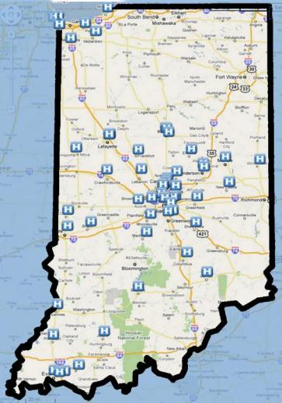

HIE Examples → IHIE (cont.)
The Indiana HIE (IHIE) includes (as of mid-2011):
Federated Consistent Databases
22 hospital systems → ~70 hospitals
5 large medical groups and clinics & 5 payors
Several free-standing labs and imaging centers
State and local public health agencies
10.75 million unique patients
20 million registration events
3 billion coded results
38 million dictated reports
9 million radiology reports
12 million drug orders
577,000 EKG tracings
120 million radiology images
Copyright Regenstrief Institute

Slide 61
HIE Examples → IHIE (cont.)
Network Connection
HL7 ADT
message
Hospital Interface Engine
(Routing)
Hospital Firewall
(Encryption)
Hospital ED Registration
Imported into Clinical Repository
Message Listener
Firewall
(Decryption)
Clinical Repository
Message Processor
Information flow
Copyright Regenstrief Institute

Slide 62
HIE Examples → IHIE (cont.)
Core Technologies:
  Master Patient Index
  Vocabulary/Code Standardization
  Master Provider Index
  Message Processing Pipeline
  Secure Data Transmission
  Access Controls
  Licensing
Data Integrity Checks:
  Source Validation
  Data Cleansing
  Quality Control
  Message Flow Monitoring
  Data Transmission Fail Over
Copyright Regenstrief Institute

Slide 63
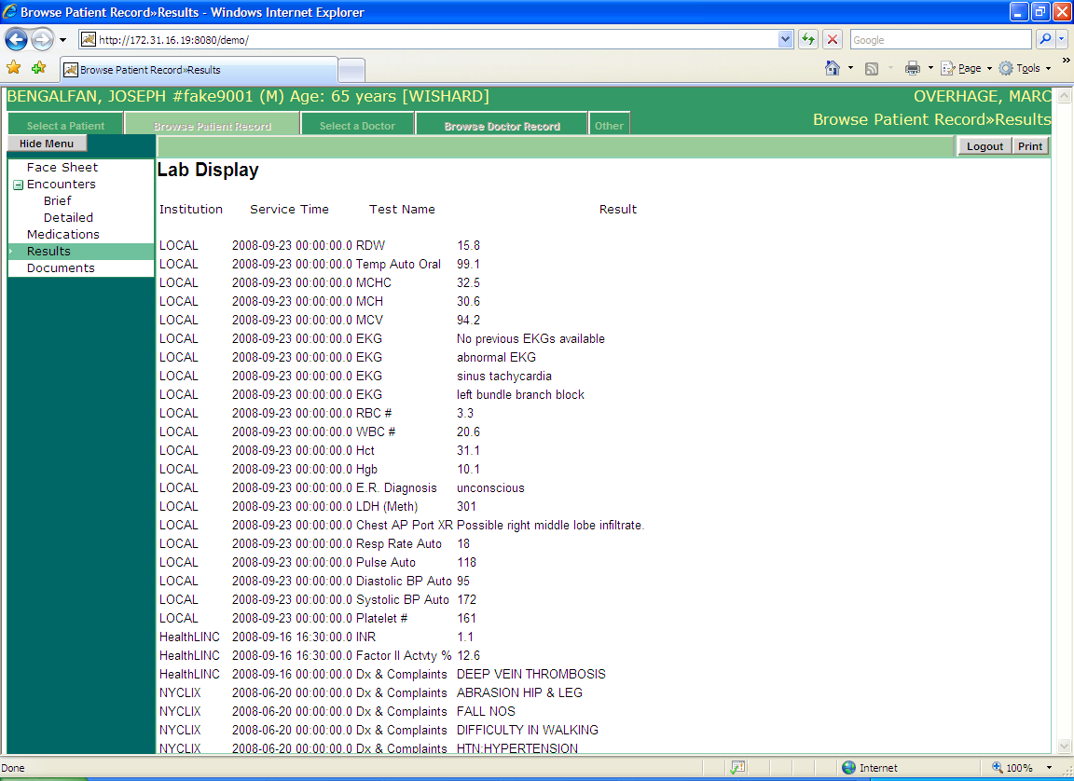
HIE Examples → IHIE (cont.) → CareWeb (summary of care)
Copyright Regenstrief Institute

Slide 64
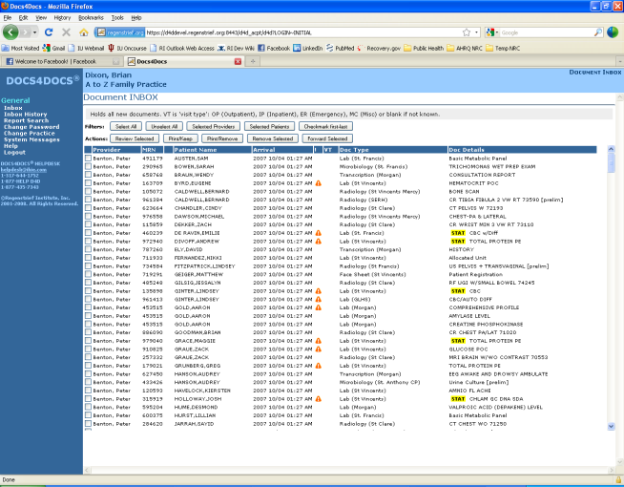
HIE Examples → IHIE (cont.) → Docs4Docs
Copyright Regenstrief Institute

Slide 65
HIE Examples → IHIE (cont.) → Quality Health First (QHF)
Copyright Regenstrief Institute

Slide 66
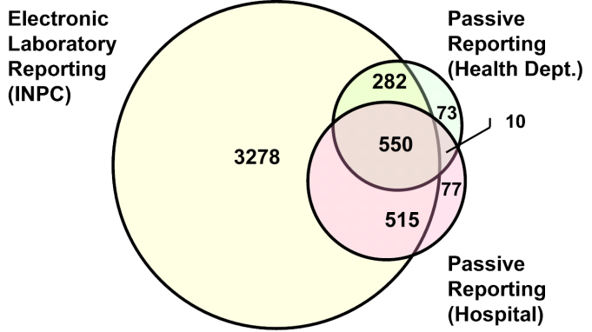
HIE Examples → IHIE (cont.) → ELR Data Completeness
Overhage JM, Grannis S, McDonald CJ. Am J Public Health. 2008 Feb
Copyright Regenstrief Institute

Slide 67
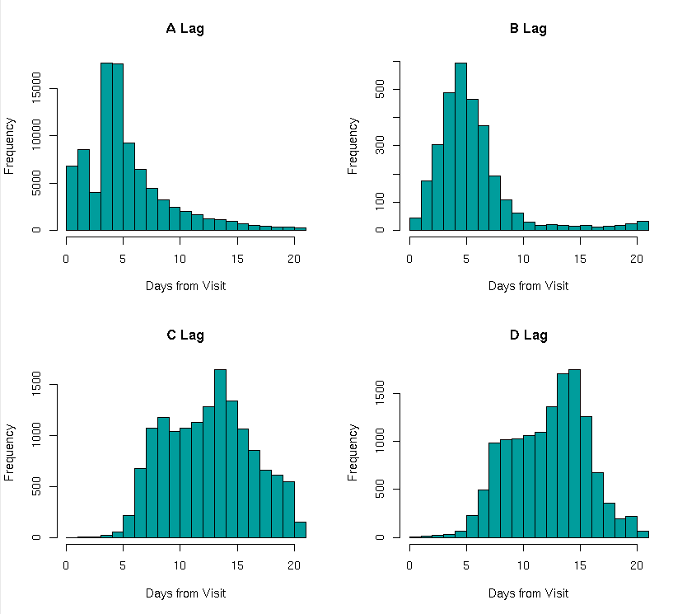
HIE Examples → IHIE (cont.) →Timeliness of Data (CC vs ICD9
Copyright Regenstrief Institute

Slide 68
HIE Examples → IHIE (cont.) →Notifiable Condition Detector (NCD)
Copyright Regenstrief Institute
Notes:
A community program that helps physicians identify and prioritize necessary health screenings and other testing for their patients. The goal of the program is to ensure patients receive recommended preventive care and that their chronic diseases are being appropriately monitored and managed.

Slide 69
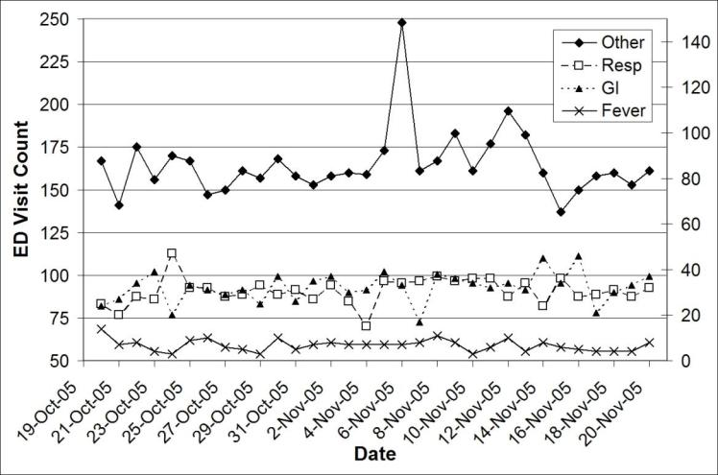
HIE Examples → IHIE (cont.) →Syndromic Surveillance Service (SSS)
Copyright Regenstrief Institute
Notes:
A community program that helps physicians identify and prioritize necessary health screenings and other testing for their patients. The goal of the program is to ensure patients receive recommended preventive care and that their chronic diseases are being appropriately monitored and managed.

Slide 70

HIE Examples → CRISP (Chesapeake Regional Info. Sys. for our Patients)
Mission: To advance the health and wellness of Marylanders by deploying health information technology solutions adopted through cooperation and collaboration.
Vision: Enable and support the Maryland healthcare community to appropriately and securely share data in order to facilitate care, reduce costs, and improve health outcomes.
Focus Areas:
  Query Portal Growth
  Direct Secure Messaging
  Encounter Notification System (ENS)
  Encounter Reporting System (ERS)
  Health Benefits Exchange integration
Copyright CRISP

Slide 71
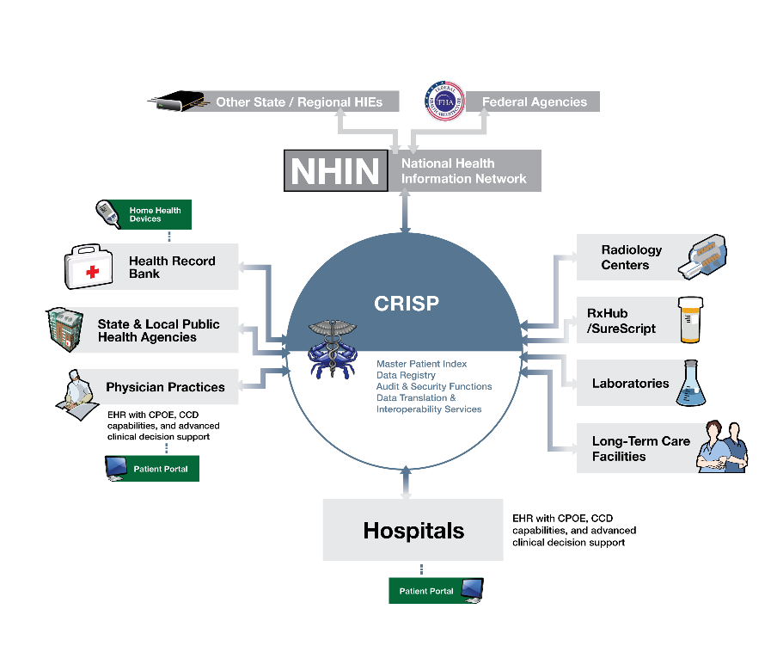
HIE Examples → CRISP (cont.)
Copyright CRISP
Notes:
A community program that helps physicians identify and prioritize necessary health screenings and other testing for their patients. The goal of the program is to ensure patients receive recommended preventive care and that their chronic diseases are being appropriately monitored and managed.

Slide 72
HIE Examples → CRISP (cont.)
Progress Metric | Result
Organizations Live
Hospitals (Total 48) | 48
Hospital Clinical Data Feeds (Total 143 - Lab, Radiology, Clinical Docs) | 86
National Labs | 2
Radiology Centers (Non-Hospital) | 5
Identities and Queries
Master Patient Index (MPI) Identities | ~4M
Opt-Outs | ~1500
Queries (Past 30 Days) | ~3500
Data Feeds Available
Lab Results | ~16M
Radiology Reports | ~5M
Clinical Documents | ~2M
Copyright CRISP
Notes:
A community program that helps physicians identify and prioritize necessary health screenings and other testing for their patients. The goal of the program is to ensure patients receive recommended preventive care and that their chronic diseases are being appropriately monitored and managed.

Slide 73
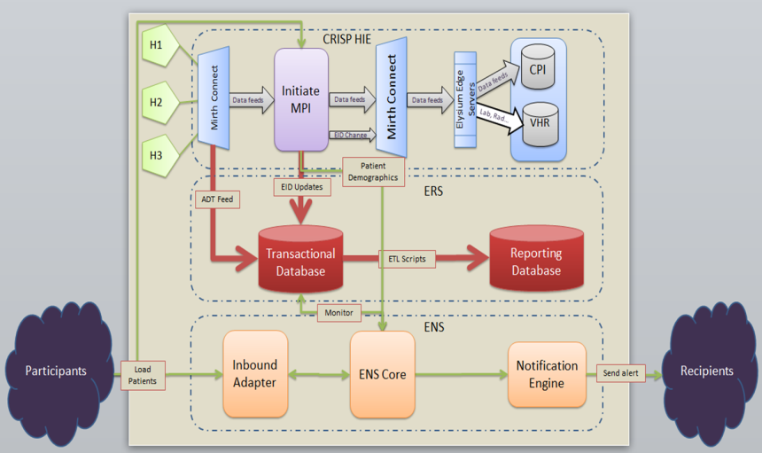
HIE Examples → CRISP (cont.)
Copyright CRISP
Notes:
A community program that helps physicians identify and prioritize necessary health screenings and other testing for their patients. The goal of the program is to ensure patients receive recommended preventive care and that their chronic diseases are being appropriately monitored and managed.

Slide 74
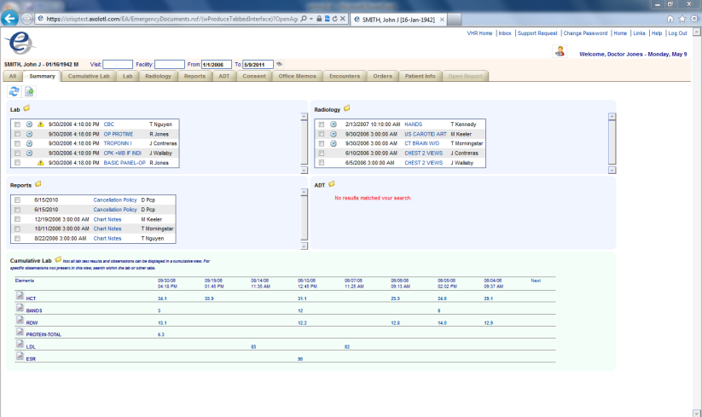
HIE Examples → CRISP (cont.) →Query Portal
Copyright CRISP
Notes:
A community program that helps physicians identify and prioritize necessary health screenings and other testing for their patients. The goal of the program is to ensure patients receive recommended preventive care and that their chronic diseases are being appropriately monitored and managed.

Slide 75
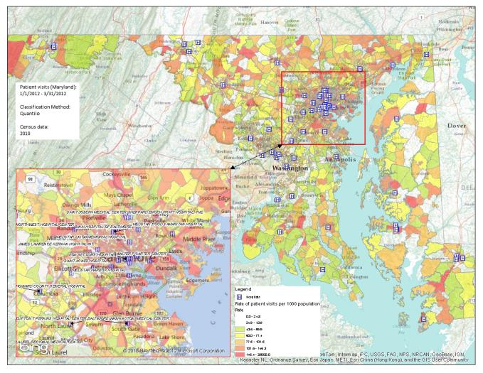
HIE Examples > CRISP (cont.) →Encounter Reporting System (ERS)
Copyright CRISP
Notes:
A community program that helps physicians identify and prioritize necessary health screenings and other testing for their patients. The goal of the program is to ensure patients receive recommended preventive care and that their chronic diseases are being appropriately monitored and managed.

Slide 76
HIE and Population Health IT

Slide 77
HIE and Population HIT → Clinical Informatics
If patient has x, y then do z
CDSS
Administrative
EHR
EMR
JHH EPR
Accounting
Clinical Information Systems
Clinical Inpatient
Clinical Informatics
Clinical Outpatient
Laboratory
Imaging
QM, KD…
Non-clinical
Notes:
Patient oriented
Very personalized
No population health embedded

Slide 78
HIE and Population HIT → Public Health Informatics
Public Health Informatics
Registries
EHR
1
Commun. Diseases
Reports
EHR
2
Public Health
Claims
Non-clinical
?
Syndromic Surveillance
?
Quality Measures
Periodic public reports and alerts
Notes:
Manual process → time consuming → increased latency
Manual process → higher risk of errors
Too many abstraction layers → too public → can’t reverse back to the individual patient

Slide 79
HIE and Population HIT → HIE Role
EHR
n
Public Health Informatics
Other sources
Registries
Commun. Diseases
EHR
…
HIE
EHR
1
Public Health
Syndromic Surveillance
Quality Measures
Notes:
Helps standardize data → e.g. consistent federated IHIE
Almost real time with much less manual effort
Can get back to the individual patient (e.g., communicable diseases) but not focused on the DSS that needs to provide

Slide 80
HIE and Population HIT → Population Health Informatics
Population Health Info.
Population Health Analytics
Population Health Data-warehouse
PubHI to CI
CI to PubHI
Personal Health Records
Insurance Data
Rx Data
Admin data repositories
CI to PubHI
PubHI to CI
Clinical Informatics
EHRs
1…n
HIE
Public Health Informatics
Public Health
A
B
C
Notes:
Helps standardize data → e.g. consistent federated IHIE
Almost real time with much less manual effort
Can get back to the individual patient (e.g., communicable diseases) but not focused on the DSS that needs to provide

Slide 81
HIE and Population HIT → Clinical Decision Support (CDS) Continuum
If patient has x, y, has gene w, lives in Baltimore, is high risk, is Hispanic, has insurance q,
and more population health rules…, and you don’t have an MRI then do z”
If patient has x, y
then do z
If patient has x, y with insurance q then do z’
If patient has x, y and is in high risk population
then do z’
If patient has x, y, and gene w
then do z’
If patient has x, y and you don’t have an MRI
then do z’
If patient has x, y and is Hispanic then do z’
If patient has x, y and lives in Baltimore
then do z’
Bioinformatics
Clinical Informatics
Organizational Info.
Public Health Info
Population Health Informatics
HIE
Notes:
Helps standardize data → e.g. consistent federated IHIE
Almost real time with much less manual effort
Can get back to the individual patient (e.g., communicable diseases) but not focused on the DSS that needs to provide

Slide 82
HIE and Population HIT → CDS Continuum (cont.)
Population-based HIE
EHRs
PHRs
MPI
Claims
Registries
PACS
LABs
Population-based CDSS across databases

Slide 83
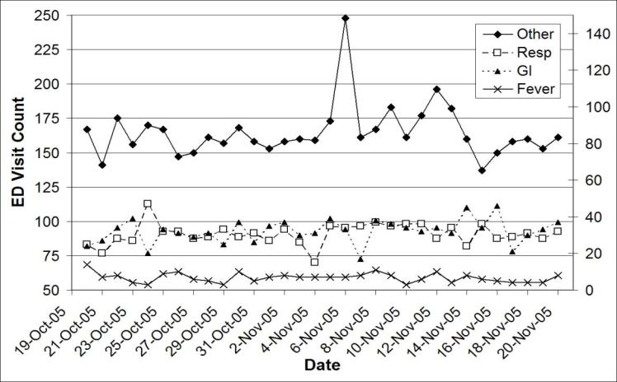
HIE and Population HIT → CDS Continuum (cont.)
Population HIT will reveal the causes, and…
Simple statistics based on numerical statistics
Consider the potentials with Population-based CDSS integration
Copyright Regenstrief Institute

Slide 84
HIE Future

Slide 85
HIE Future
HIE will “happen” but will seldom follow the script.
Established entities that can provide services “on the margin” will have a competitive advantage.
The primary barrier to competitor entry is trust.
Many geographic HIOs will become highly-valued CHINS (version 2.0).
Under certain payment models, providers who fail to collaborate will be at a competitive disadvantage.
Policy may not keep up with the pace of information use; enforcement of detailed policy is problematic.
The role of innovation is an important component in shaping the future of HIE such as “Beacon” communities.
The complexity of the U.S. healthcare ecosystem may hinder some of the anticipated efforts to connect a variety of stakeholders.
Standards will continue to evolve and each HIE must be resilient
Copyright HiMSS

Slide 86
HIE Future (cont.)
Cost: High infrastructure costs may accelerate merging of HIEs or truncating plans for a variety of HIEs in a state.
Political Environment: Given the current national debt and concerns about funding existing programs, future federal funding may be compromised in the future.
Sustainability: Long-term sustainability will remain a challenge for some HIEs, especially if they must support all costs, potentially without federal funds.
Emerging Services: Can each HIE develop additional services that are emerging in a timely, cost-effective manner, as well as secure the level of adoption required to sustain emerging services?
Copyright HiMSS

Slide 87
HIE Future (cont.)
Business Drivers:
  Sustainability; Adoption; Improved Care; Coordination of Care; Decreased Health Costs
Industry Drivers
  New models: ACOs, Care Coordination, Patient-centered Medical Homes
  Need to access patient information across various healthcare organizations
  Requirement to facilitate coordination of care
  Maintain and access metrics to show outcomes of patient care
  Leverage electronic transmission of data to payers / insurers
  Need to automate with EHRs to capture more data
  Engage consumers with services to accelerate services such as scheduling, physician communication, request for records, etc.
Copyright HiMSS

Slide 88
Additional Resources

Slide 89

Resources → Books (upcoming)
Title | Health Information Exchange: Navigating and Managing a Network of Health Information Systems
Authors | Brian Dixon
Year | 2016?
Hardcover | ?
Publisher | Elsevier
Language | English
ISBN | Pending…

Slide 90
Resources → Web
Associations:
  AMIA (American Medical Information Association): www.amia.org
  IMIA (International Medical Information Association): www.imia-medinfo.org
  HIMSS (Healthcare Information and Management Systems Society): www.himss.org
  Academy Health (HIT Interest Group): www.academyhealth.org
Government and Non-for-profit:
  ONC: www.healthit.gov
  CMS MU: www.cms.gov/Regulations-and-Guidance/Legislation/EHRIncentivePrograms
  HL7: hl7.org
  NLM: https://www.nlm.nih.gov
Journals:
  JAMIA (Journal of AMIA): jamia.bmj.com
  JMIR (Journal of Medical Internet Research): www.jmir.org
  IJMI (International Journal of Medical Informatics): www.ijmijournal.com
  HIJ (Health Informatics Journal): jhi.sagepub.com
  ACI (Applied Clinical Informatics): aci.schattauer.de

Slide 91
Summary
Introduction
History of HIE
  CHIN, CHMIS, SBCCDE, EDI, ONC, NeHC, SI.Framework, HISPC, NHII/NwHIN, HIO
HIE Architecture
HIE Services
HIE Sustainability
  Federal (HITECH) Impact
  States Impact
HIE Examples
  Indiana HIE
  CRISP
HIE and Population Health IT
HIE Future
Summary

